Slide 1
Weekly Report
程文胜 2020.10.30-11.7

Slide 2
Weekly Report
Abstract
Content
End

Slide 3
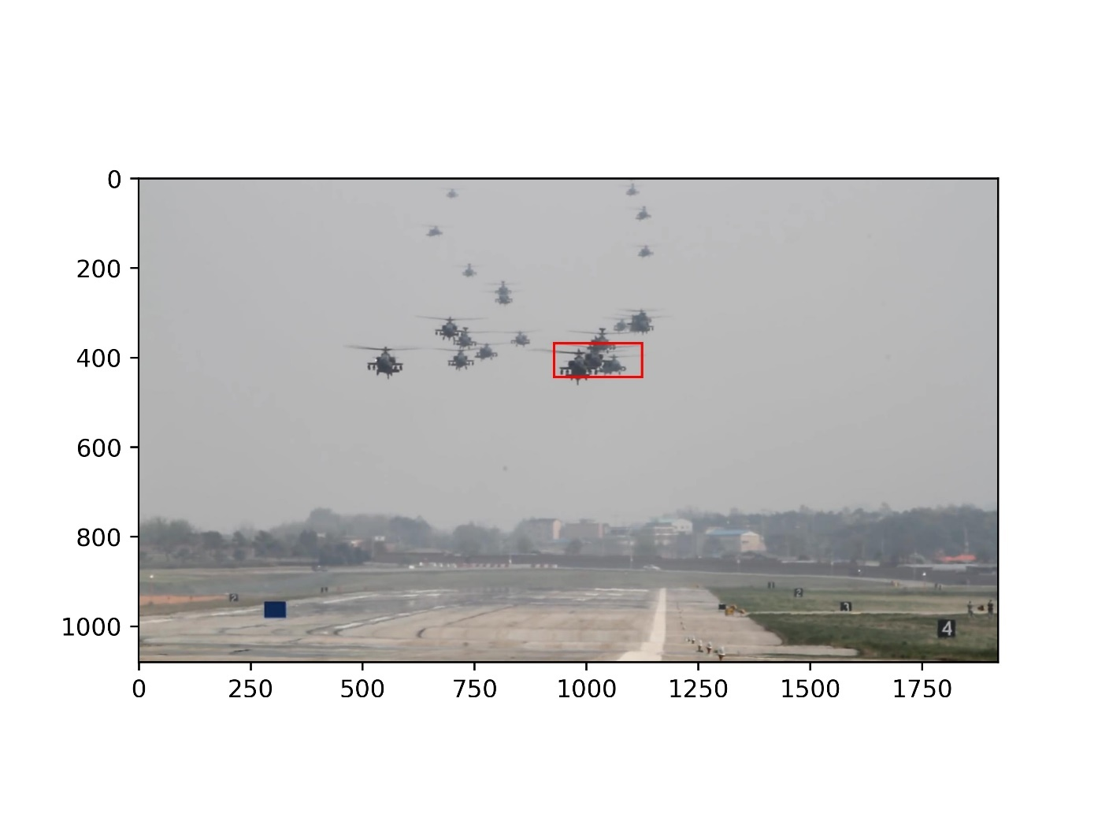
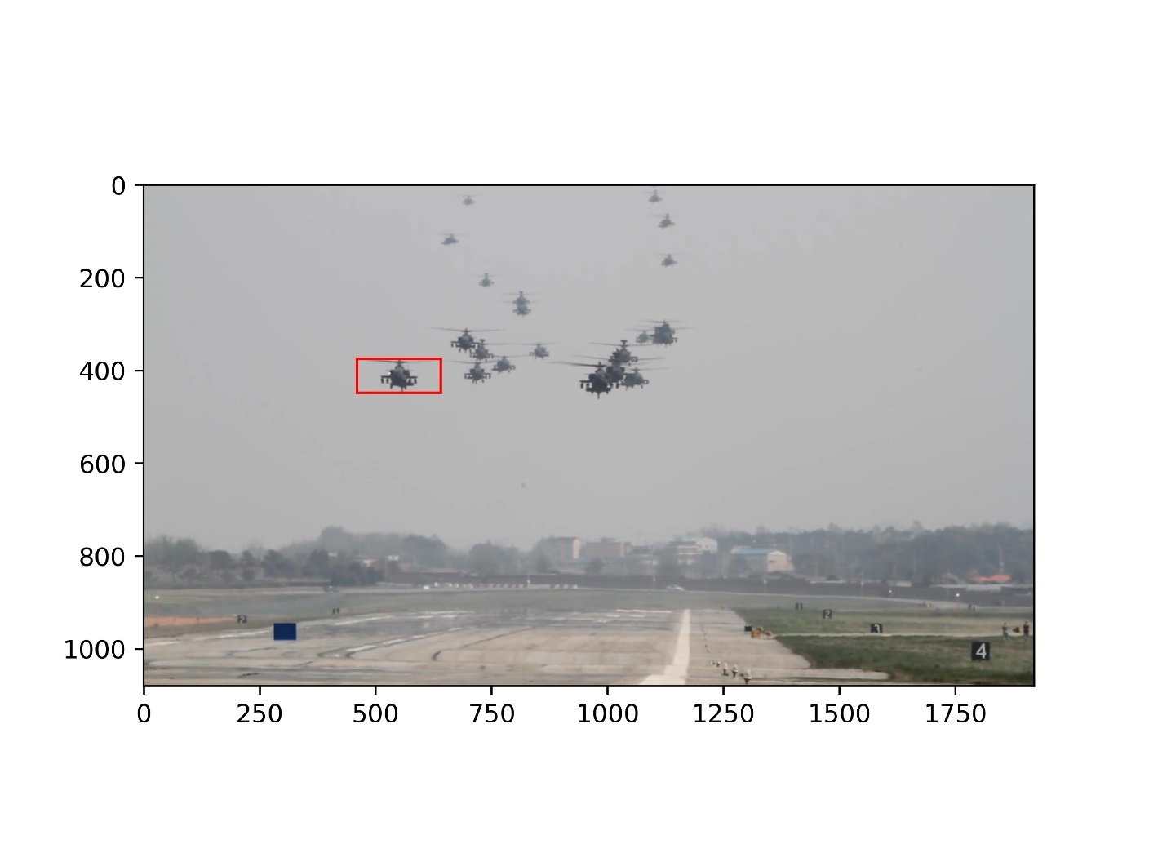
Abstract
This week I mainly spent time on refining the initial box results of GlobalTrack and training the Deep Sort model.
before
after

Slide 4
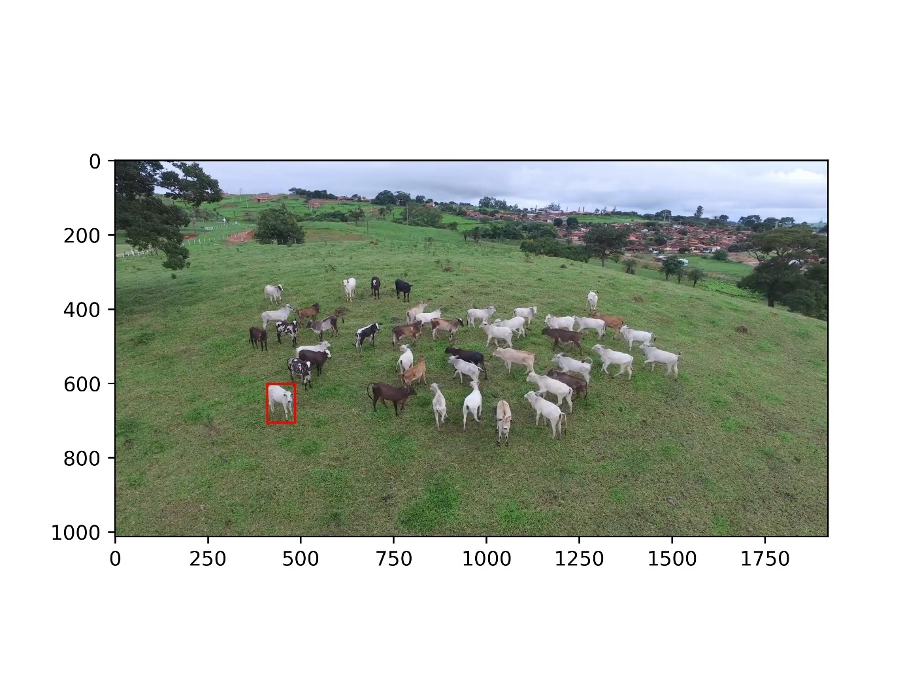
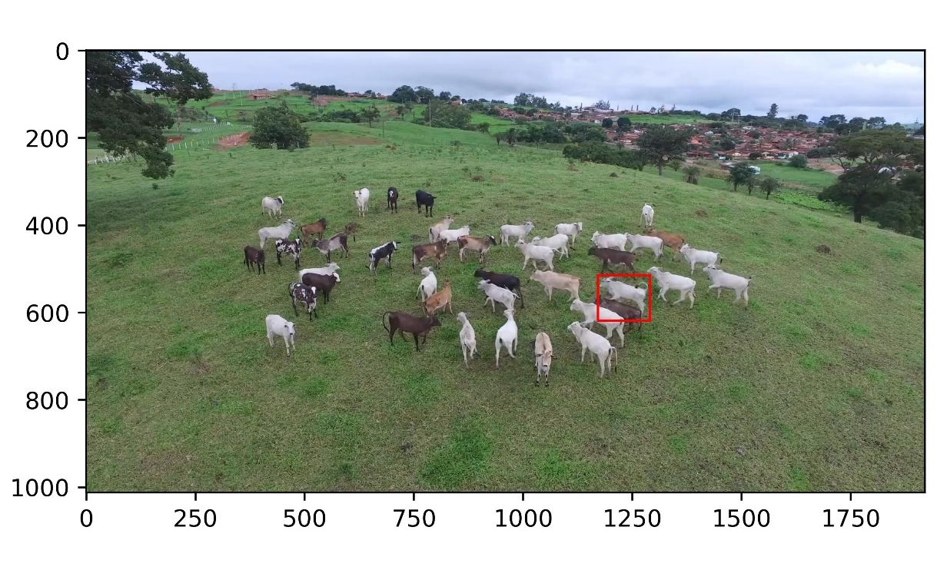
Content
Since the results generated by GlobalTrack including boxes that contains multiple objects, and it would largely influence the process of finding similar objects. So I checked these boxes and filtered some by hand.

Slide 5
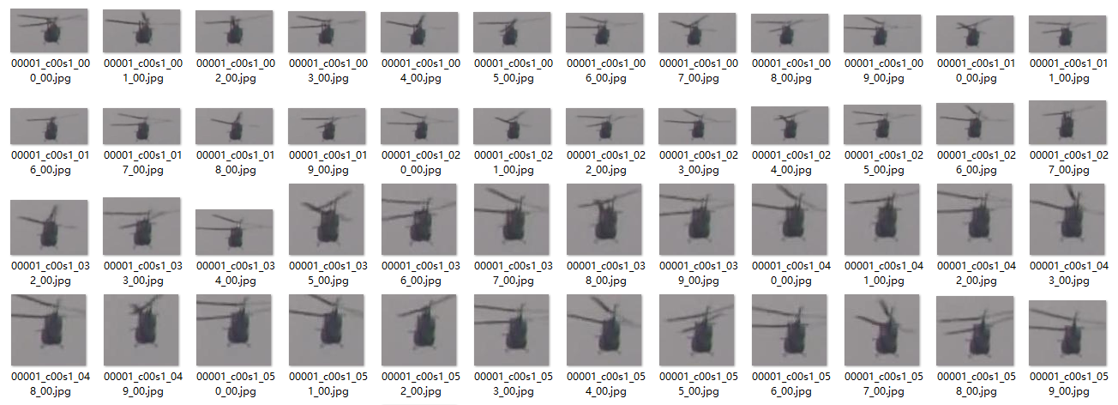
Content
For our protocol 1.2, we need to train Deep Sort with ground truth. The re-id part needs training to recover lost tracklets. We use Market-1501 format to train the re-id model.

Slide 6
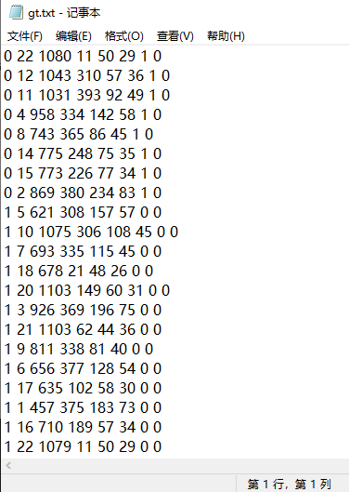
Content
For our one shot protocol, since with public detection results, we cannot train re-id model, we would use the pre-trained re-id model and public detection to get the results. We also found a bug which influences Deep Sort performance a lot and solved it. Now Deep Sort has good performance with ground truth detections.

Slide 7
Report End
程文胜 11.7

