Slide 1
Weekly Report
程文胜 2018.12.28-2019.1.4

Slide 2
Weekly Report
Abstract
Content
Discussion

Slide 3
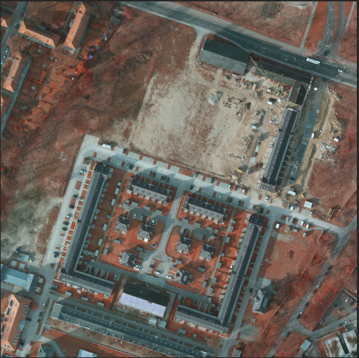
Abstract
This week I mainly put my effort on testing basic models with ISPRS Vahingen and Postdam dataset with augmented dataset and another version of code.
Postdam data

Slide 4
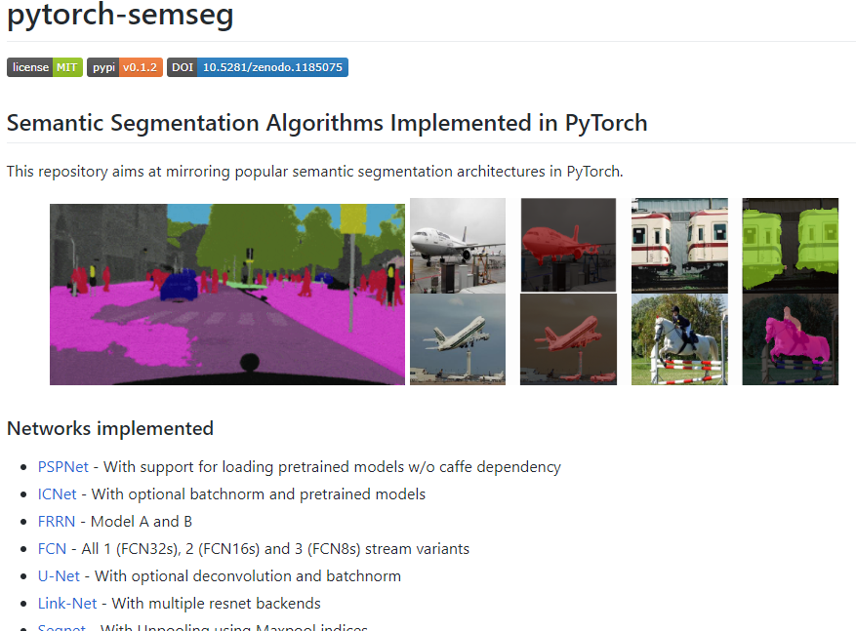
Content
Since the original code is based on Tensorflow, and I doubt that the reason why fashion models didn’t perform well is related to the code.
So I found another version of code based on Pytorch and tried these models again.
Pytorch code for semseg

Slide 5
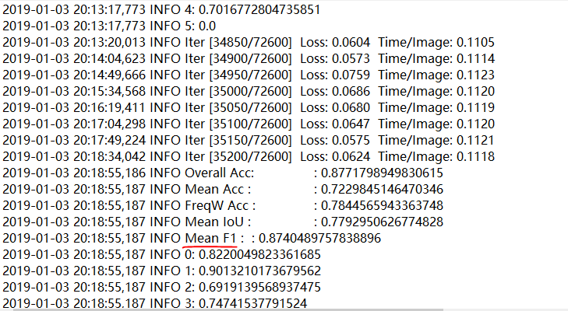
Content
I tried some baseline models with the Pytorch version code. I adjusted some hyper parameters and optimization algorithms, then these models converged steadily and the accuracy is higher than Tensorflow version code. With augmented data, FCN got 86% F1 score, and Refinenet got 87% F1 score, and this is what I expected.
RefineNet result

Slide 6

Discussion
Many factors can influence model’s performance, including dataset, initialization methods, optimization algorithms, even code framework. From this experience, al least it’s easier to get high accuracy with Pytorch model than Tensorflow.
I also found a Pytorch acceleration pacgage, which is to calculate with FP16 method, and could be 30% faster than regular FP32 method. This is very useful and can improve our training speed efficiently.

Slide 7
Report End
程文胜 VIPG

