Slide 1
Weekly Report
程文胜 2019.3.9-2019.3.16

Slide 2
Weekly Report
Abstract
Content
Discussion

Slide 3
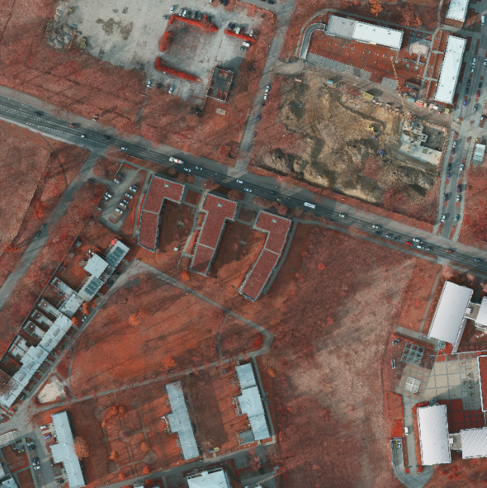
Abstract
This week I mainly put my effort on conducting experiments of Potsdam dataset and writing journal paper.
Potsdam sample image (6000* 6000)

Slide 4
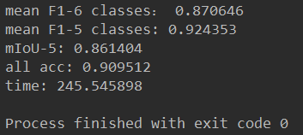
Content
Last week, I got a preliminary result of my own model on Potsdam dataset, which is 90.4% OA v.s. 91.1%, the best score. This week I augmented training images with more rescaled images, and got 90.9% OA, which is close to it.
Result on Potsdam dataset

Slide 5
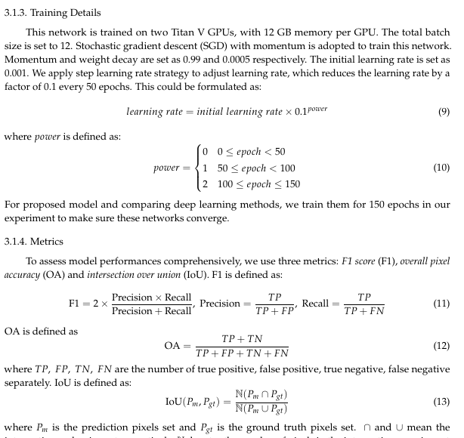
Content
I’m also working on my journal paper. The progress is pushed to experiment part. I compare proposed model with both deep learning models and benchmark methods. I plan to finish the draft next week.
Paper draft

Slide 6

Discussion
For Potsdam dataset, I improved proposed model’s performance by data augmentation. I plan to add more transformations to enlarge the dataset and train it again.
For Vaihingen dataset, although I get better result than benchmark models, I’d like to try different methods to increase the number of train set if time permits.
I’d also work with Luo Hao on the DVS dataset. I’d test some baselines for lane detection or extraction on the dataset we labeled.

Slide 7
Report End
程文胜 VIPG

