Slide 1
Weekly Report
程文胜 2019.2.24-2019.3.2

Slide 2
Weekly Report
Abstract
Content
Discussion

Slide 3
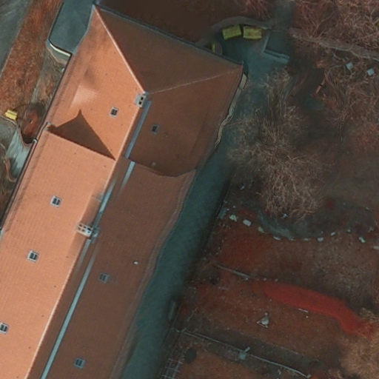
Abstract
This week I mainly put my effort on writing NSFC project, and testing my own model on another ISPRS dataset- Potsdam.
Potsdam training sample (512*512)

Slide 4
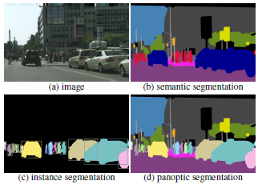
Content
Last week, I took part in writing NSFC project application. I was in charge of panoptic segmentation, which is a brand new concept proposed by Kaiming He.
Panoptic segmentation

Slide 5
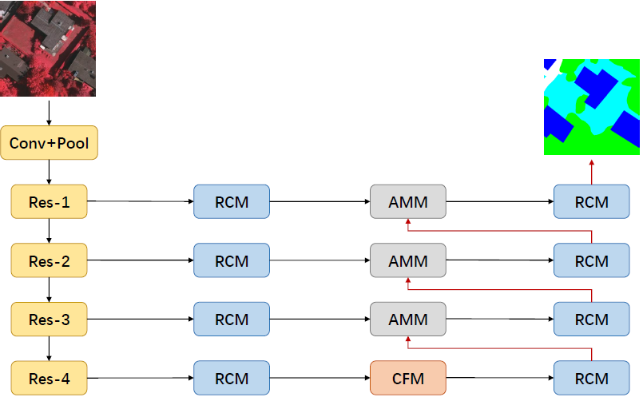
Content
I also conducted experiments on another ISPRS dataset, Potsdam, to test my own model. However, preliminary results show that my own model performs the same with RefineNet, and they have almost same accuracy.
My model arch

Slide 6

Discussion
For Vaihingen dataset used in ICIP paper, I tuned my model for some time. And now I get 91.1% OA, which is the same with ISPRS Journal paper, and the best score on Vaihingen dataset, not considering those results without paper.
For Potsdam dataset, I plan to train my model with more settings, and hope it can outperforms other FCN-based models. Yet Postdam dataset is much bigger than Vaihingen, 6000*6000 v.s. 1500*1500 per image, i.e., 16x larger than Vaihingen, and training one time would cost 60 hours on our machine with 4 GPUs, about 3 days. So I’d like to train it on school supercomputers for quick validation.

Slide 7
Report End
程文胜 VIPG

