Slide 1
Weekly Report
程文胜 2020.8.7-8.13

Slide 2
Weekly Report
Abstract
Content
End

Slide 3
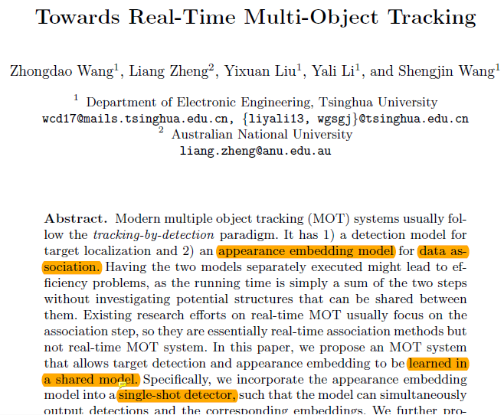
Abstract
In this week, I mainly put my effort on getting familiar with some recent tracking paradigms, like JDE, RetinaTrack and Siamese Track-RCNN.

Slide 4
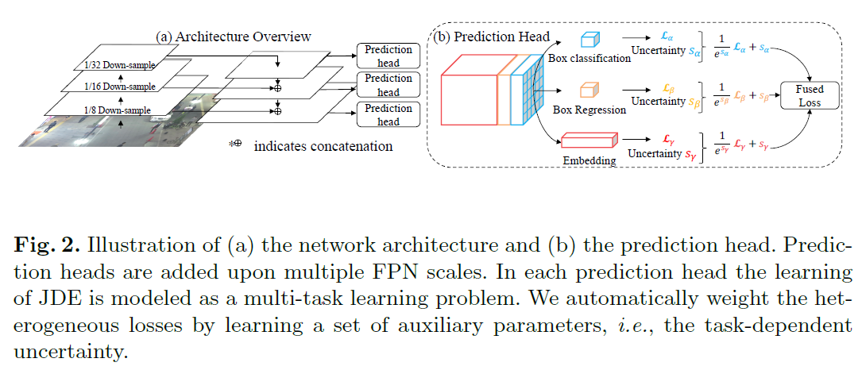
Content
JDE incorporates the appearance embedding model into a single-shot detector, such that the model can simultaneously output detections and the corresponding embeddings.
Wang, Zhongdao, Liang Zheng, Yixuan Liu, and Shengjin Wang. "Towards real-time multi-object tracking." ECCV 2020.

Slide 5
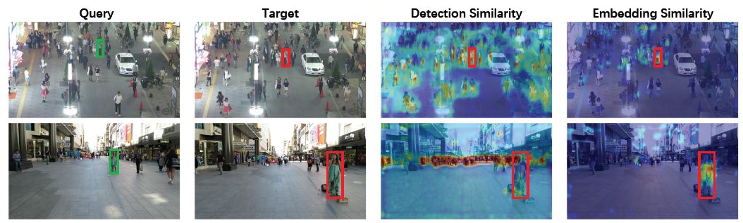
Content
The reasons for the speed:
One forward, embedding features for all targets
Simpler data association than Deep SORT
Vectorized Kalman filter to deal with all tracklets with one operation
Wang, Zhongdao, Liang Zheng, Yixuan Liu, and Shengjin Wang. "Towards real-time multi-object tracking." ECCV 2020.

Slide 6
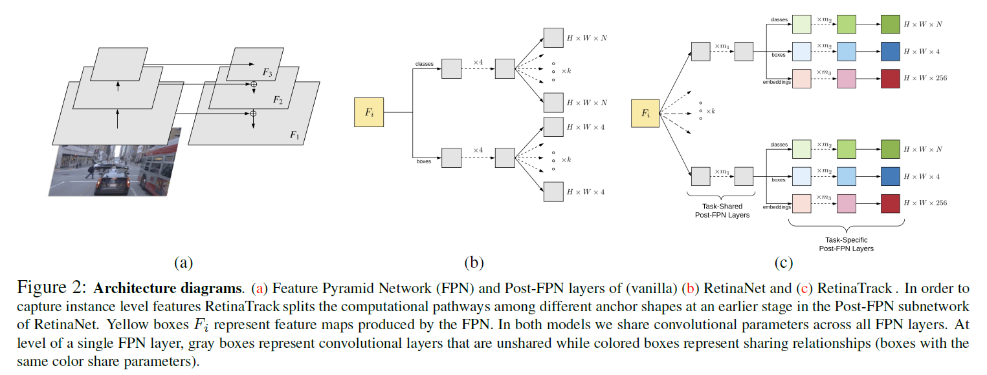
Content
RetinaTrack forces the split among the anchors to occur earlier among the post-FPN prediction layers, allowing it to access intermediate level features that can still be uniquely associated with an anchor(and a final
detection).
Lu, Zhichao, Vivek Rathod, Ronny Votel, and Jonathan Huang. "RetinaTrack: Online Single Stage Joint Detection and Tracking.“
CVPR 2020.

Slide 7
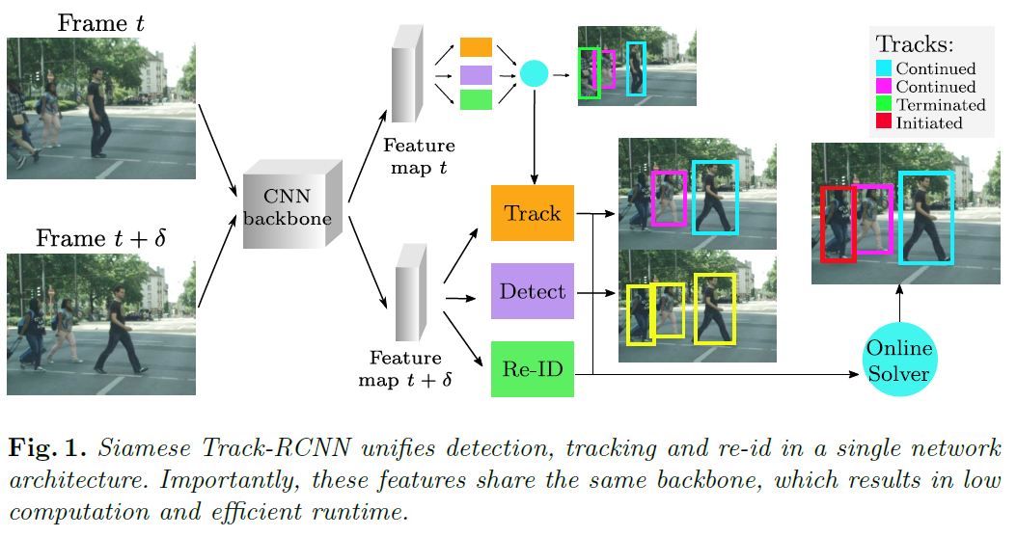
Content
Siamese Track-RCNN performs both detection and association in a single forward pass of its network, which consists of a backbone shared among three branches: detection, tracking and re-identication.
Shuai, Bing, Andrew G. Berneshawi, Davide Modolo, and Joseph Tighe. "Multi-Object Tracking with Siamese Track-RCNN.“
arXiv preprint arXiv:2004.07786 (2020).

Slide 8
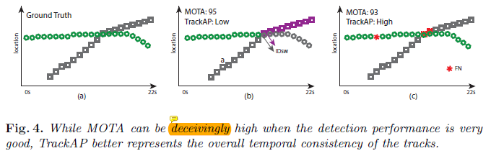
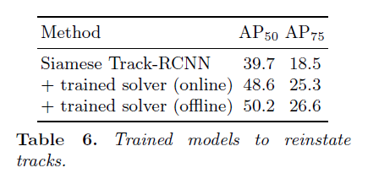
Content
They train a shallow 256-channels two-layer network for binary classification (i.e., same track or not). The input to this network is a combination of these simple features: embedding difference, mean bounding box centers, width and height, velocity, and track confidence.
Shuai, Bing, Andrew G. Berneshawi, Davide Modolo, and Joseph Tighe. "Multi-Object Tracking with Siamese Track-RCNN.“
arXiv preprint arXiv:2004.07786 (2020).

Slide 9
Report End
程文胜 8.13

