Slide 1
Weekly Report
程文胜 2019.3.30-2019.4.7

Slide 2
Weekly Report
Abstract
Content
Discussion

Slide 3

Abstract
This week I mainly put my effort on the ACM MM conference paper with Lei Xu.

Slide 4
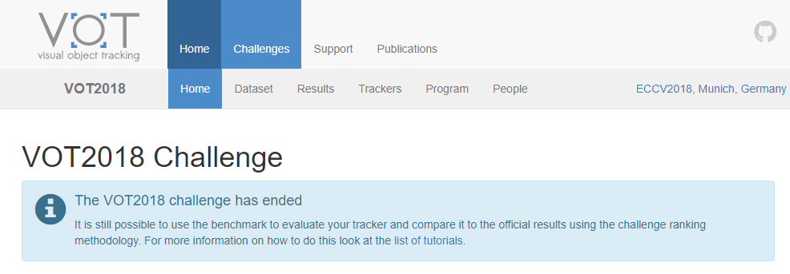
Content
At the first, Lei Xu said he had tested his method on two datasets, VOT 2018 and OTB. The result shows that his method outperforms state-of-the-art method, SiamRPN. The method is also convincing and has solid mathematical foundation.

Slide 5
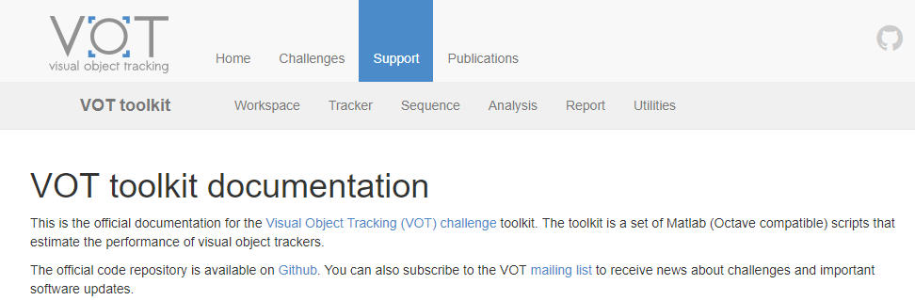
Content
So we discussed the arrangement and set down some deadlines. The deadline is delayed again and again mainly due to the experiments. He still has some problems on experiments and he tries to deal with them first. However, there are still problems in VOT toolkit, that can’t be solved quickly until the night of 7th, April. We have to give up.

Slide 6

Discussion
This work is still in progress in fact, Lei Xu only got validation set result, rather than test set result.
Since we haven’t gotten the key result of test set, it’s improper to register conference or prepare paper ahead. It’s unnecessary in fact. The most likely result is missing the deadline, just like this.
Health matters. Lei Xu has stayed up late for a long time, and got a fever, which made him tired. But if these key experiments had been performed ahead, there would have been no need to stay up late ++++so many times.

Slide 7
Report End
程文胜 VIPG

