Slide 1
Weekly Report
程文胜 2019.5.13-2019.5.19

Slide 2
Weekly Report
Abstract
Content
Discussion

Slide 3
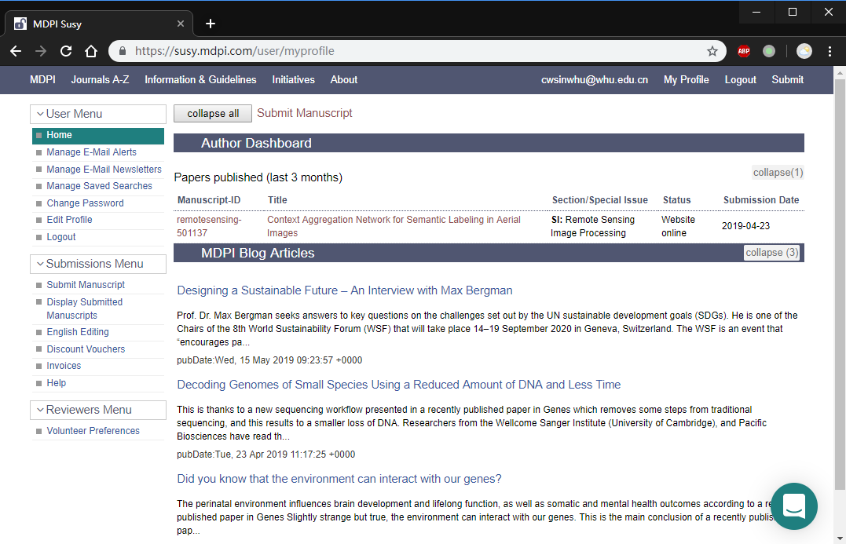
Abstract
This week I mainly put my effort on revising RS journal paper and writing lane extraction journal paper.

Slide 4
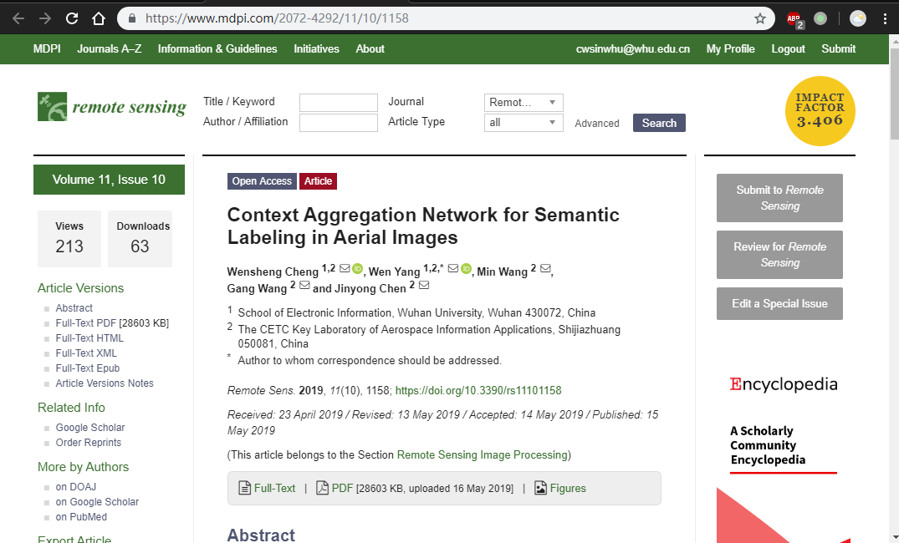
Content
About RS paper, I revised the manuscript partially. Then I uploaded materials needed to the system. I got the email saying that the manuscript was accepted the next day. After paying for it, it was published online quickly.

Slide 5
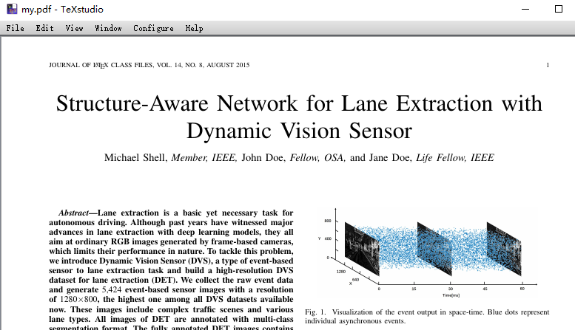
Content
About lane extraction paper, Luo Hao has conducted related experiments and I continued writing the manuscript. The contribution of the paper includes the DVS dataset, lane extraction model and post-process method.

Slide 6
Discussion
About lane extraction model, we first tried attention module and it presented improvement on the old metric used wrongly. After we changed the metric to IoU, the attention module showed no improvement and we abandoned it.
Since we abandoned the attention module, there is only one our proposed novel module for the lane extraction model. But considering the DVS dataset and the trick of post-process method, I think the contribution is still enough. We plan to finish the manuscript next week.

Slide 7
Report End
程文胜 VIPG

