Slide 1
Weekly Report
程文胜 2021.6.21-6.27

Slide 2
Weekly Report
Abstract
Content
End

Slide 3
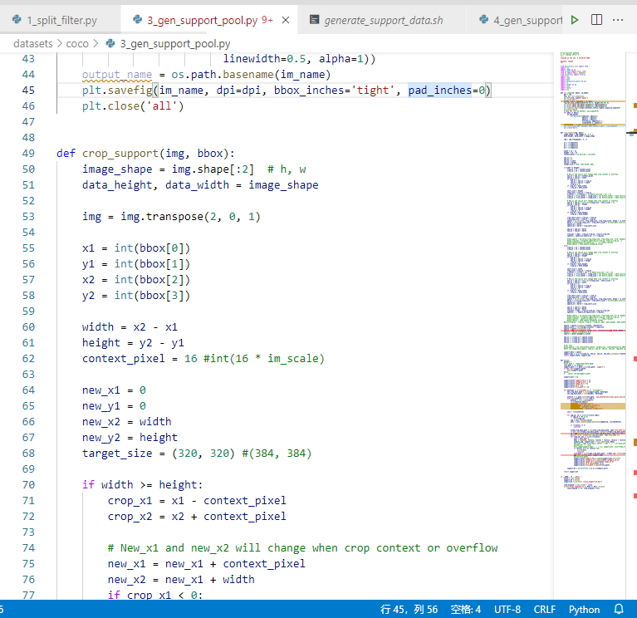
Abstract
Last week I mainly spent time on generating required data files for the few shot object detection method, and studying the evaluation way used in that method.

Slide 4
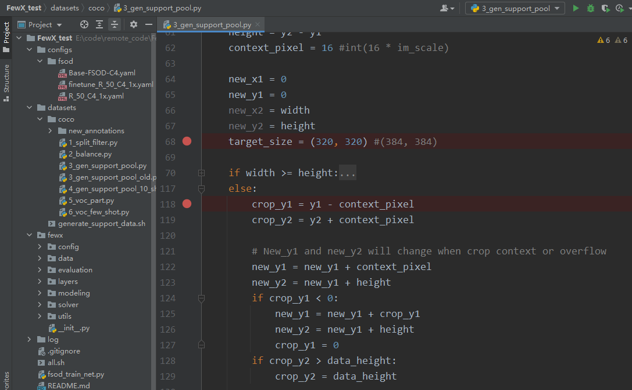
Content
After converting our dataset to COCO format, we need to generate required support images for the few shot object detection method. The cropped image is padded to include context information.

Slide 5
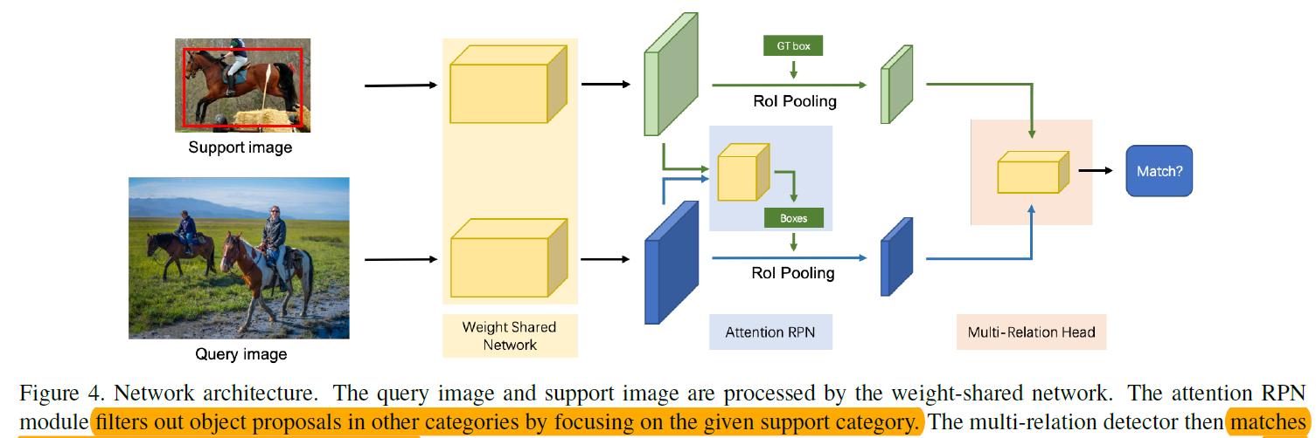
Content
About evaluation method, the one used in the provided code includes a finetune process(N-way K-shot). However, this requires that the instance number of one image <= K, which doesn’t fit our one-shot setting on dense scenes. Hence we need to change the evaluation way.

Slide 6
Report End
程文胜 6.27

