Slide 1
Weekly Report
程文胜 2018.11.3-11.10

Slide 2
Weekly Report
Abstract
Content
Discussion

Slide 3
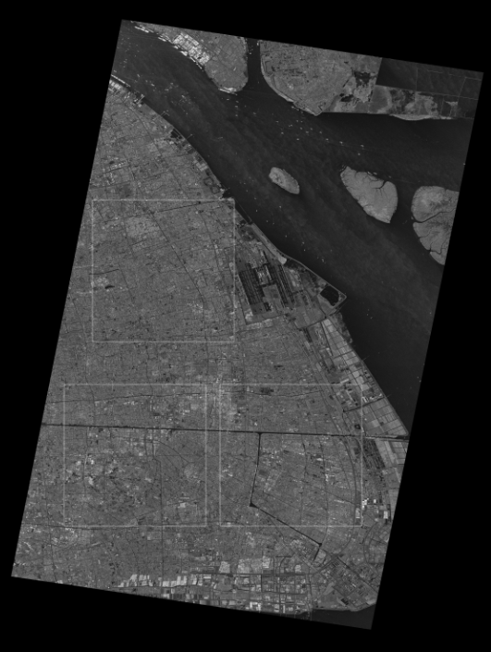
Abstract
This week I mainly put my effort on dealing with the large SAR image of Shanghai City and got preliminary results.
The Image on the right is the whole image with the size of ~20,000*25,000. There are 3 white rectangular area with the size of ~5000*5000 on the bottom left corner, which are used as test images.
SAR image of Shanghai City

Slide 4
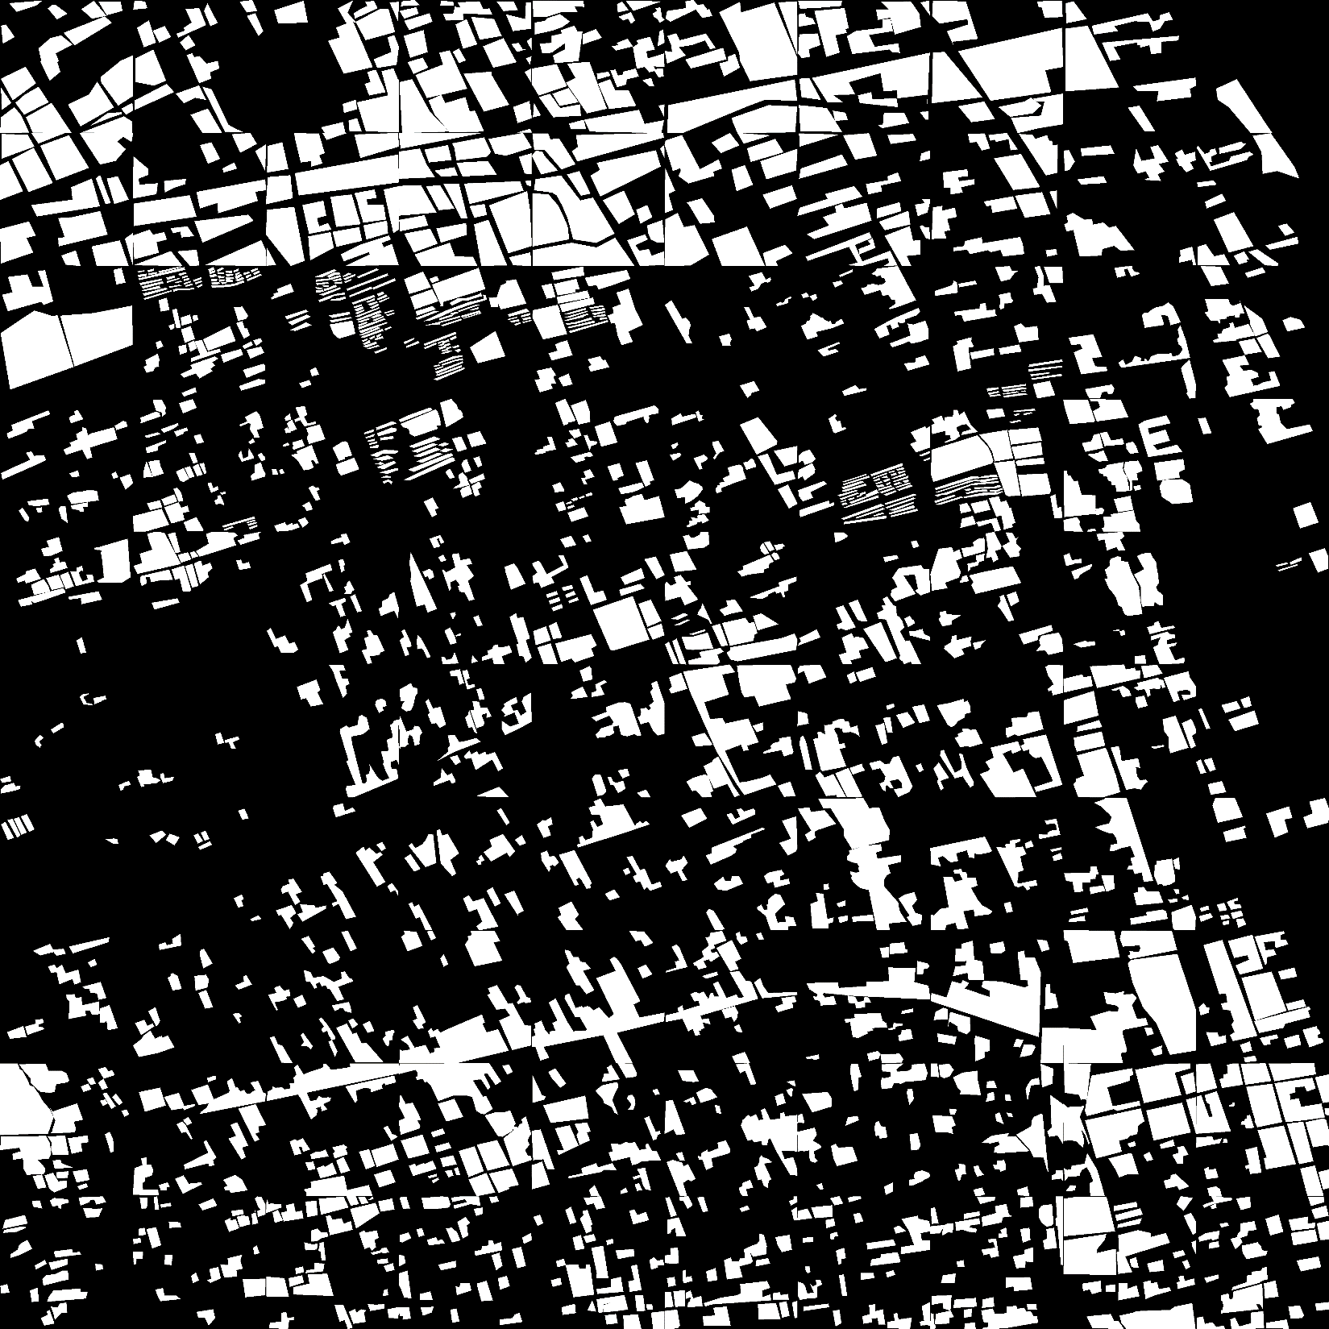
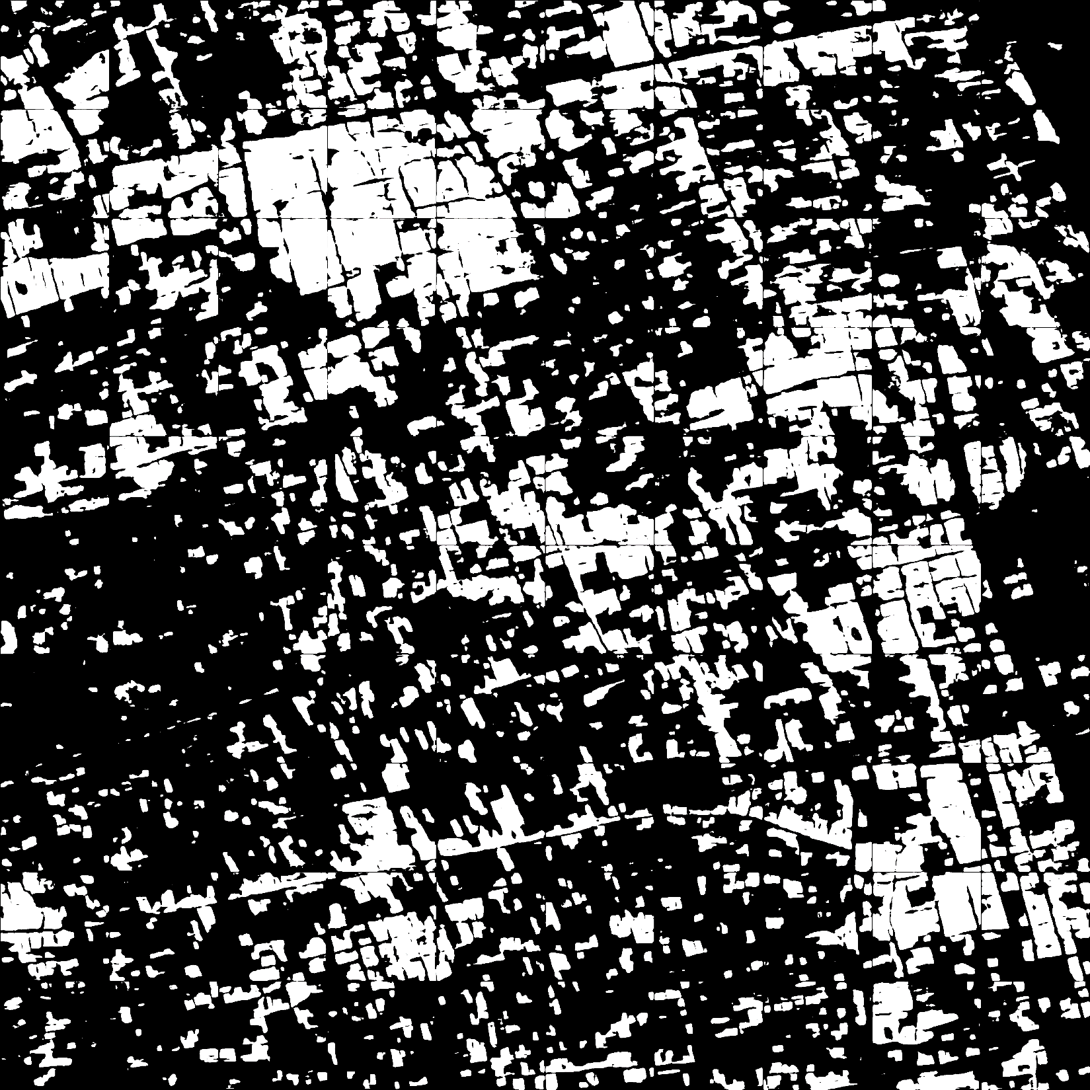
Content
With the complete white rectangular area as test image and other areas as training images, I tried many CNN-based semantic segmentation nets, and got F1 score of 70%, 68%, 75% for the 3 areas separately. This is a good baseline.
Groundtruth image of the top area
Prediction image of the top area.(F1: 70%)

Slide 5

Discussion
About label, there is one problem. Since this large picture is labeled by several undergraduate students, some of them label adjacent buildings, including tiny gaps between them as a whole area, while others label them as small distinct, individual houses, not including these gaps. These gaps are generally roads, lawns, or ground. Sometimes they are labeled as buildings, while sometimes as non-building. This would certainly influence the net performance. Next time we label the Shenzhen City SAR image, we need to make this consistent and choose the former manner.

Slide 6
Discussion
I already tried those post process methods used in the contest earlier, including remove small area and fill in some holes in large buildings. It does function, but not much, just on the level of 0.1%.
I plan to try other methods, like data augmentation to increase the accuracy. Furthermore, I need to adjust the net architecture for better result, and this is important for my paper.

Slide 7
Report End
程文胜 VIPG

