Slide 1
Weekly Report
程文胜 2018.12.7-12.14

Slide 2
Weekly Report
Abstract
Content
Discussion

Slide 3
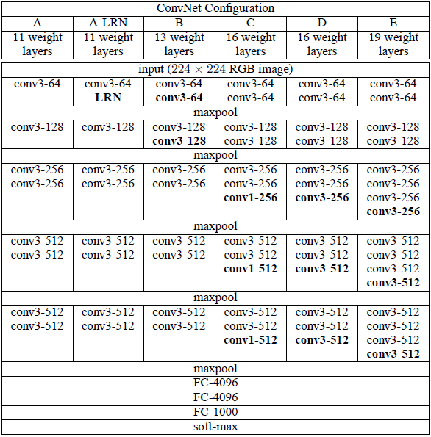
Abstract
This week I mainly put my effort on writing many project files and test different models on our dataset.
The point is that earlier models based on VGG outperforms later models based on ResNet.
VGG architecture

Slide 4
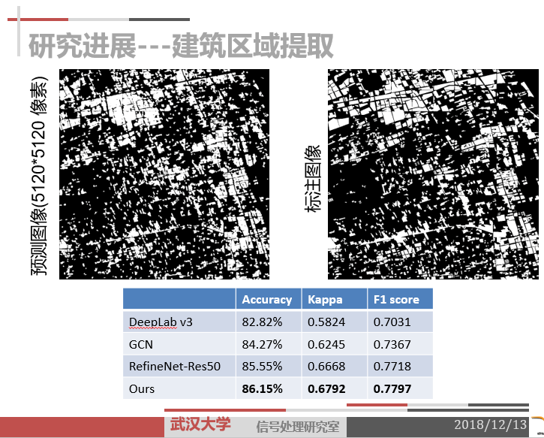
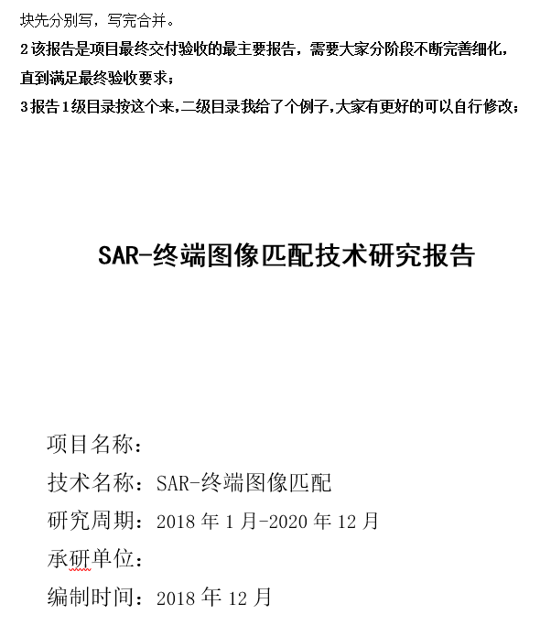
Content
Since it’s approaching the end of this year, there are much document work to do. Specifically, I participated in making NSFC project slides, writing CETC 54 files and slides, and writing 503 project files.
Some project files

Slide 5
Content
Last week, I tried modified RefineNet model on our dataset and found its F1 score gets 0.6% improvement. However, when I tried FCN, the classic model outperforms my modified model, 77.97% v.s. 78.16%.
Dataset | Model | F1 score
dataset/p1_crop_rotate_edit | RefineNet-Res50-modified | 0.7797
dataset/p1_crop_rotate_edit | FCN-VGG16 | 0.7816
Experiment result

Slide 6

Discussion
It surprised me that the most basic model-FCN can achieve best performance on the SAR image. I think it’s because this SAR image contains less information than optical image(1 channel v.s. 3 channel) and this task only contains 2 classes v.s. 21 classes on PASCAL VOC dataset.
I need to do some module adjustments, and change the base model from ResNet-50 to VGG16 to see how results vary.
I also need to hurry up and find a better model as soon as possible, since time is really urgent, and deep learning experiments take a long time.

Slide 7
Report End
程文胜 VIPG

