Slide 1
Weekly Report
程文胜 2018.10.20-2018.10.27

Slide 2
Weekly Report
Abstract
Content
Discussion

Slide 3
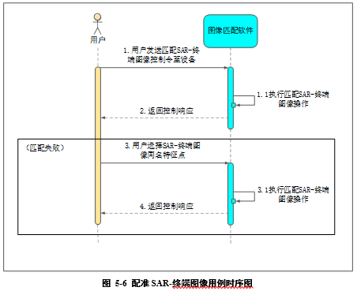
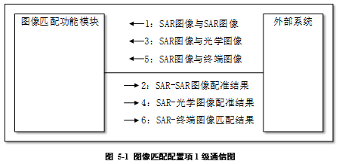
Abstract
This week I mainly put my effort on writing 503 project application and thinking of the semantic segmentation project.
The project document

Slide 4
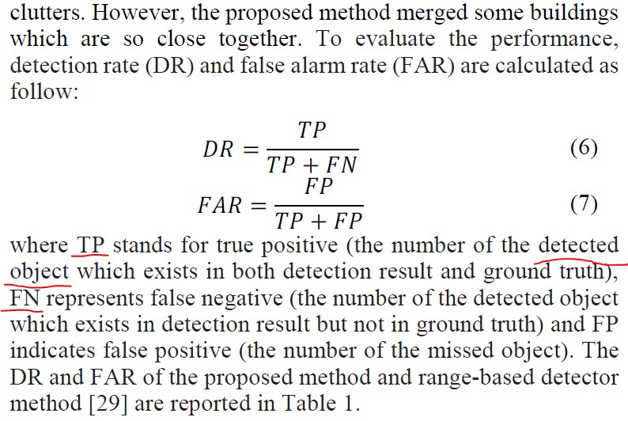
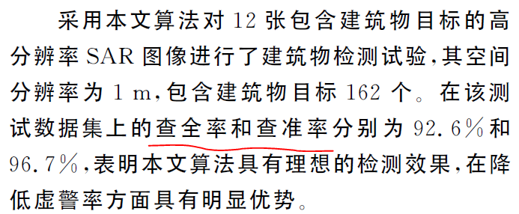
Content
To be familiar with preceding methods of Building extraction in SAR images, I looked through recent papers, both on IEEE Explore and CNKI, and found a confusing problem.

Slide 5

Discussion
The problem is the evaluation standard. For these traditional methods, including filters and regular features, they generally regard a house as an individual sample, and they compute precision/recall based on one building, not one pixel. But for deep learning based semantic segmentation, pixel is the unit we use, which would be much stricter than that based on one building. So which standard should be applied?

Slide 6
Report End
程文胜 2018.10.20-2018.10.27

