Slide 1
Weekly Report
程文胜 2020.3.20-3.27

Slide 2
Weekly Report
Abstract
Content
End

Slide 3
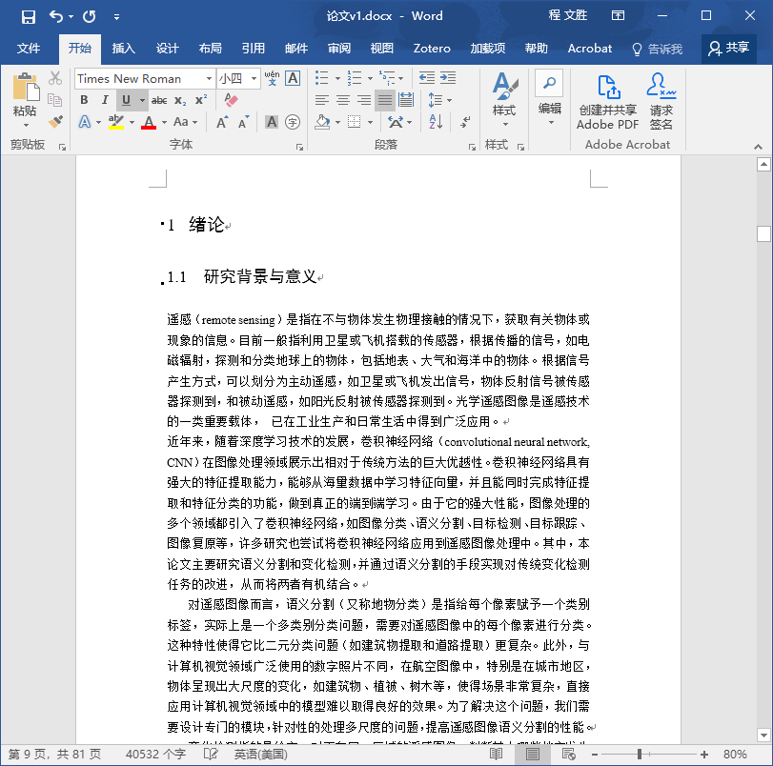
Abstract
This week I continue to write thesis, and conducting experiments for Zhang Heng.

Slide 4
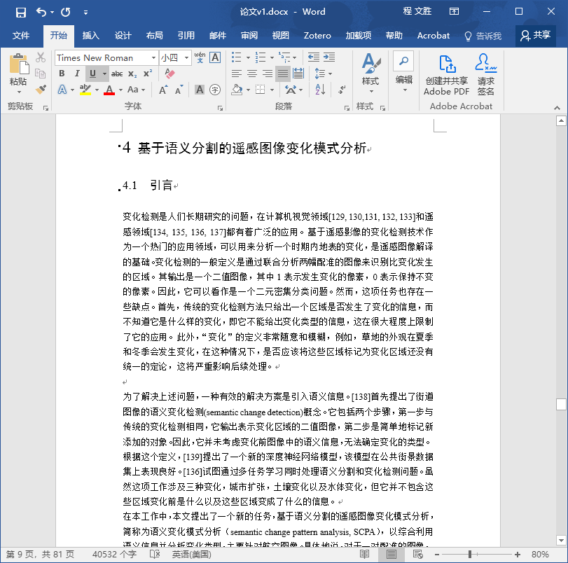
Content
I mainly put effort on the change detection part of my thesis this week. I would try to finish the thesis next week.

Slide 5
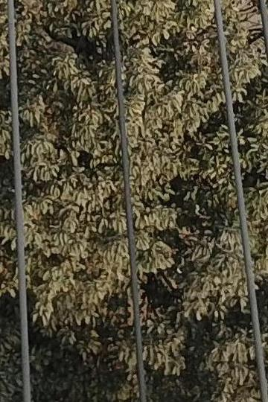

Content
I also help Zhang Heng on his experiments. I run semantic segmentation methods to extract the power lines in the image. The result seems good, and the mIoU is as high as 80% for RefineNet. A key trick is to use different coefficients for losses of background and power line, to solve the class imbalance problem.
Test image
Result of RefineNet

Slide 6
Report End
程文胜 VIPG

