Slide 1
Weekly Report
程文胜 2019.2.15-2020.2.21

Slide 2
Weekly Report
Abstract
Content
End

Slide 3
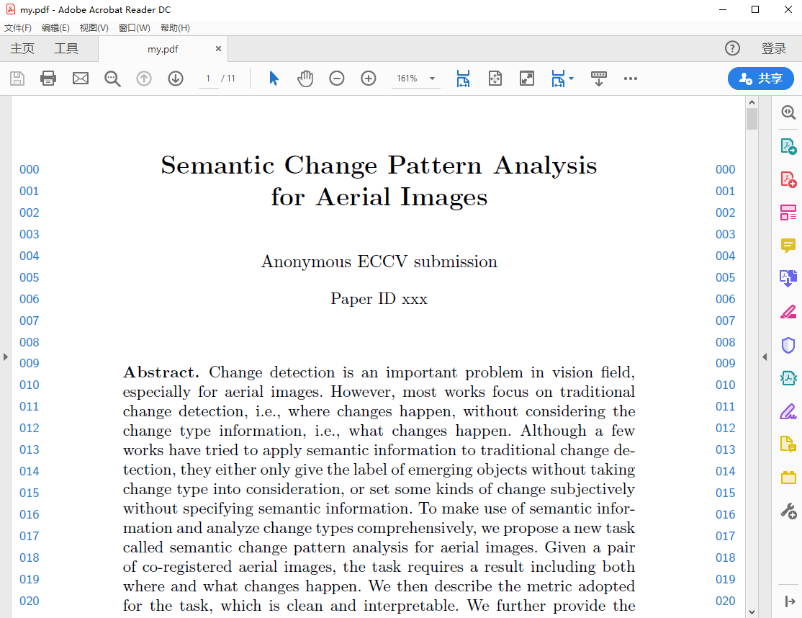
Abstract
This week I mainly put my effort on writing the new paper about change detection.

Slide 4
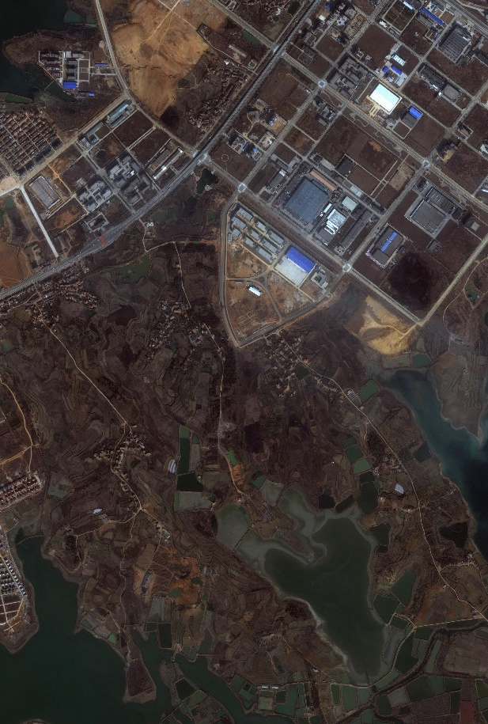
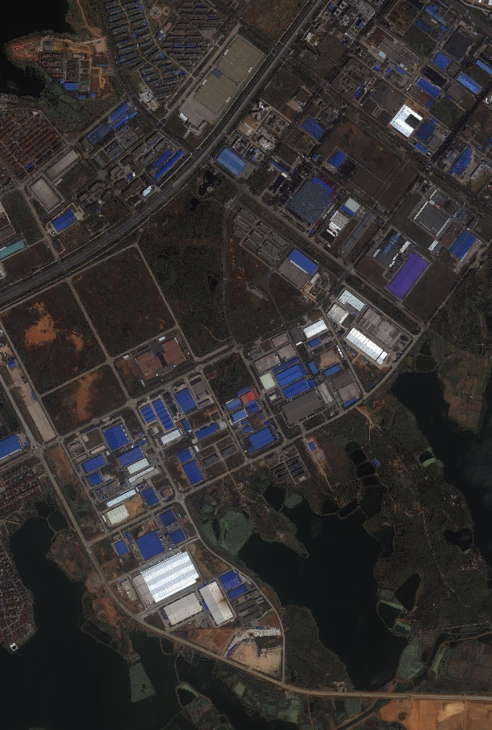
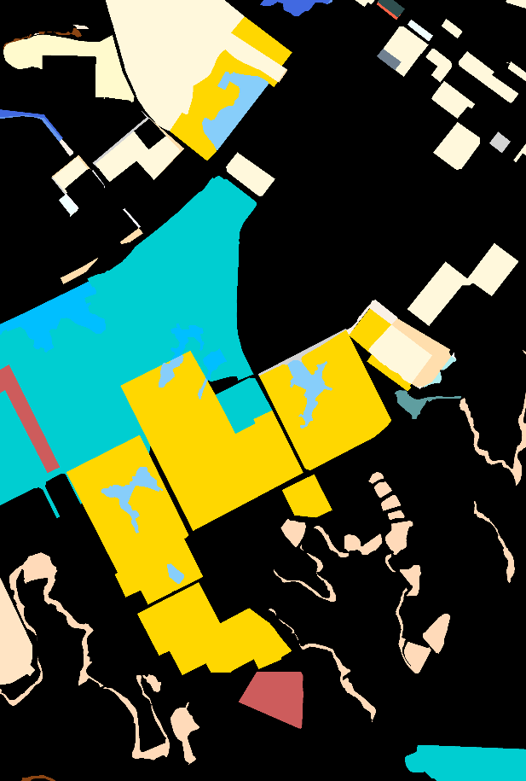
Content
I have finished all experiments with our own servers. Since these methods are based on semantic segmentation, I didn’t spend too much time on writing training code.
2002
2009
Change map of new task

Slide 5
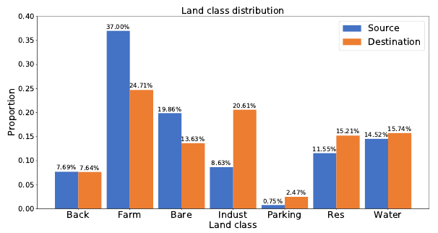
Content
I mainly spent time on dealing with experiment data and drawing figures. Since many figures need Matplotlib package, I take much time to use the package and draw figures with python code. I plan to finish the draft as soon as possible.

Slide 6
Report End
程文胜 VIPG

