Slide 1
Weekly Report
程文胜 2018.11.10-11.17

Slide 2
Weekly Report
Abstract
Content
Discussion

Slide 3
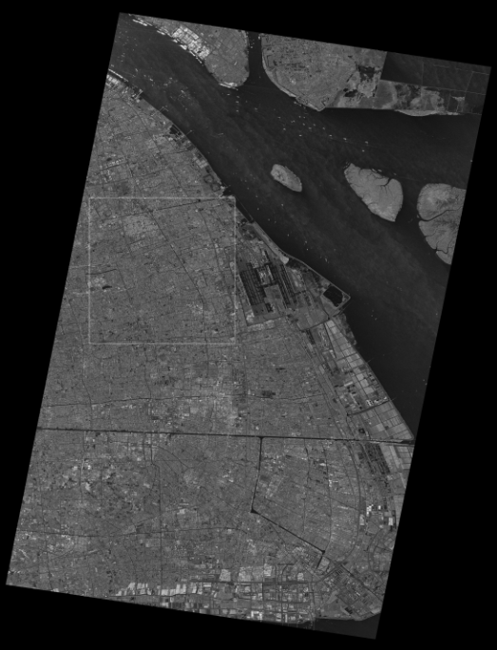
Abstract
This week I mainly put my effort on improving the preliminary semantic segmentation results of Shanghai SAR image. I use the top white rectangular area of this large image as test image.
Specifically, I tried data augmentation, i.e., random crop and a new normalization method, group normalization, then got corresponding results.
SAR image of Shanghai City

Slide 4
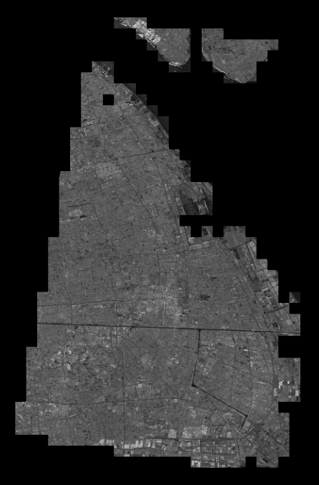
Content
Firstly, I tried random crop. Since original SAR image is not fully annotated, I need to carefully choose image patches which are well-annotated and not in the rectangular test area.
I had 546 images(size: 512* 512) before, and got 500 more images with random crop. The result shows 0.7% improvement for Refinet-Res152 from 69.54% to 70.29%, but shows basically no change for Res50.
Combined annotated images

Slide 5
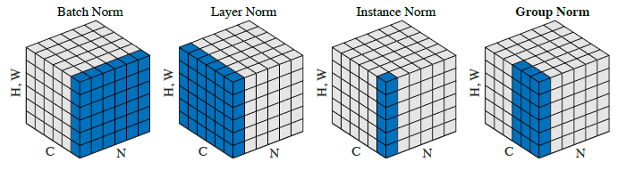
Content
Then, I tried group normalization. This method is proposed in the paper Group Normalization by Yuxin Wu and Kaiming He. This paper got ECCV 2018 best paper honorable mention award. Since semantic segmentation requires large computation resources and have small batch size, it would behave better than regular batch normalization with small batch size. I spend much energy on this since it needs to change bottom layers of existing models. I got 70.417% with group normalization, compared with 70.257% with batch normalization for RefineNet-Res50.
Different norm
ways

Slide 6

Discussion
I plan to try more data augmentation methods, like image flipping and rotation. Although it benefits our model in the contest, we still need to try it to see whether it gains same advantage in this SAR image.
Besides, multi-scale means has been reported with obvious profit in some papers, like DeepLab(2% improvement with multi-scale alone). This can alleviate scale problem for CNN model, especially when image objects have various sizes. So this way is worth a try.

Slide 7
Report End
程文胜 VIPG

