Slide 1
Weekly Report
Wensheng Cheng
2022.3.13-3.27

Slide 2
Last discussion
Check the box score statistics in RPN method, try RPN feature from multiple FPN levels, try ImageNet pretrained backbone to extract box feature, and do numerical test on the RPN method.
How about the ImageNet backbone?
Conclusion: not good. For some objects, it’s better than RPN feature, but it’s worse for other objects.
How about the numerical test result of RPN method?
Conclusion: not as good as earlier iterative way.
Thought: for the 1st image, which way we should choose.

Slide 3
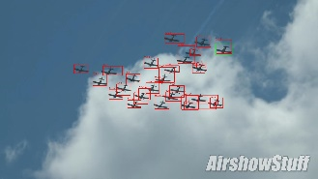
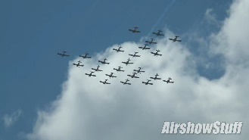
Full Process
Output
Find objects on
first img
Semi-supervised detection
Data association
Filter
Iterative search
or
Filter
RPN based method
Input

Slide 4
This week
Tried recent semi-supervised detection method, which is trained end to end and published in ICCV 21.
How about the training process?
Conclusion: it takes long time, so I tested several seqs(not all) and tuned related parameters.
How about its detection performance?
Conclusion: worse than the fully supervised one, which is trained only with the 1st img and tested on all frames.

Slide 5
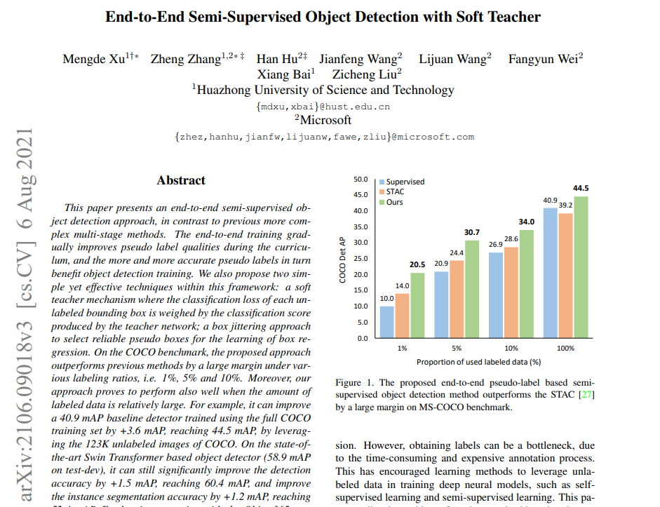
Method-Soft Teacher
End-to-End semi-supervised object detection with soft teacher.
ICCV 2021. https://arxiv.org/abs/2106.09018

Slide 6
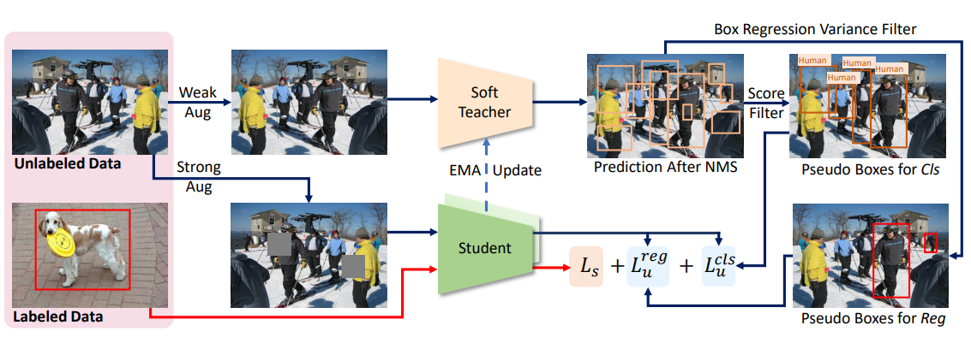
Method-Soft Teacher
Unlabeled images and labeled images form the training data batch. In each training iteration, a soft teacher is applied to perform pseudo-labeling on weak augmented unlabeled images on the fly. Two sets of pseudo boxes are produced: one is used for classification branch by filtering boxes according to the foreground score, and the other is used for box regression branch by filtering boxes according to box regression variance. The teacher model is updated by student model via exponential mean average (EMA) manner. The final loss is the sum of supervised detection loss Ls and unsupervised detection loss Lu.
ICCV 2021. https://arxiv.org/abs/2106.09018

Slide 7
Numerical Result
The performance of soft teacher is worse than the basic one, which simply uses the 1st image to train, and all frames to test(file:my_soft_teacher_bs_20_lr_0_01_iter_1500_warmup_500_gpu_x1, below shows the peak value of teacher model and basic).
Seq-method | AP | AP50 | AP75
bird-0-soft | 21.70 | 60.10 | 8.50
bird-0-basic | 22.10 | 67.40 | 7.50
ball-3-soft | 13.00 | 38.50 | 2.70
ball-3-basic | 25.80 | 46.40 | 26.00
boat-0-soft | 7.60 | 27.00 | 1.30
boat-0-basic | 11.20 | 38.70 | 2.70
airplane-0-soft | 1.00 | 4.30 | 0.00
airplane-0-basic | 5.20 | 19.20 | 0.50

Slide 8
Thoughts
I think the reason might be the label img is too few, compared with unlabel img. The 1% COCO setting in the soft teacher is 1k label vs. 10k unlabel img. The training images are more than our case.
To make semi-supervised detection way work, we may need to use more labeled data, not just the 1st img, or decrease the unlabeled data in the training process.

Slide 9
End
End and Thanks!

