Slide 1
Weekly Report
Wensheng Cheng
2022.3.27-4.3

Slide 2
Last discussion
Tried recent semi-supervised detection method, which is trained end to end and published in ICCV 21.
How about the training process?
Conclusion: it takes long time, so I tested several seqs(not all) and tuned related parameters.
How about its detection performance?
Conclusion: worse than the fully supervised one, which is trained only with the 1st img and tested on all frames.

Slide 3
This week
Explore the effect that including all frames of one seq to train an object detector. These training labels are generated by iterative search. I guess this may improve the performance with more training data.
How about the performance?
Observation: if both using the result of 24 epochs, the performance is worse than the way that only using the first img to train. But in fact, if both using the best epoch, or a fixed epoch where most seqs get high results, then it’s better.
Conclusion: it’s better. The point is that with lost of noisy pseudo labels, it has been proved that early stopping is necessary. Since the model would first try to fit high-quality label, then overfit those noisy label, and the performance firstly goes up and then drops down quickly.

Slide 4
Numerical Result
We compare the train_all method with train_1 method, and the result is shown on next page. (file:my_workdir/search_iterative_all_frame/iter_2/from_post_process/t2_1_from_inst_th_05/t2_12_post_process/t2_121_inst_th_05/bs_8_lr_0_005).
Best epoch is to use the best epoch across all 24 epochs. The epoch is not the same across different seqs.
Major epoch is to use the epoch where most seqs get best result. The epoch is the same across different seqs.

Slide 5
Numerical Result
 | AP | AP50 | AP75
gt(train_1)-24th epoch | 38.28 | 77.50 | 32.57
baseline(iter_1)-24th epoch | 26.48 | 57.77 | 20.51
iter_2 (train_1)-24th epoch | 29.10 | 64.34 | 22.70
iter_2 (train_all)-24th epoch | 26.64 | 54.69 | 22.87
iter_2 (train_1)-best epoch | 29.34 | 64.65 | 22.90
iter_2 (train_all)-best epoch | 30.40 | 61.52 | 26.69
iter_2 (train_1)-major epoch | 29.10 | 64.34 | 22.70
iter_2 (train_all)-major epoch | 29.88 | 61.51 | 25.53
Major epoch of iter_2 (train_1): [22, 10, 10, 24, 22, 10, 24, 22, 24, 24, 24, 22, 4, 24, 24, 24, 24, 24, 24, 24, 24, 24, 8, 8, 24, 24, 24, 24, 24, 24, 24, 12, 24, 20, 24, 24, 24, 22, 24, 24]
Major epoch of iter_2 (train_all):[2, 4, 6, 2, 2, 2, 4, 2, 2, 8, 4, 2, 2, 2, 4, 2, 2, 2, 2, 4, 2, 2, 4, 2, 2, 2, 2, 6, 2, 10, 6, 2, 2, 2, 6, 4, 2, 4, 2, 4]

Slide 6
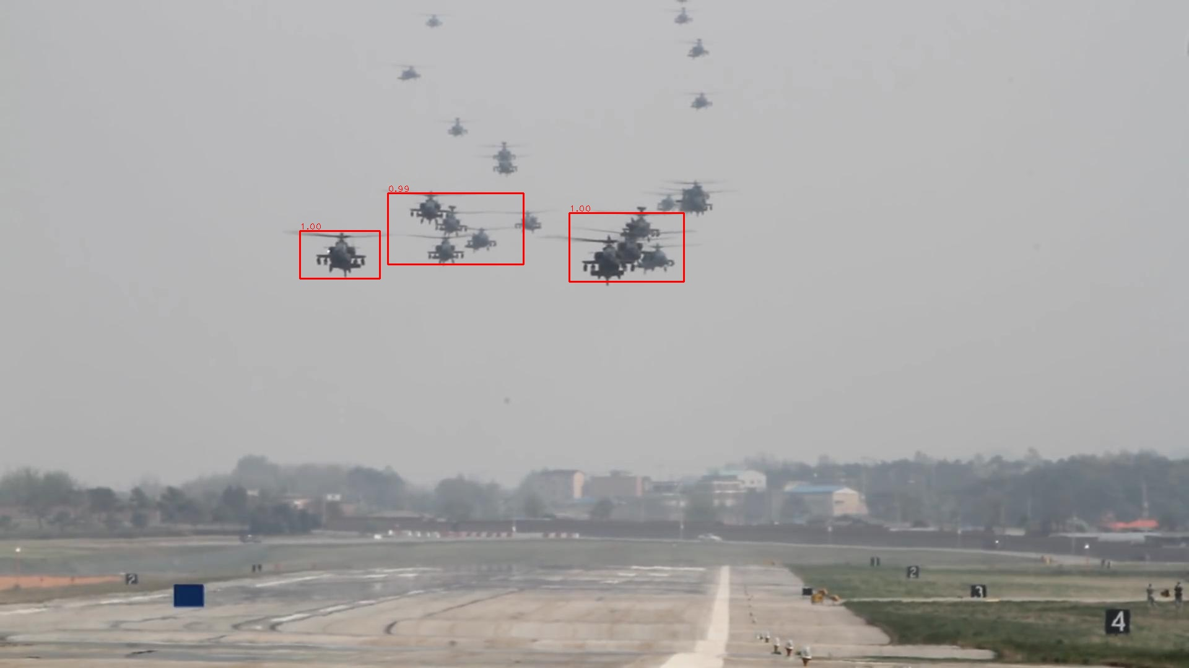
Vis Result-Better Seq
For airplane-0, AP(best epoch) goes from 5.2 to 21.4.
Iter2-000.jpg

Slide 7
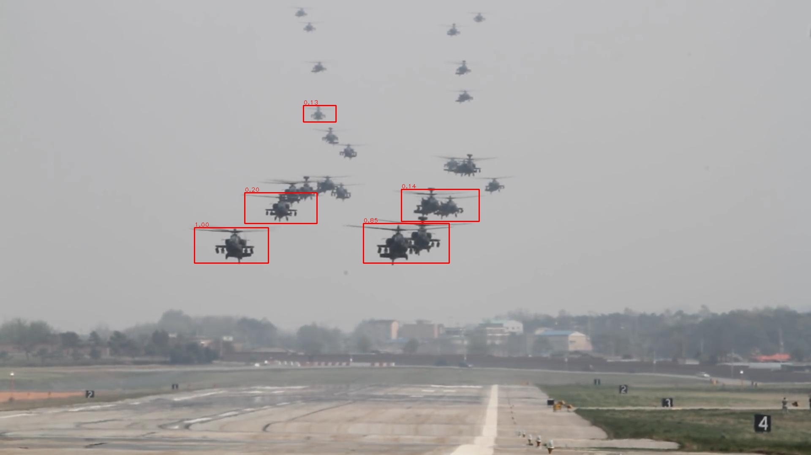
Vis Result-Better Seq
For airplane-0, AP(best epoch) goes from 5.2 to 21.4.
Iter1-99.jpg

Slide 8
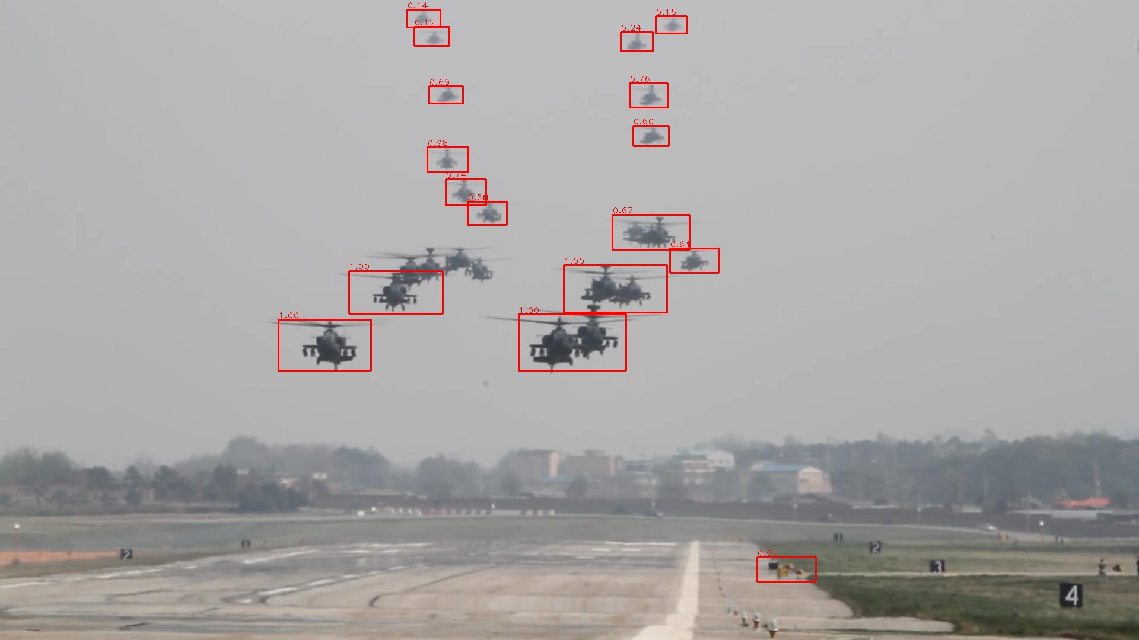
Vis Result-Better Seq
For airplane-0, AP(best epoch) goes from 5.2 to 21.4.
Iter2-99.jpg

Slide 9
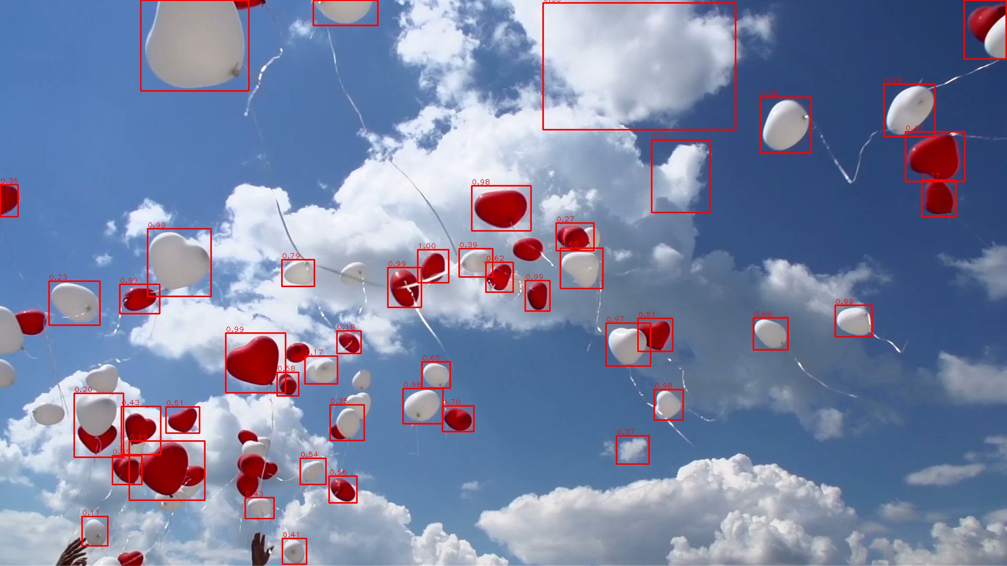
Vis Result-Worse Seq
For balloon-3, AP(best epoch) goes from 40.6 to 28.3.
Iter2-000.jpg

Slide 10
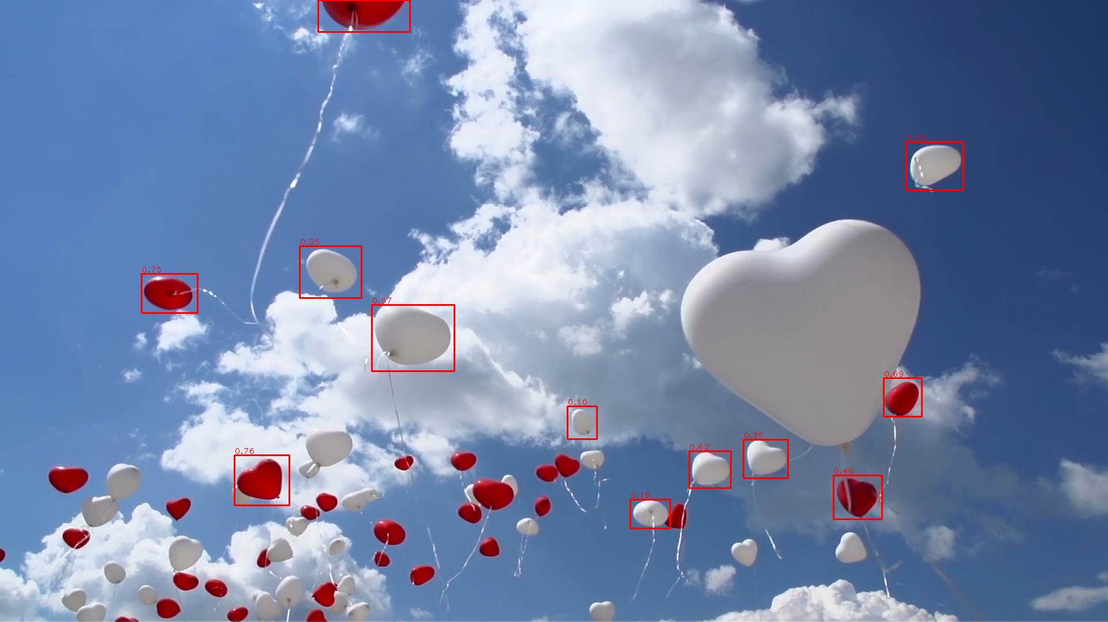
Vis Result-Worse Seq
For balloon-3, AP(best epoch) goes from 40.6 to 28.3.
Iter1-199.jpg

Slide 11
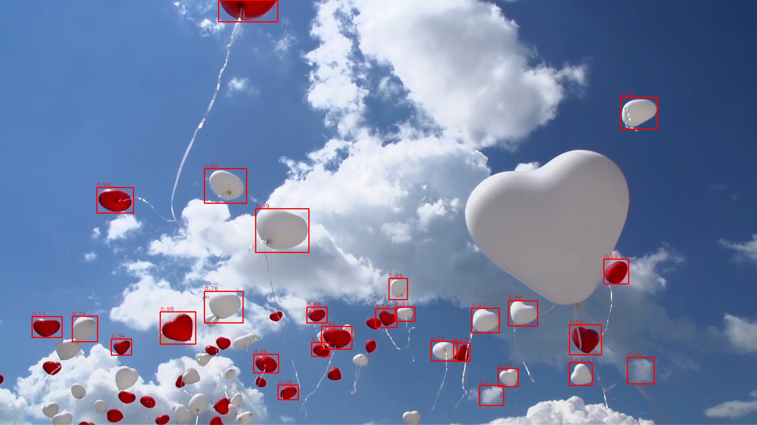
Vis Result-Worse Seq
For balloon-3, AP(best epoch) goes from 40.6 to 28.3.
Iter2-199.jpg

Slide 12
End
End and Thanks!

