Slide 1
Weekly Report
Wensheng Cheng
2022.4.3-4.10

Slide 2
Last discussion
Explore the effect that including all frames of one seq to train an object detector. These training labels are generated by iterative search. I guess this may improve the performance with more training data.
How about the performance?
Observation: if both using the result of 24 epochs, the performance is worse than the way that only using the first img to train. But in fact, if both using the best epoch, or a fixed epoch where most seqs get high results, then it’s better.
Conclusion: it’s better. The point is that with lost of noisy pseudo labels, it has been proved that early stopping is necessary. Since the model would first try to fit high-quality label, then overfit those noisy label, and the performance firstly goes up and then drops down quickly.

Slide 3
This week
Check works related to object detection with noisy label.
Since this is a small field, not many works about it. Only several ones appeared in recent years, and the latest one is published on BMVC 2021.

Slide 4

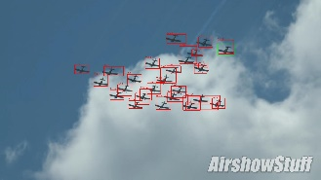
Pipeline
Template
Iterative search
Input
Initial Noisy Labels
Data association
Prediction with the detector
Train detector with noisy label
Output

Slide 5
Numerical Result
 | AP | AP50 | AP75
gt(train_1)-24th epoch | 38.28 | 77.50 | 32.57
baseline(iter_1)-24th epoch | 26.48 | 57.77 | 20.51
iter_2 (train_1)-24th epoch | 29.10 | 64.34 | 22.70
iter_2 (train_all)-24th epoch | 26.64 | 54.69 | 22.87
iter_2 (train_1)-best epoch | 29.34 | 64.65 | 22.90
iter_2 (train_all)-best epoch | 30.40 | 61.52 | 26.69
iter_2 (train_all)-best epoch bs_24_lr_0_01_gpu_x2 | 33.17 | 66.25 | 29.58
iter_2 (train_1)-major epoch | 29.10 | 64.34 | 22.70
iter_2 (train_all)-major epoch | 29.88 | 61.51 | 25.53
iter_2 (train_all)-major epoch bs_24_lr_0_01_gpu_x2 | 30.85 | 63.74 | 26.60
Major epoch of iter_2 (train_all, bs_24_lr_0_01_gpu_x2): [1, 3, 2, 3, 3, 3, 4, 1, 7, 2, 2, 1, 4, 2, 1, 2, 2, 1, 5, 1, 1, 5, 2, 1, 5, 2, 6, 1, 6, 1, 2, 2, 2, 7, 1, 9, 1, 2, 1, 7].

Slide 6
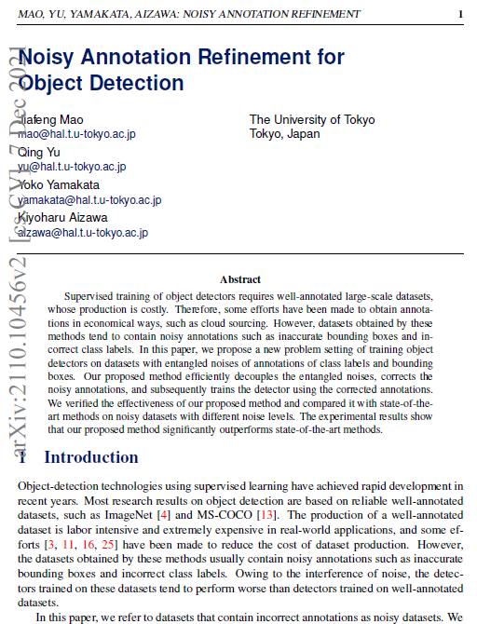
Method-Decoupled Refinement
Noisy Annotation Refinement for Object Detection.
BMVC 2021. https://arxiv.org/abs/2110.10456

Slide 7
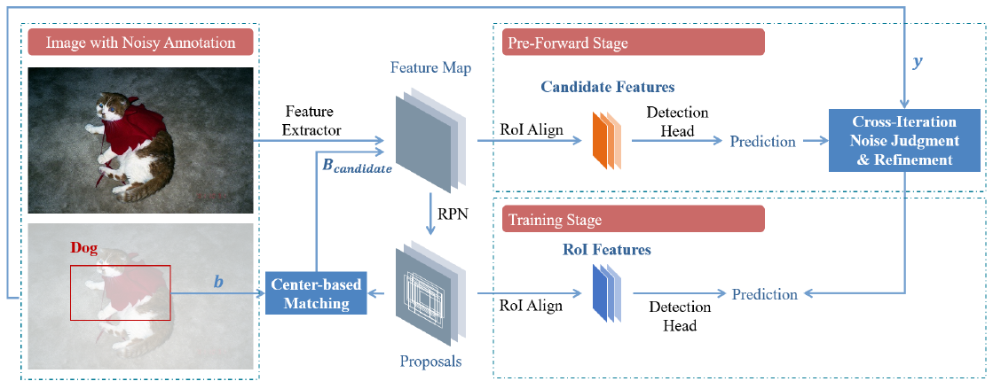
Method-Framework
Below is the architecture of the proposed framework. The center matching initially corrects the annotated bounding boxes and outputs the results grouped with the candidate regions. The pre-forward stage classifies and regresses the candidate regions, and the cross-iteration noise judgment identifies the noisy labels on the basis of the results.
BMVC 2021. https://arxiv.org/abs/2110.10456

Slide 8
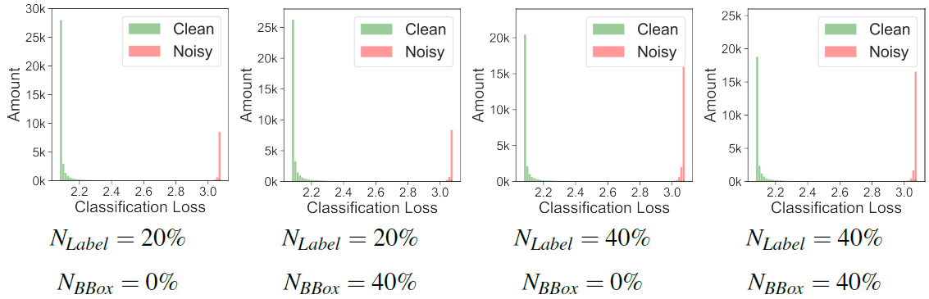
Method-Loss of Noisy Label
Below is the distribution of the classification loss caused by noisy labels and clean labels. The loss values of the noisy labels are clearly separated from those of the clean labels.
BMVC 2021. https://arxiv.org/abs/2110.10456

Slide 9
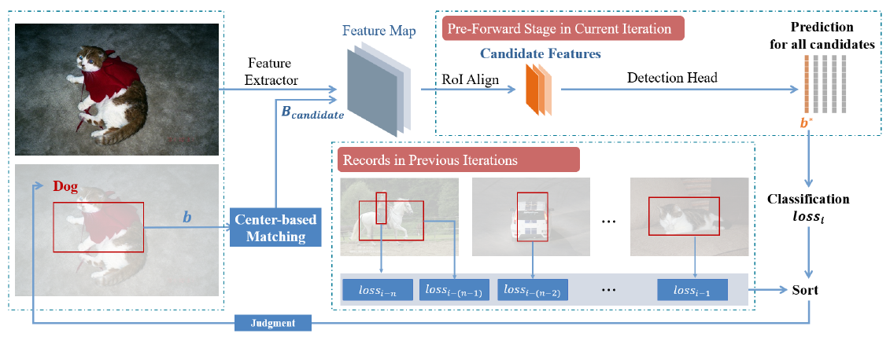
Method-Cross Iteration Noise Judgement
Below is the architecture of the cross-iteration noise judgment. A dynamic threshold is calculated according to the loss values maintained in the previous iterations. The CINJ judges the credibility of the current labels by comparing their loss values with the threshold. The labels judged to be clean are maintained for training, whereas the labels judged to be noisy are modified.
BMVC 2021. https://arxiv.org/abs/2110.10456

Slide 10
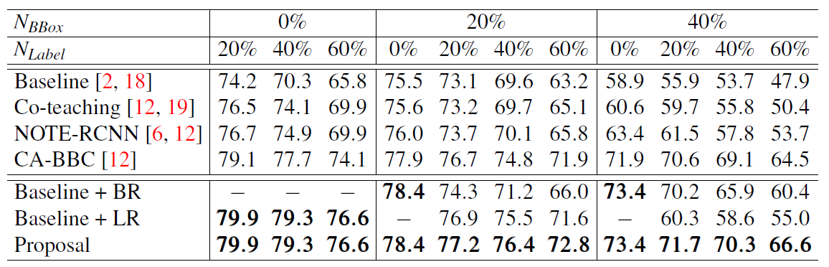
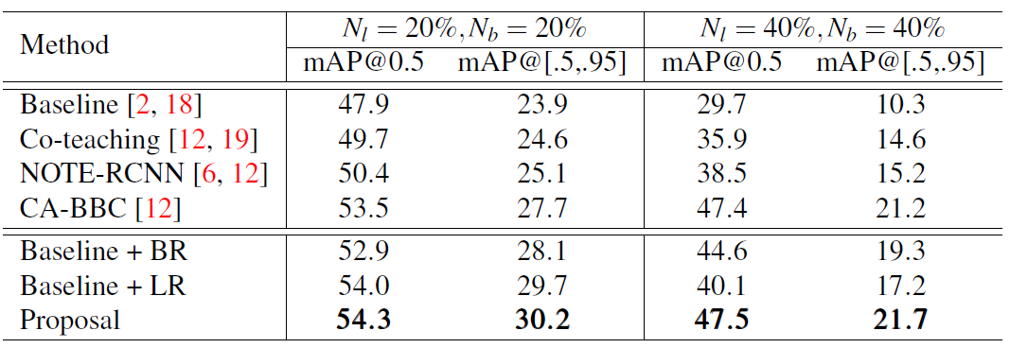
Method-Experiment
Pascal VOC result
COCO result
BMVC 2021. https://arxiv.org/abs/2110.10456

Slide 11
End
End and Thanks!

