Slide 1
Weekly Report
Wensheng Cheng
2022.4.11-4.17

Slide 2
Last discussion
Check works related to object detection with noisy label.
Since this is a small field, not many works about it. Only several ones appeared in recent years, and the latest one is published on BMVC 2021.

Slide 3
This week
Check works related to early stopping in noisy label training.
More experiment results on using all frames to train a detector with fully supervised way.
Try to select some frames that has high-quality labels to train a detector, instead of using all frames.
Result: could get comparable or higher performance with the one trained in all frames based on AP metric.

Slide 4
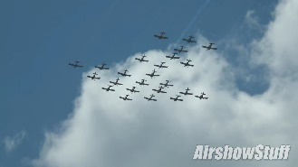
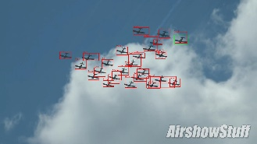
Pipeline
Template
Iterative search
Input
Initial Noisy Labels
Select high-quality labels
Output
Data association
Prediction with the detector
Train detector with noisy label
Indicates where the crowd assumption applies.

Slide 5
Numerical Result
Training set: all frames/labels | AP | AP50 | AP75
gt(train_1)-24th epoch | 38.28 | 77.50 | 32.57
baseline(iter_1)-24th epoch | 26.48 | 57.77 | 20.51
iter_2 (train_1)-24th epoch | 29.10 | 64.34 | 22.70
iter_2 (train_all)-24th epoch | 26.64 | 54.69 | 22.87
iter_2 (train_1)-best epoch | 29.34 | 64.65 | 22.90
iter_2 (train_all)-best epoch | 30.40 | 61.52 | 26.69
iter_2 (train_all)-best epoch bs_24_lr_0_01_gpu_x2 | 33.17 | 66.25 | 29.58
iter_2 (train_all)-best epoch bs_48_lr_0_01_gpu_x4 | 34.74 | 70.10 | 30.53
Major epoch of iter_2 (train_all, bs_48_lr_0_01_gpu_x4): [1, 1, 1, 1, 3, 4, 4, 3, 7, 3, 5, 1, 1, 1, 3, 1, 4, 1, 2, 2, 2, 2, 1, 1, 4, 3, 3, 3, 8, 1, 3, 3, 16, 7, 1, 1, 1, 4, 2, 6].

Slide 6
Numerical Result
Training set: high-quality labels | AP | AP50 | AP75
iter_2 (train_all)-best epoch bs_48_lr_0_01_gpu_x4 (previous slide) | 34.74 | 70.10 | 30.53
iter_2 (train_top_img_20) best epoch bs_8_lr_0_005 | 34.39 | 69.96 | 30.03
iter_2 (train_top_img_50) best epoch bs_48_lr_0_01_gpu_x4 | 34.71 | 69.99 | 30.37
iter_2 (train_top_img_50) best epoch bs_48_lr_0_005_gpu_x4 | 35.13 | 70.48 | 31.10
Major epoch of iter_2 (train_top_img_50, bs_48_lr_0_005_gpu_x4): [6, 3, 5, 7, 11, 6, 24, 5, 8, 6, 7, 8, 4, 5, 7, 4, 24, 7, 7, 4, 9, 24, 4, 5, 5, 24, 8, 4, 9, 4, 6, 6, 4, 24, 5, 7, 24, 7, 16, 4].

Slide 7
End
End and Thanks!

