Slide 1
Weekly Report
Wensheng Cheng
2022.4.17-4.24

Slide 2
Last discussion
Check works related to early stopping in noisy label training.
More experiment results on using all frames to train a detector with fully supervised way.
Try to select some frames that has high-quality labels to train a detector, instead of using all frames.
Result: could get comparable or higher performance with the one trained in all frames based on AP metric.

Slide 3
This week
Rethink our GMOT task.
Problem formulation.
Method pipeline.
Key points/challenges.

Slide 4
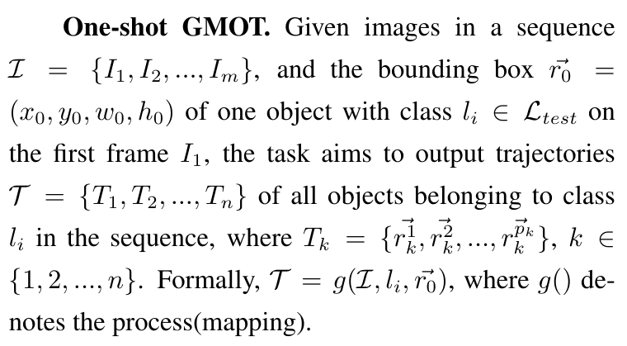
Problem Formulation
Below is the problem formulation for our GMOT task.

Slide 5


Method Pipeline
One shot detection
(pretrained RPN/global SOT)
Template
Input
Initial Detection Results
Data association
Refine detection results
(directly filter/retrain a detector)
Output

Slide 6
Key Points
One shot detection process: this could be done by using a pretrained RPN, or doing iterative search by repeatedly using the baseline, which is a global SOT method. Currently the iterative search gets a higher performance. If we want to use a new block here, we need to train it in a unsupervised way.
Refine detection results: after we get initial detection labels, we need to filter them. This could be done by filtering them directly using heuristic rules, or retraining a detector by taking the initial detection labels as pseudo labels. The second way is related to noisy label learning. Currently the 2nd way gets higher performance.

Slide 7
End
End and Thanks!

