Slide 1
Weekly Report
程文胜 2019.11.10-11.15

Slide 2
Weekly Report
Abstract
Content
End

Slide 3
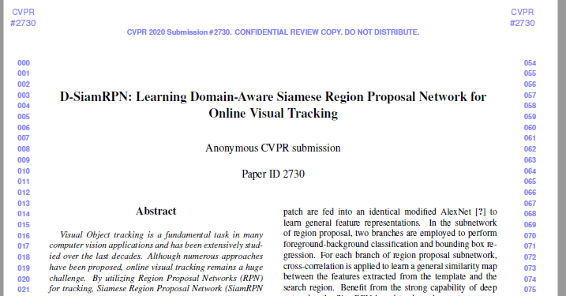
Abstract
This week I mainly put my effort on preparing CVPR 2020 paper with Lei Xu and Guo Haowen.

Slide 4
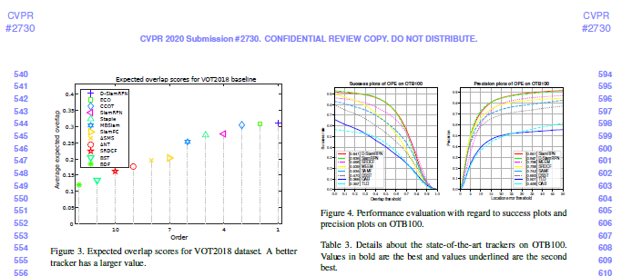
Content
Although Lei Xu has conducted experiments ahead, it still took us some time on processing the experimental data and drawing diagrams and tables. This is mainly because these datasets have special toolkits to draw various curves, which would take extra effort.

Slide 5
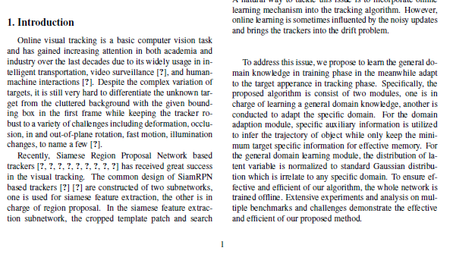
Content
About time management, we didn’t realize that it would take a week for Lei Xu to write the method section earlier, and he didn’t have time to write Related Work section. As a result, we wrote the Related Work section only 1 hour earlier than the deadline. He gave me the method section only 10 minutes before the deadline which he still didn’t finishing revising.

Slide 6
Discussion
Due to the tight time, we didn’t check the manuscript carefully, and just submitted it 1 minute and 30 seconds before the deadline. So there are many flaws in the manuscript and we even got the Conclusion section wrong.
Next time for IJCAI conference paper, I would talk with Lei Xu more and prepare for the worst. Since he might estimate the time wrong, I would just finish all the rest work and wait for his part. This would reduce the risk of a failed paper. At least, we need to write a draft days before the deadline, and leave enough time for teacher’s review.

Slide 7
Report End
程文胜 VIPG

