Slide 1
Weekly Report
程文胜 2019.11.23-11.29

Slide 2
Weekly Report
Abstract
Content
End

Slide 3
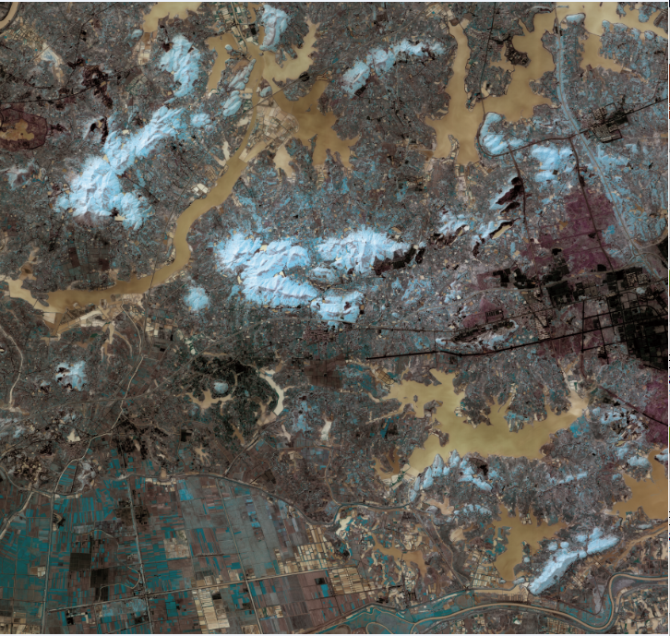
Abstract
This week I mainly put my effort on managing project data of Gaofen-2 satellite.

Slide 4
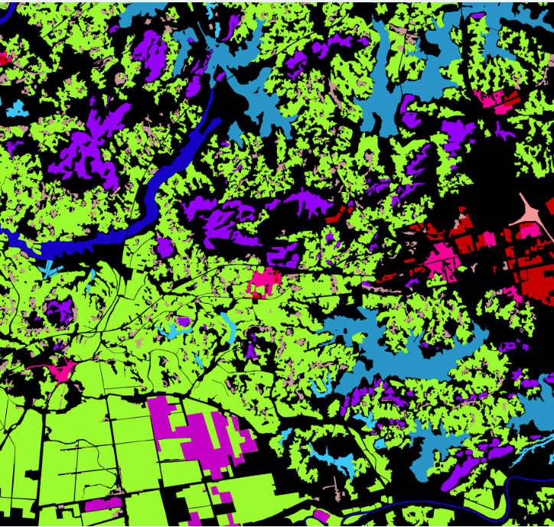
Content
Tong Xinyi gave me about 40 pictures with labels. The project requirement is 40 views. So the number of data is enough.

Slide 5
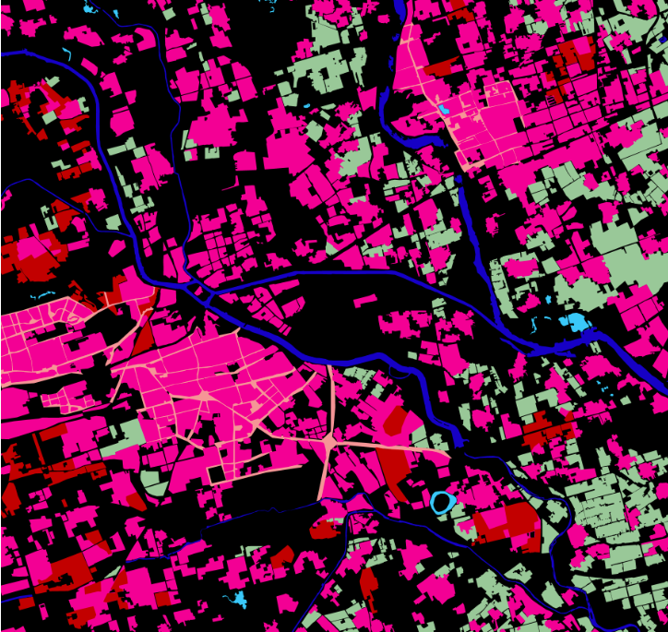
Content
I discussed about building extraction with Guo Haowen. The problem is the label of building is really coarse, so the performance would be bad if we use the GID dataset. Maybe we could use other data sources to train a instance segmentation model.
Red and pink parts are buildings. It didn’t label each building separately.

Slide 6
Report End
程文胜 VIPG

