Slide 1
Weekly Report
程文胜 2020.5.14-5.29

Slide 2
Weekly Report
Abstract
Content
End

Slide 3
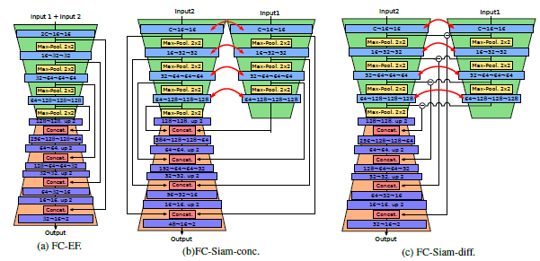
Abstract
For the two weeks, I mainly put my effort on re-implementing change detection baseline models and searching for images which could be used in our dataset.

Slide 4
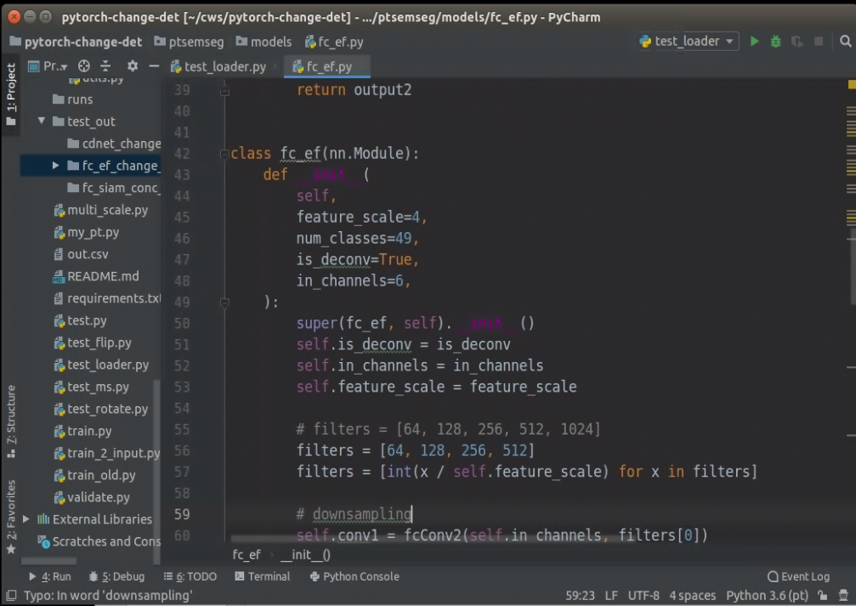
Content
I have chosen 5 representative change detection models based on CNN, and re-implement them with pytorch, since all of them doesn’t release their code.

Slide 5
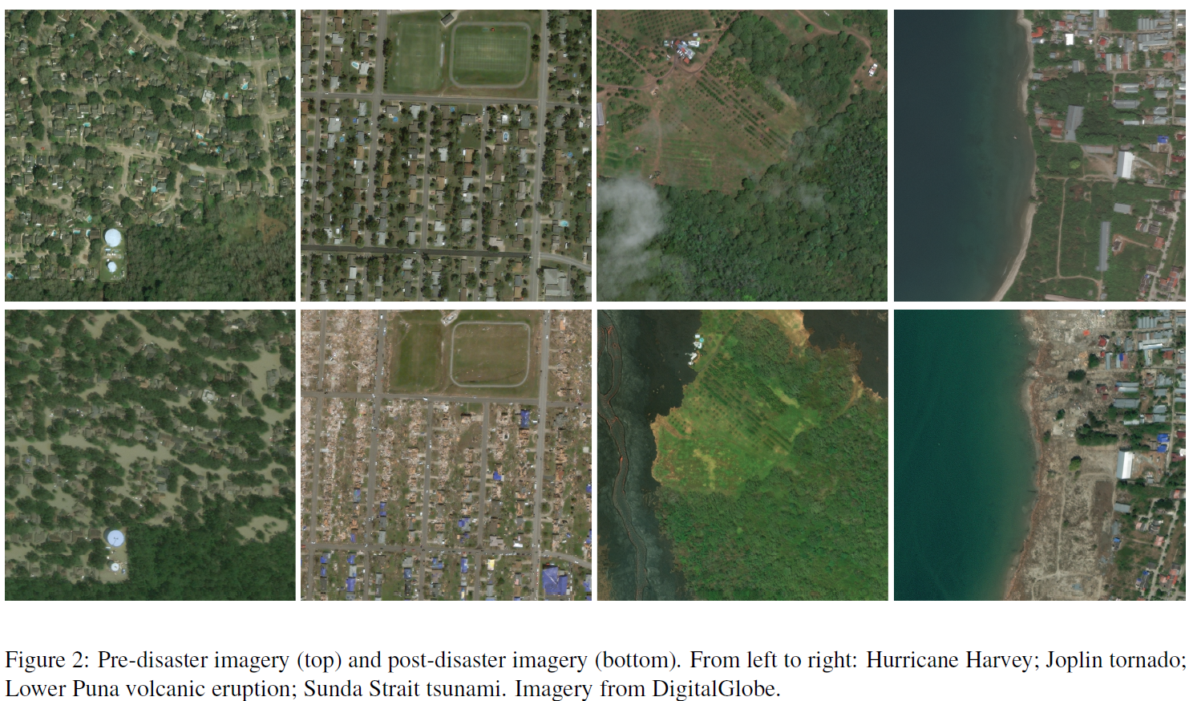
Content
To expand the dataset, we need to collect registered images at first.
We found a dataset released recently for building damage assessment. The images were taken before and after some kind of disaster. It might be useful for us.

Slide 6
Content
One disappointing thing is that the paper was rejected by ECCV. The main problem is that reviewers don’t consider it as a new task, and they think the contribution is limited without new method. After checking some older papers(published in 2007) pointed by reviewers, I have to say they are right. The task was called multi-class change detection in the early period. But there is little research in this field in recent years, and the main reason might be the lack of dataset. I’m a little unsure about whether we should go ahead :).

Slide 7
Report End
程文胜 5.29

