Slide 1
Weekly Report
程文胜 2021.2.7-2.14

Slide 2
Weekly Report
Abstract
Content
End

Slide 3
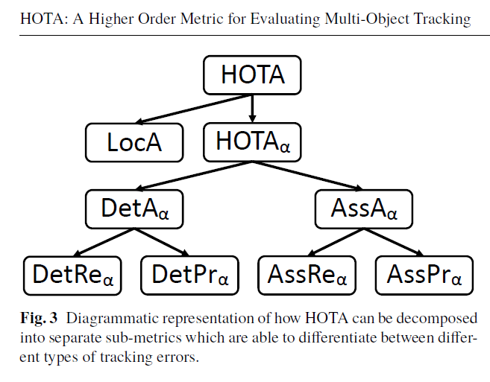
Abstract
Last week I mainly spent time on testing the new version of HOTA metric code, and staring re-labeling balloon data.

Slide 4
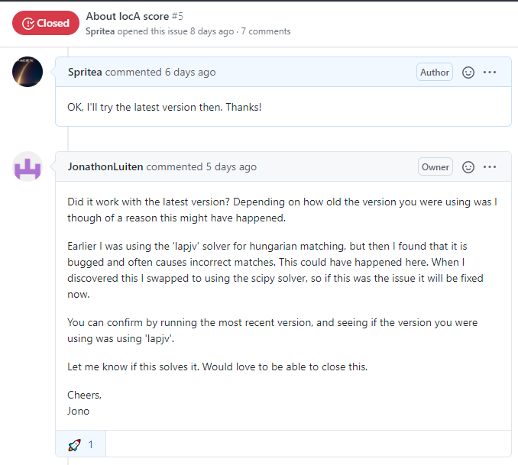
Content
After reporting a numeric issue to the author, he suggested me trying his new version of code. He told me that the reason should be the package lapjv, which didn’t work as expected. After changing to the new code with scipy solver, it works.

Slide 5

Content
I also stared re-labeling our balloon data. Only red balloons in the balloon-3 data were labeled at first, so we need to label other white balloons as well, following reviewer’ opinions.

Slide 6
Report End
程文胜 2.14

