Slide 1
Weekly Report
程文胜 2020.4.24-4.30

Slide 2
Weekly Report
Abstract
Content
End

Slide 3
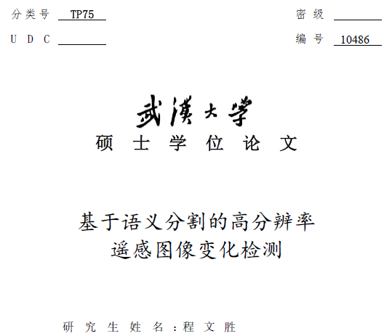
Abstract
This week I mainly put my effort on revising my master thesis and reading the code of ClusDet.

Slide 4
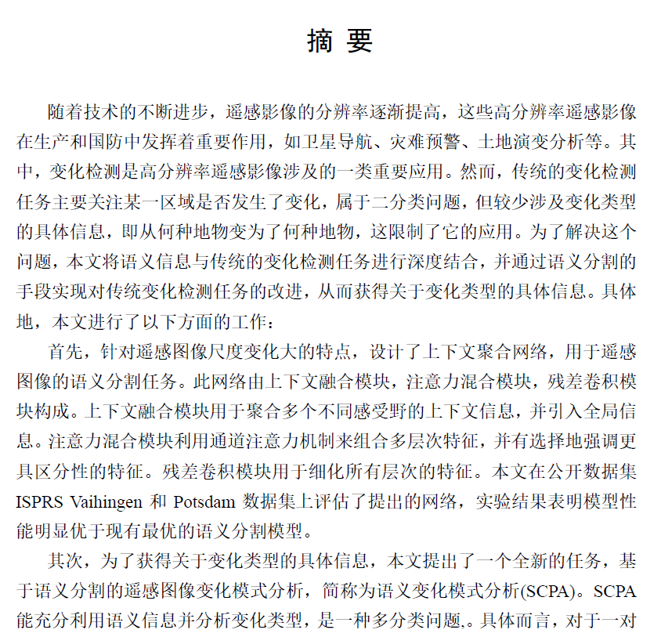
Content
I have finished my thesis recently, and spent some time on revising the paper to make it cleaner and more consistent.

Slide 5
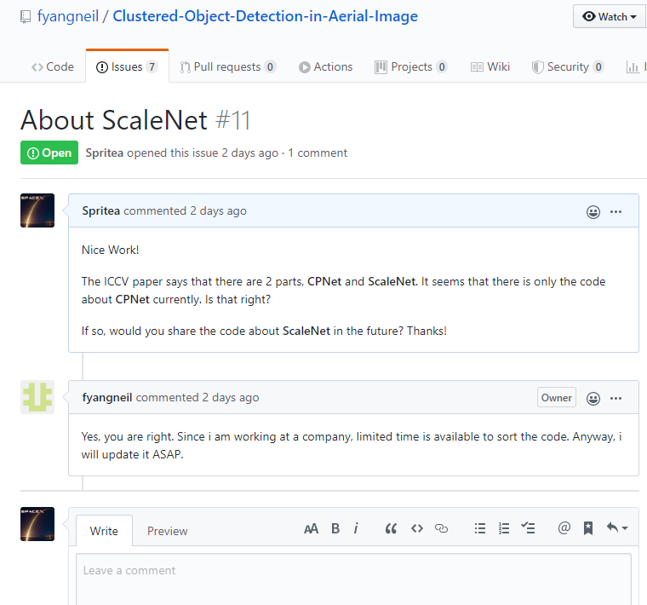
Content
I have checked the code of “Clustered Object Detection in Aerial Images”. I have read the code of CPNet, which is used for cluster proposal generation, and understanded its implementation. But I found the code of ScaleNet is not available currently. I asked Fan Yang about it on github, and he confirmed it. I would check the code again when the whole code is released.

Slide 6

Discussion
About study topic, I agree it’s practical for me to start with aerial image/video. Specifically, I think my recent idea about change detection is worth exploring. I’d like to discuss it with you in the meeting.
The related paper was submitted to ECCV 2020. It proposes a new task about change detection, named Semantic Change Pattern Analysis. It transferred the traditional binary change detection task into multi-class task, which could provide specific information about change type.
The arxiv doc is here: https://arxiv.org/abs/2003.03492.

Slide 7
Report End
程文胜 4.30

