Slide 1
A Survey of Semantic Change
Pattern Analysis
Student
Wensheng Cheng
May, 2020

Slide 2
Task
Dataset
Method
CONTENTS

Slide 3
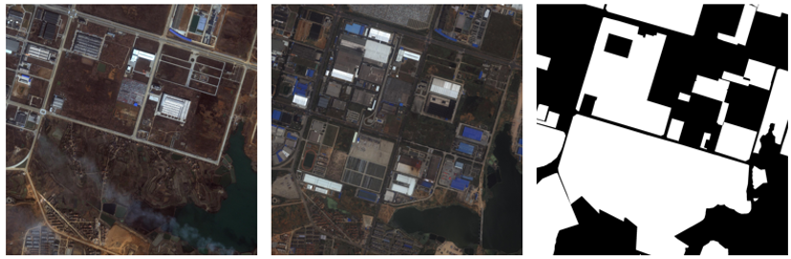
TASK
DATASET
METHOD
Change Detection
Change detection aims to identify changed areas for a pair of co-registered images. This task is only able to determine whether a region has changed, without telling the type
of change.

Slide 4
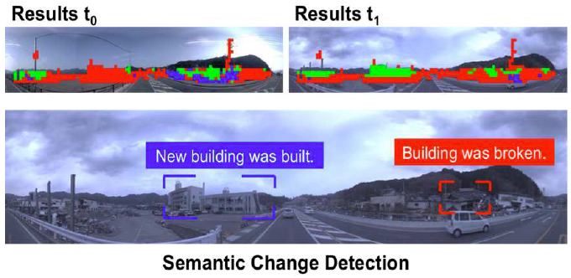
TASK
DATASET
METHOD
Semantic Change Detection
[1] first proposed the concept named semantic change detection for street images. It adds semantic label to change detection dataset. But it only outputs the change in object level, like “New building was built”, “Building was broken”. It didn’t specify specific change type.
[1] Kataoka, H., Shirakabe, S., Miyashita, Y., Nakamura, A., Iwata, K., Satoh, Y.: Semantic change detection with hypermaps. arXiv preprint arXiv:1604.07513 2(4) (2016)

Slide 5
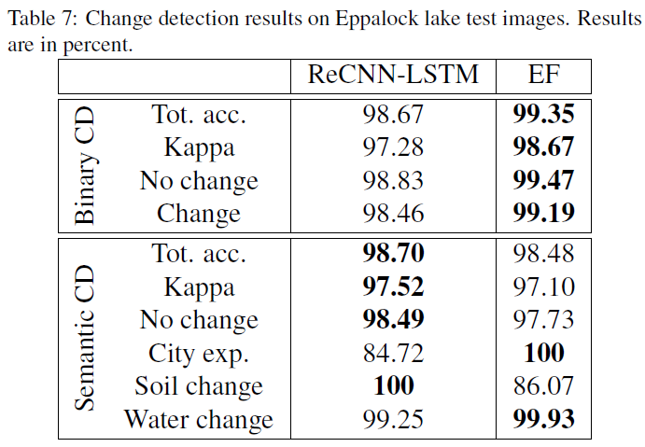
TASK
DATASET
METHOD
Semantic Change Detection
[2] studied the topic with satellite image. It involves three kinds of change, city expansion, soil change, and water change. It also focuses on objects and doesn't conform to the change type definition of SCPA task.
[2] Daudt, R.C., Le Saux, B., Boulch, A., Gousseau, Y.: Multitask learning for largescale semantic change detection. Computer Vision and Image Understanding 187, 102783 (2019)

Slide 6
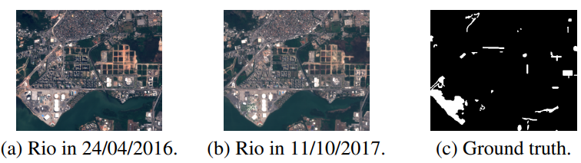
TASK
DATASET
METHOD
Change Detection Dataset
[3] presented a dataset called ONERA satellite change detection dataset, which is composed of some multispectral satellite image pairs.
[3] Daudt, R. C., Le Saux, B., Boulch, A., & Gousseau, Y. (2018, July). Urban change detection for multispectral earth observation using convolutional neural networks. In IGARSS 2018-2018 IEEE International Geoscience and Remote Sensing Symposium (pp. 2115-2118). IEEE.

Slide 7
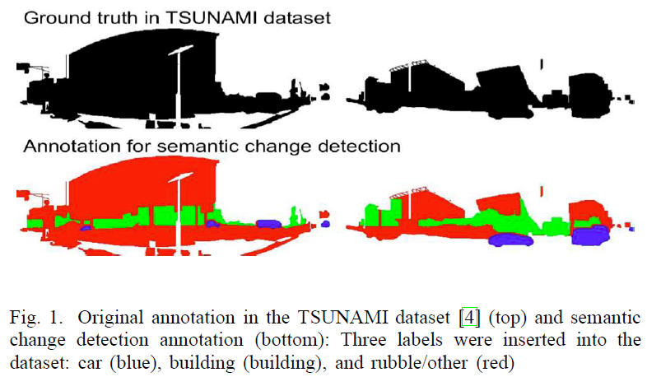
TASK
DATASET
METHOD
Semantic Change Detection Dataset
[1] transformed the TSUNAMI dataset for the task via adding semantic label to the destination image.
[1] Kataoka, H., Shirakabe, S., Miyashita, Y., Nakamura, A., Iwata, K., Satoh, Y.: Semantic change detection with hypermaps. arXiv preprint arXiv:1604.07513 2(4) (2016)

Slide 8
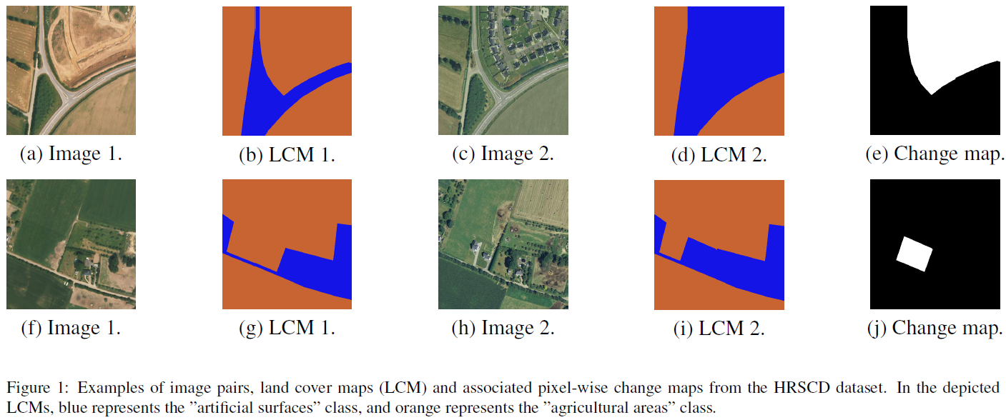
TASK
DATASET
METHOD
Semantic Change Detection Dataset
[2] built a dataset named HRSCD, whose images and labels come from different sources. The only guarantee is that the images and labels are acquired in the same year, which means the time difference between the images and labels could be as large as one year.
[2] Daudt, R.C., Le Saux, B., Boulch, A., Gousseau, Y.: Multitask learning for largescale semantic change detection. Computer Vision and Image Understanding 187, 102783 (2019)

Slide 9
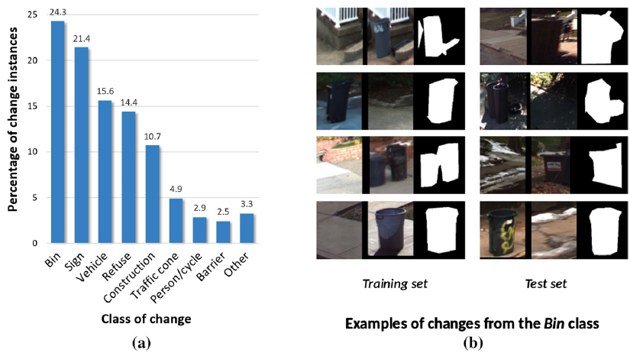
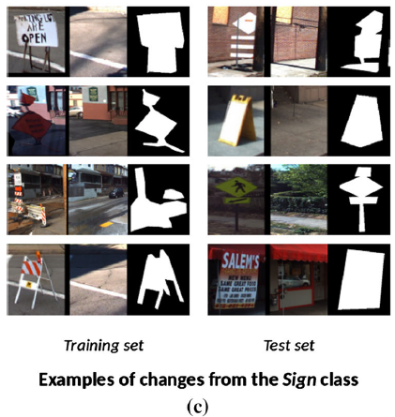
TASK
DATASET
METHOD
Semantic Change Detection Dataset
[4] proposed the VL-CMU-CD dataset, which uses simultaneous localization and mapping
technique to get nearly registered images.
[4] Alcantarilla, P.F., Stent, S., Ros, G., Arroyo, R., Gherardi, R.: Street-view change detection with deconvolutional networks. Autonomous Robots 42(7), 1301-1322.(2018)

Slide 10
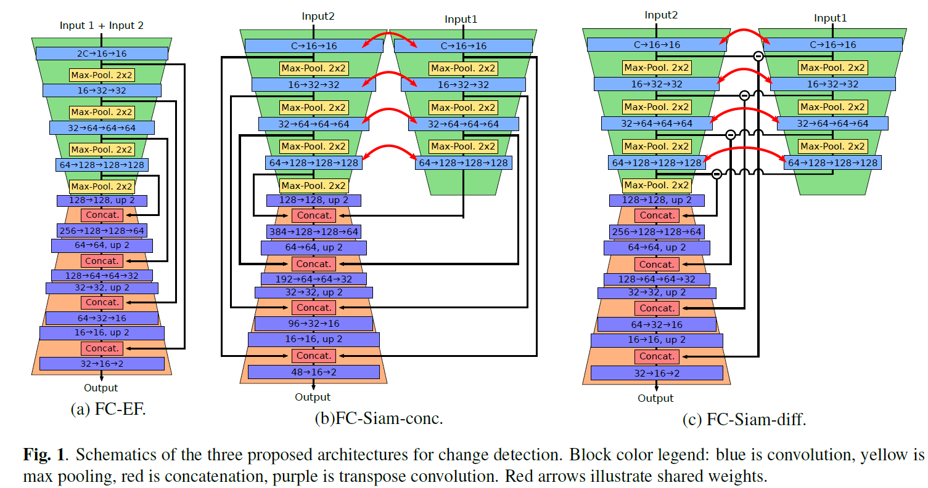
TASK
DATASET
METHOD
Change Detection Method
[5] This paper presents three fully convolutional neural network architectures which perform change detection using a pair of coregistered images.
[5] Caye Daudt, R., Le Saux, B., & Boulch, A. (2018). Fully Convolutional Siamese Networks for Change Detection. 2018 25th IEEE International Conference on Image Processing (ICIP), 4063–4067.

Slide 11
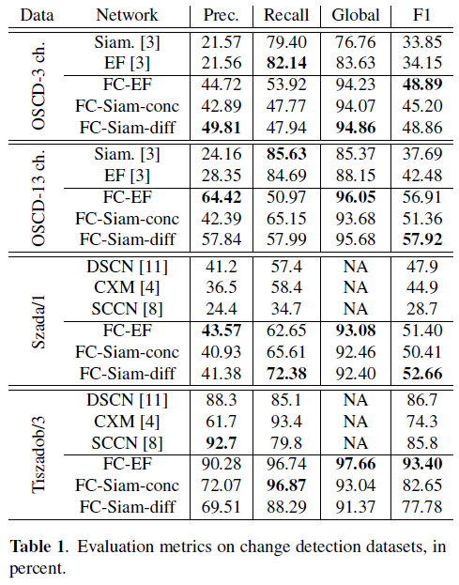
TASK
DATASET
METHOD
Change Detection Method
[5] This paper presents three fully convolutional neural network architectures which perform change detection using a pair of coregistered images.
[5] Caye Daudt, R., Le Saux, B., & Boulch, A. (2018). Fully Convolutional Siamese Networks for Change Detection. 2018 25th IEEE International Conference on Image Processing (ICIP), 4063–4067.

Slide 12
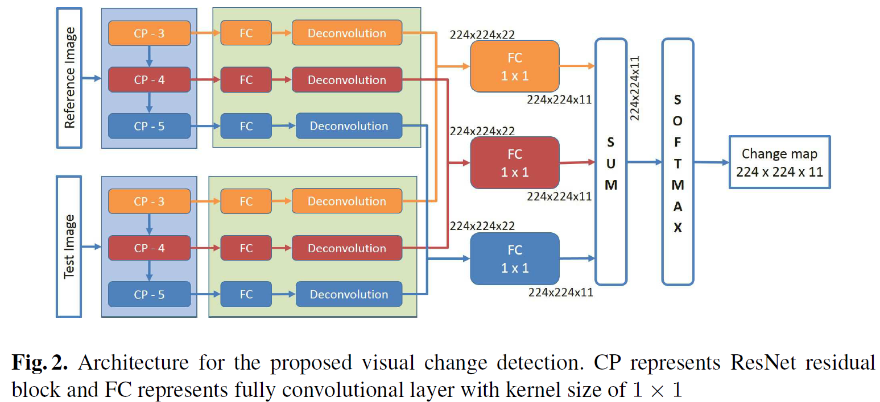
TASK
DATASET
METHOD
Semantic Change Detection Method
[6] presented a network named ChangeNet based on parallel deep convolutional
neural network architecture for the task.
[6] Varghese, A., Gubbi, J., Ramaswamy, A., Balamuralidhar, P.: Changenet: a deep learning architecture for visual change detection. In: Proceedings of the European Conference on Computer Vision (ECCV) workshop (2018).

Slide 13
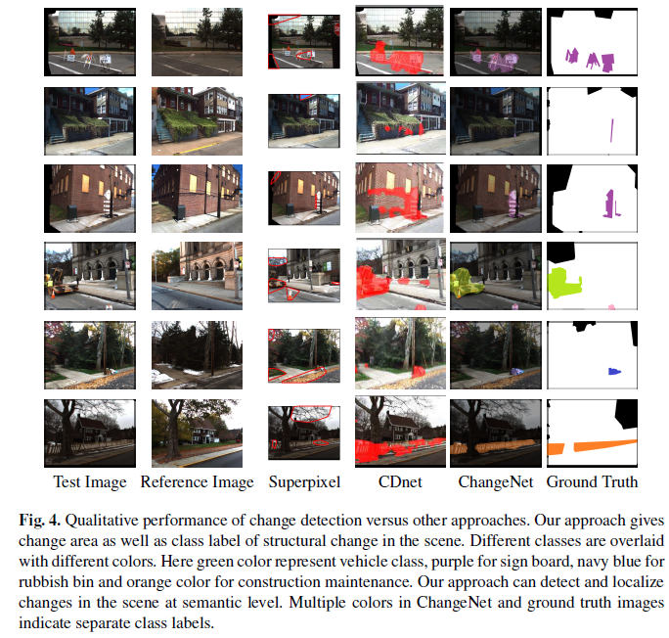
TASK
DATASET
METHOD
Semantic Change Detection Method
The image below shows the result of the method.
[6] Varghese, A., Gubbi, J., Ramaswamy, A., Balamuralidhar, P.: Changenet: a deep learning architecture for visual change detection. In: Proceedings of the European Conference on Computer Vision (ECCV) workshop (2018).

Slide 14
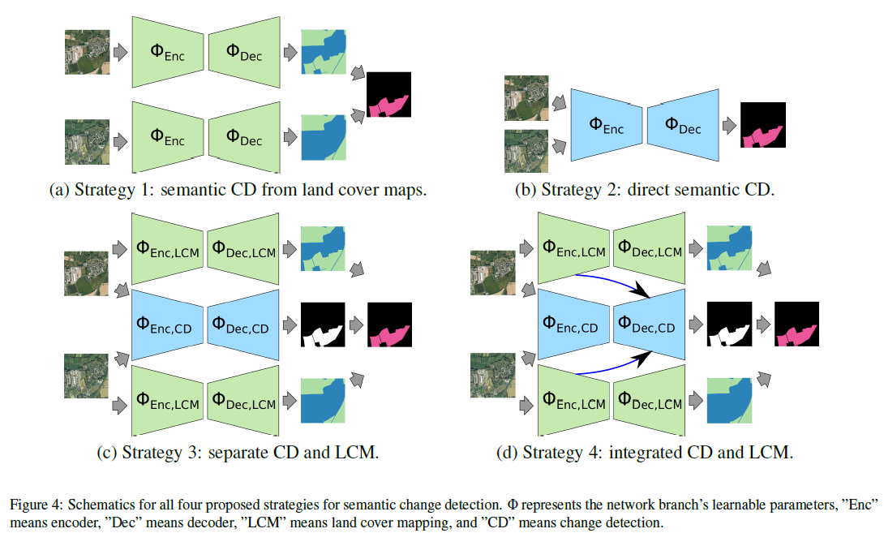
TASK
DATASET
METHOD
Semantic Change Detection Method
[2] tried to deal with semantic segmentation and change detection problems simultaneously through multitask learning.
[2] Daudt, R.C., Le Saux, B., Boulch, A., Gousseau, Y.: Multitask learning for largescale semantic change detection. Computer Vision and Image Understanding 187, 102783 (2019)

Slide 15
THANKS

