Slide 1
Weekly Report
程文胜 2020.5.29-6.5

Slide 2
Weekly Report
Abstract
Content
End

Slide 3
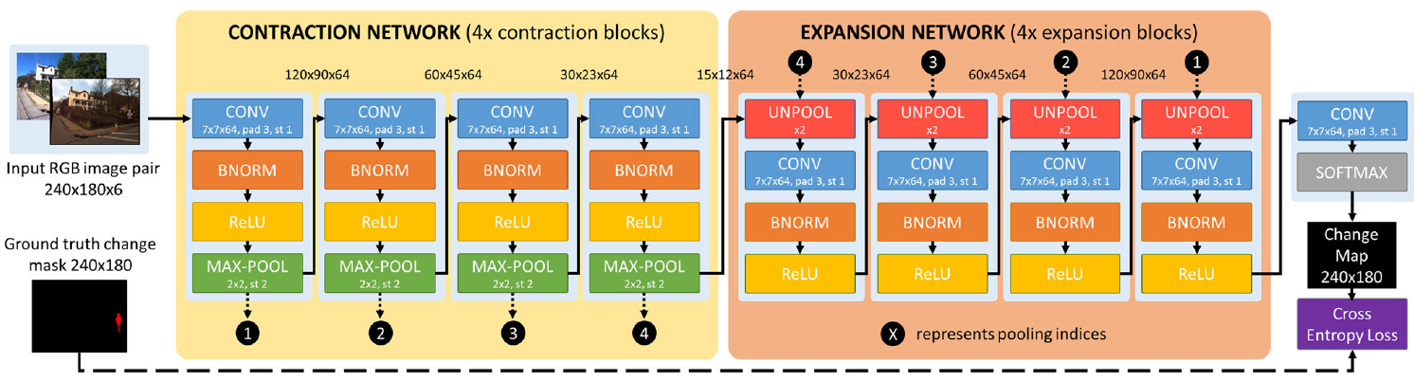
Abstract
In this week, I mainly put my effort on testing change detection baseline models and checking the STN paper.
CDNet architecture

Slide 4
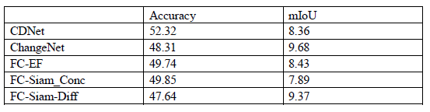
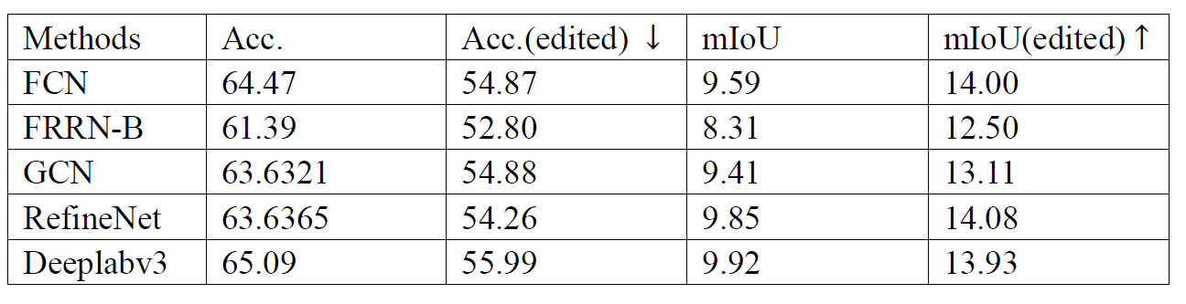
Content
After re-implementing 5 representative change detection models based on CNN with pytorch, I have trained them and got their performance results on the SCPA-WC dataset for 49 classes.

Slide 5
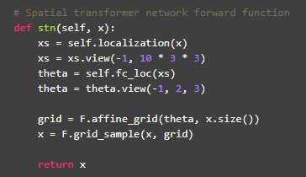
Content
I also checked the Spatial Transformer Network paper, and checked related code of the paper. I found that pytorch have implemented the STN paper officially with several functions. I would look into the details of the pytorch code.

Slide 6
Report End
程文胜 6.5

