Slide 1
Weekly Report
程文胜 2020.7.2-7.17

Slide 2
Weekly Report
Abstract
Content
End

Slide 3
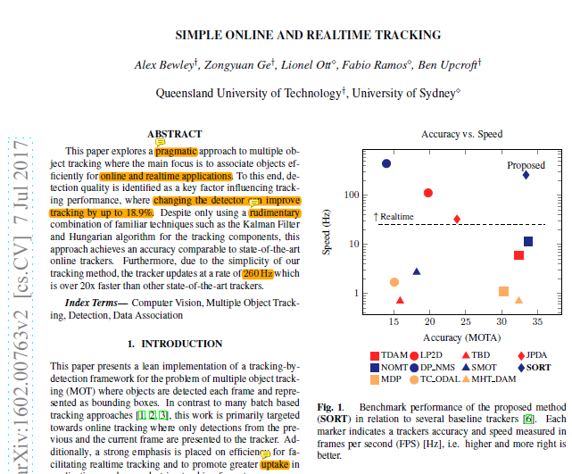
Abstract
In this week, I mainly put my effort on reading SORT paper and learning related basic knowledge used in the paper.

Slide 4
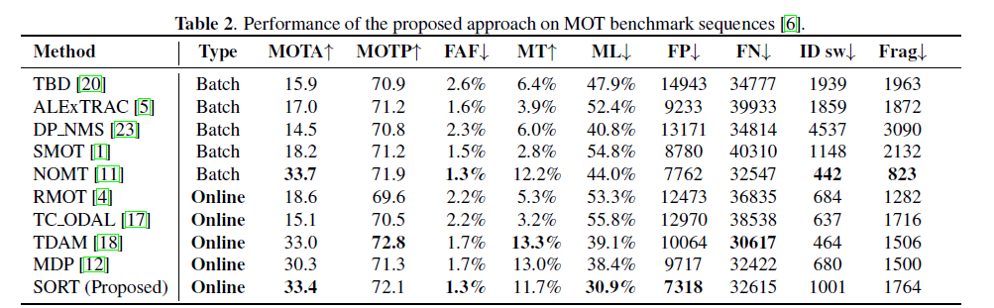
Content
SORT only uses a rudimentary combination of familiar, the Kalman Filter and Hungarian algorithm for the tracking components. It achieves an accuracy comparable to state-of-the-art online trackers.

Slide 5
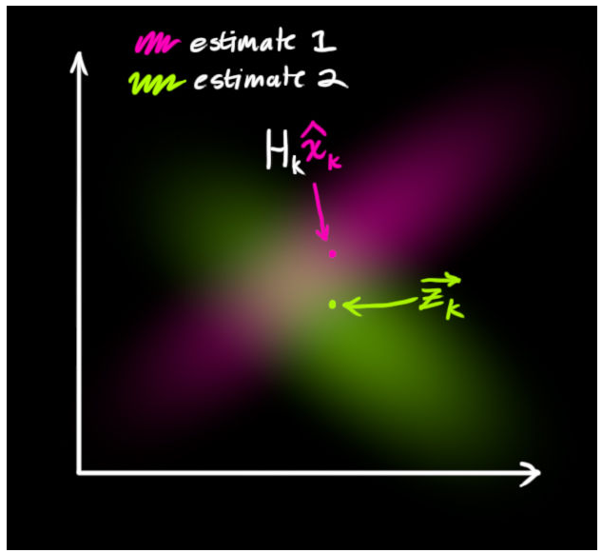

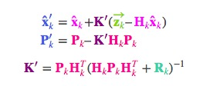
Content
Kalman filter is a key method in the paper. SORT approximates the inter-frame displacements of each object with a linear constant velocity model which is independent of other objects and camera motion.
Predict equation
Correct equation

Slide 6
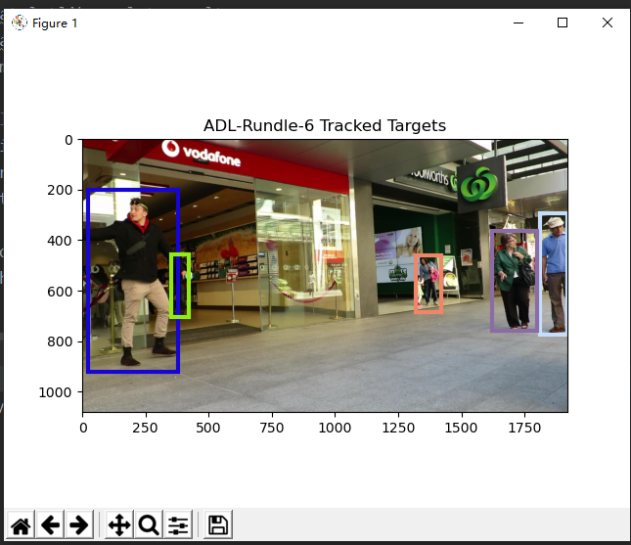
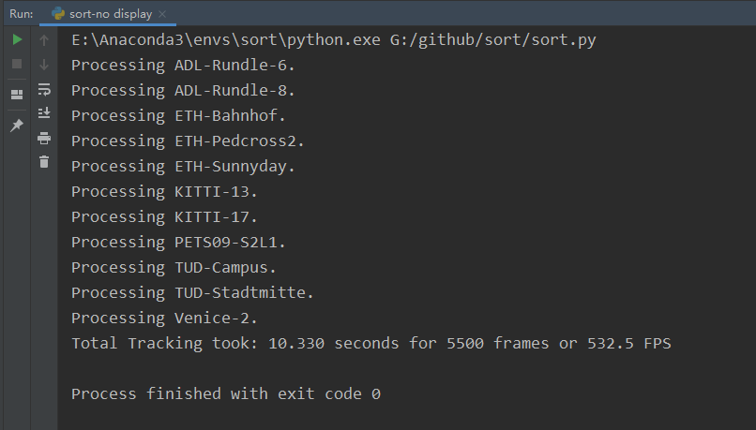
Content
I have tested the code of SORT. Since the method is direct, the tracking speed is really fast, about 530fps on my laptop with CPU.

Slide 7
Report End
程文胜 7.17

