Slide 1
Weekly Report
程文胜 2020.7.17-7.31

Slide 2
Weekly Report
Abstract
Content
End

Slide 3
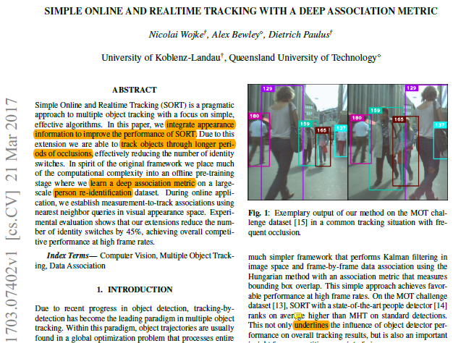
Abstract
In this week, I mainly put my effort on reading the classic Deep SORT paper and understanding the paper’s code.

Slide 4
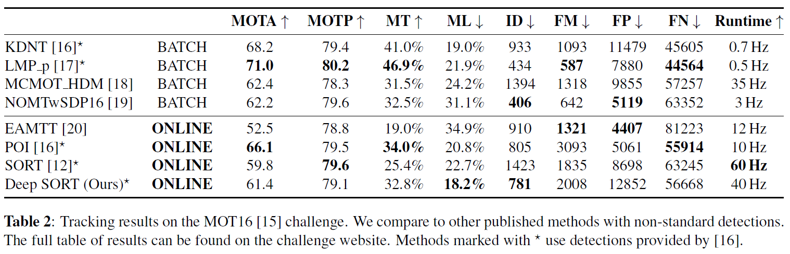
Content
Deep SORT integrates appearance information to improve the performance of SORT. Due to this extension it is able to track objects through longer periods of occlusions, effectively reducing the number of identity switches.

Slide 5




Content
Into the association problem formulation, Deep SORT integrates motion and appearance information through combination of two appropriate metrics.
Squared Mahalanobis distance of detections
And Kalman filter predictions
$$S=HP^{′}H^{T}+R$$
Normalized cosine distance of features
Weighted sum, lamda=0

Slide 6
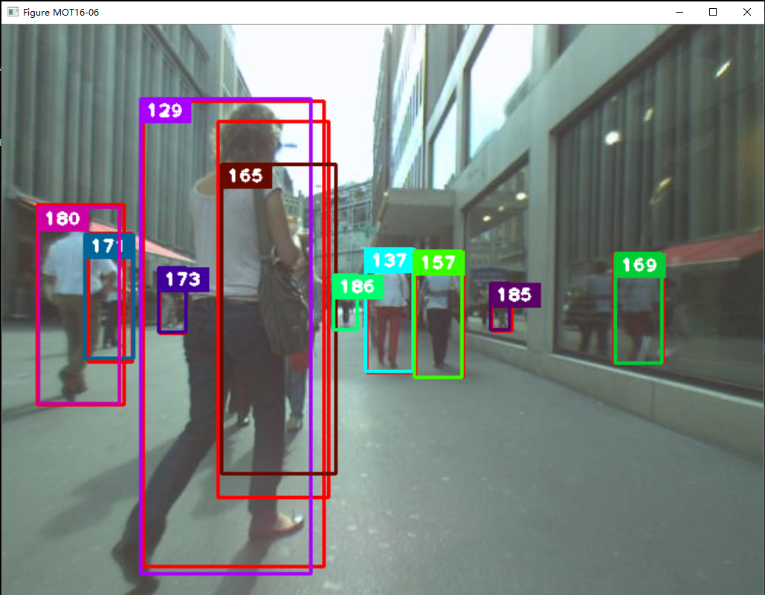
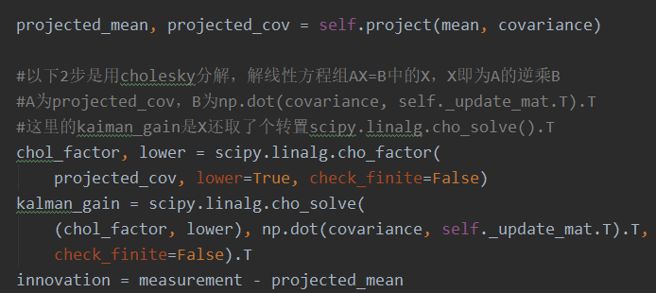
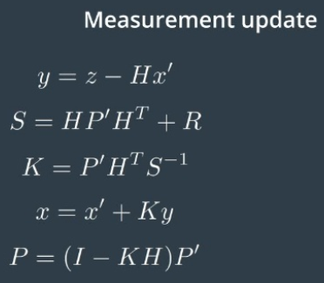
Content
I also tested the code of Deep SORT. It uses some tricks to do the Kalman
calculation. It uses Cholesky decomposition to get the inverse of matrix. But S matrix is a diagonal matrix, whose inverse matrix is easy to get.

Slide 7
Report End
程文胜 7.31

