Slide 1
Weekly Report
程文胜 2020.8.1-8.6

Slide 2
Weekly Report
Abstract
Content
End

Slide 3
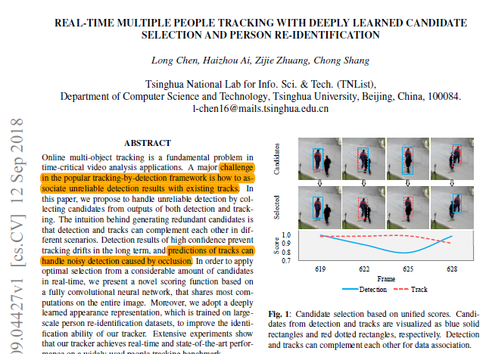
Abstract
In this week, I mainly put my effort on getting familiar with several classic paradigms, like MOTDT, GOTURN, D&T, Center Track.

Slide 4
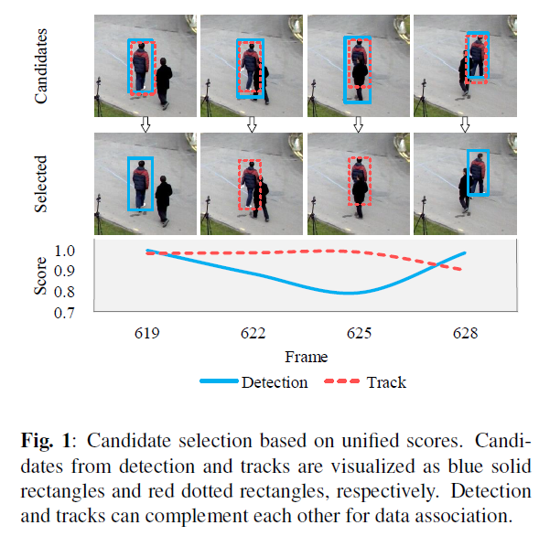
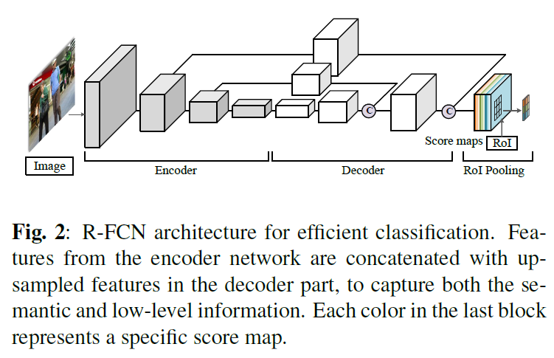
Content
MOTDT handles unreliable detection in online tracking by combining both detection and tracking results as candidates, and selecting optimal candidates based on deep neural networks.
Real-time Multiple People Tracking with Deeply Learned Candidate Selection and Person Re-Identification. ICME 2018.

Slide 5
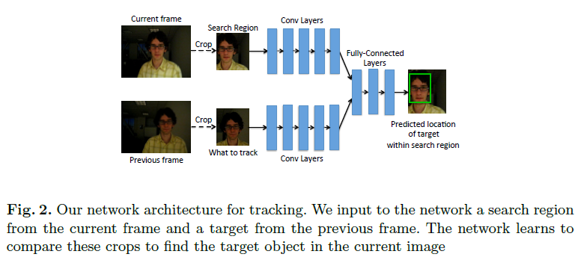
Content
GOTURN learns a generic relationship between object motion and appearance and can be used to track novel objects that do not appear
in the training set.
Learning to Track at 100 FPS with Deep Regression Networks. ECCV 2016. Cite:736.

Slide 6
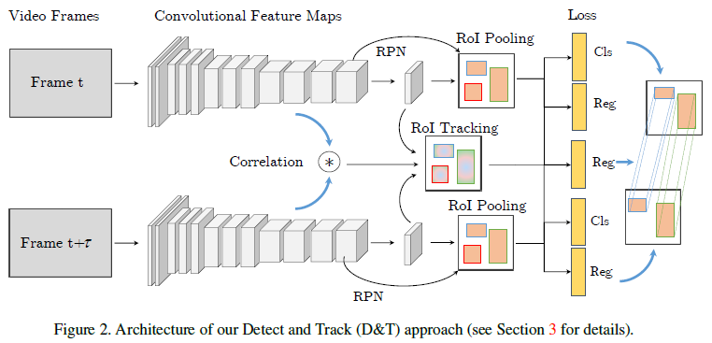
Content
D&T sets up a ConvNet architecture for simultaneous detection and tracking, using a multi-task objective for frame-based object detection and across-frame track regression.
Detect to Track and Track to Detect. ICCV 2017. cite:192.

Slide 7
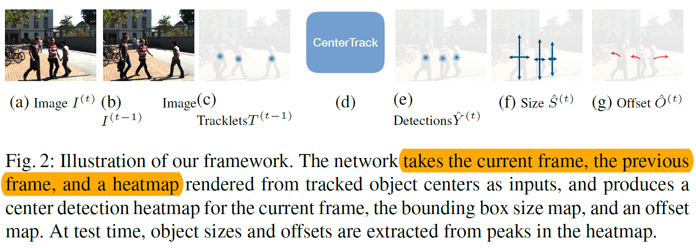
Content
CenterTrack, applies a detection model to a pair of images and detections from the prior frame. Given this minimal input, CenterTrack localizes objects and predicts their associations with the previous frame.
Tracking Objects as Points. ECCV 2020.

Slide 8
Report End
程文胜 8.6

