Slide 1
Weekly Report
程文胜 2020.8.31-9.6

Slide 2
Weekly Report
Abstract
Content
End

Slide 3
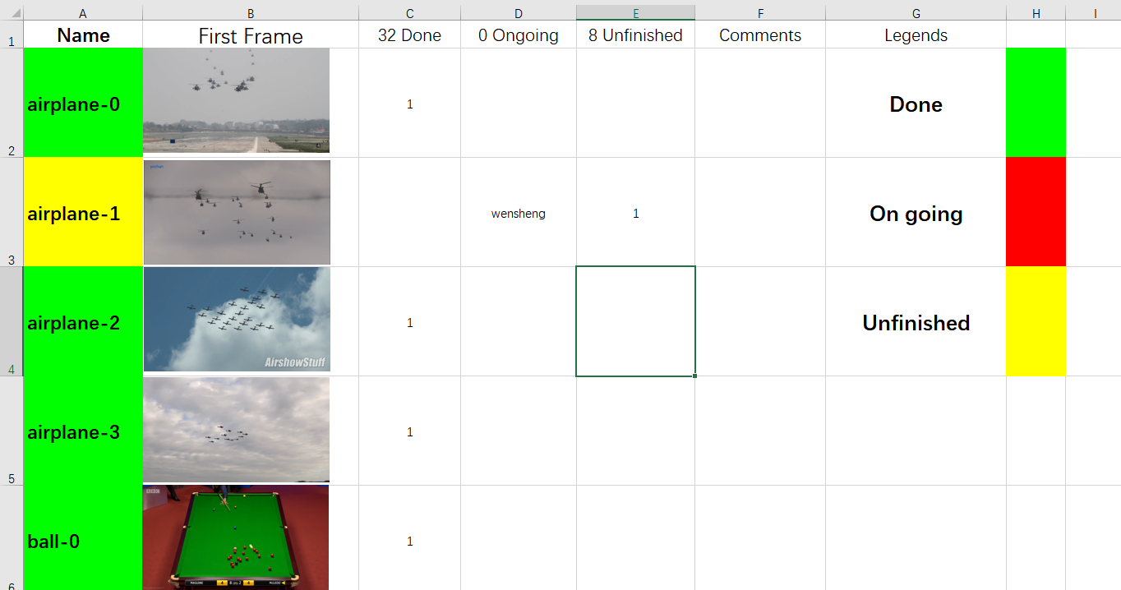
Abstract
In this week, I mainly put my effort on labeling the MOT images. There are totally 8 sequences left to be labeled, and I am responsible for 4 of them, i.e., airplane-1, fish-2, insect-3 and stock-2.

Slide 4
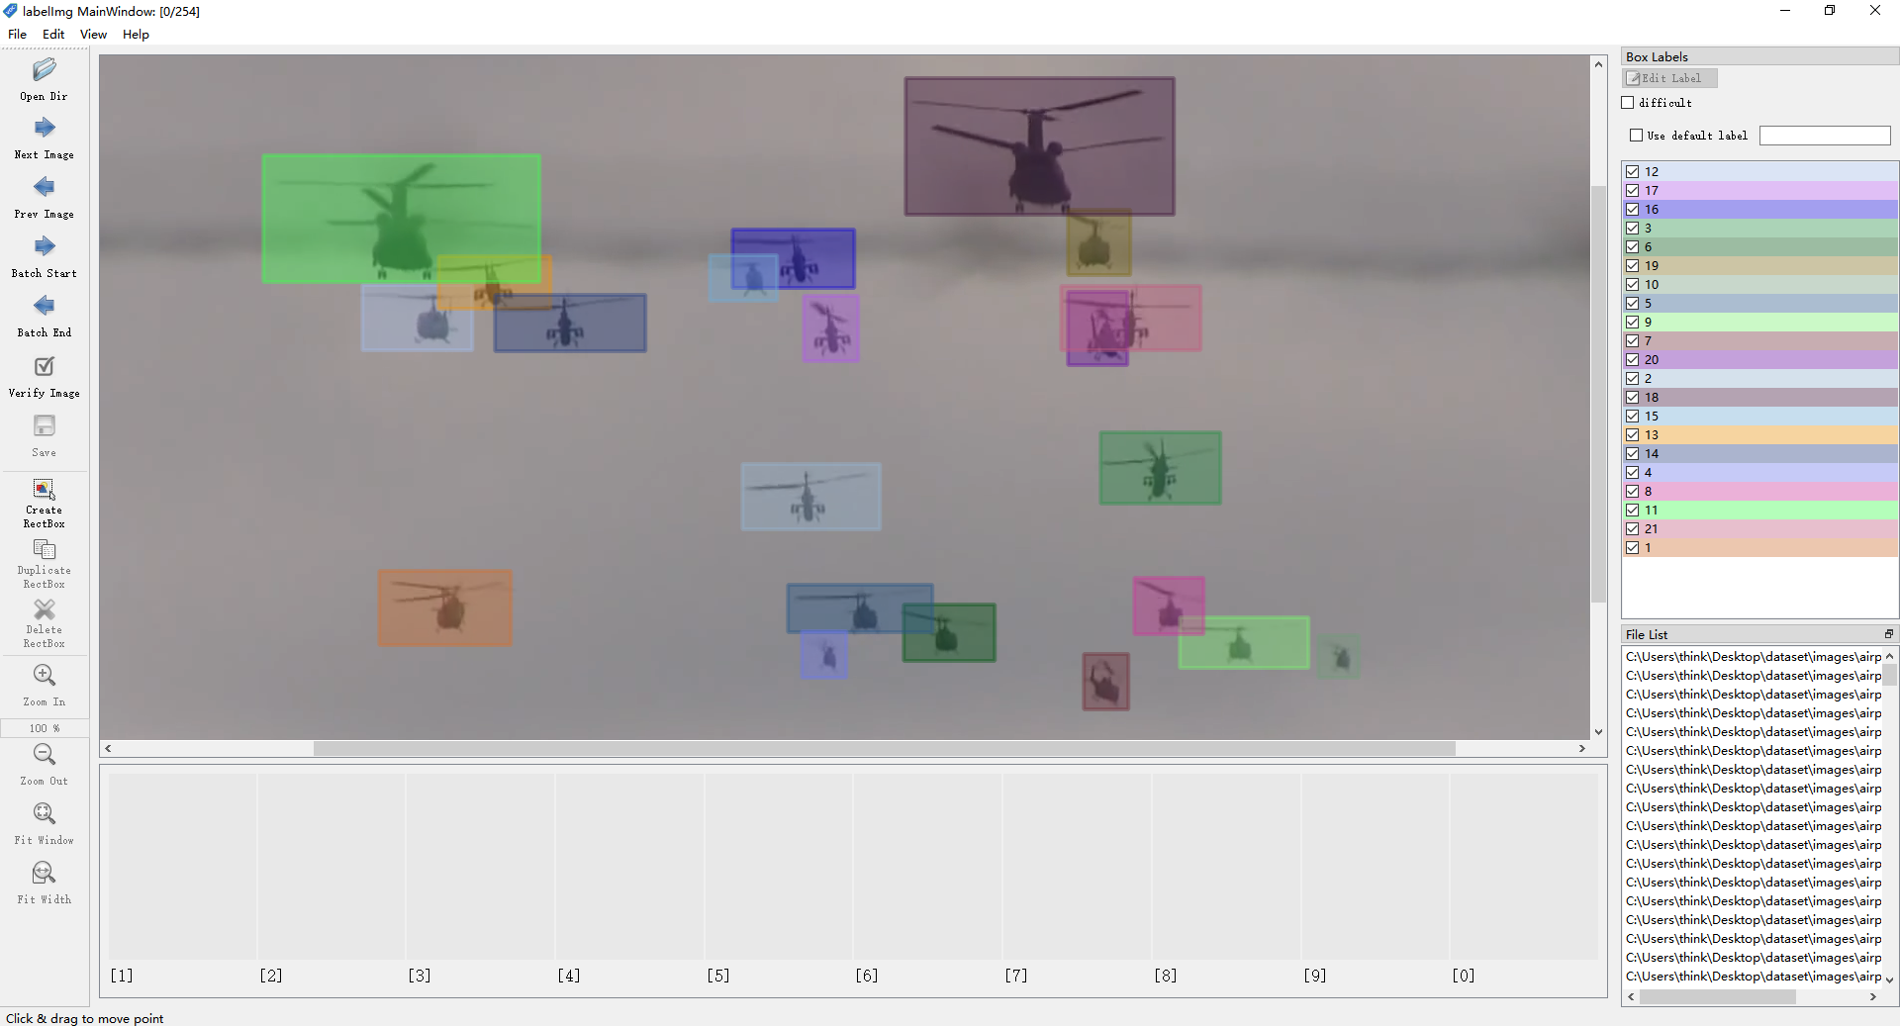
Abstract
I finished the airplane-1 sequence in this week. I estimate the speed is about 1 sequence per week, which matches with the historic labeling speed for these sequences. I also uploaded it to the shared GoogleDrive.

Slide 5
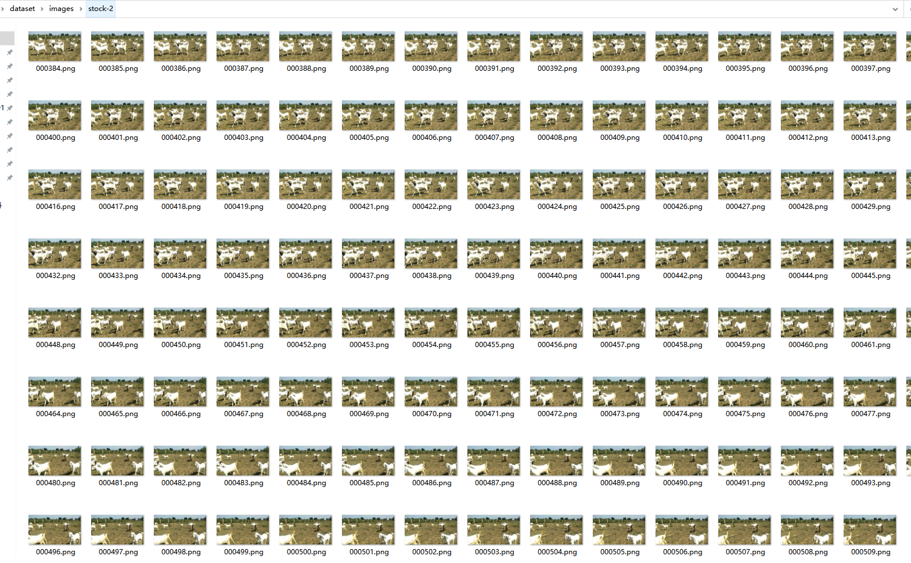
Content
About the sequence length, I’m not sure whether we should restrict it. Since many sequences have about 200-300 frames, while a few of them are very long, like the stock-2 has 510 frames.

Slide 6
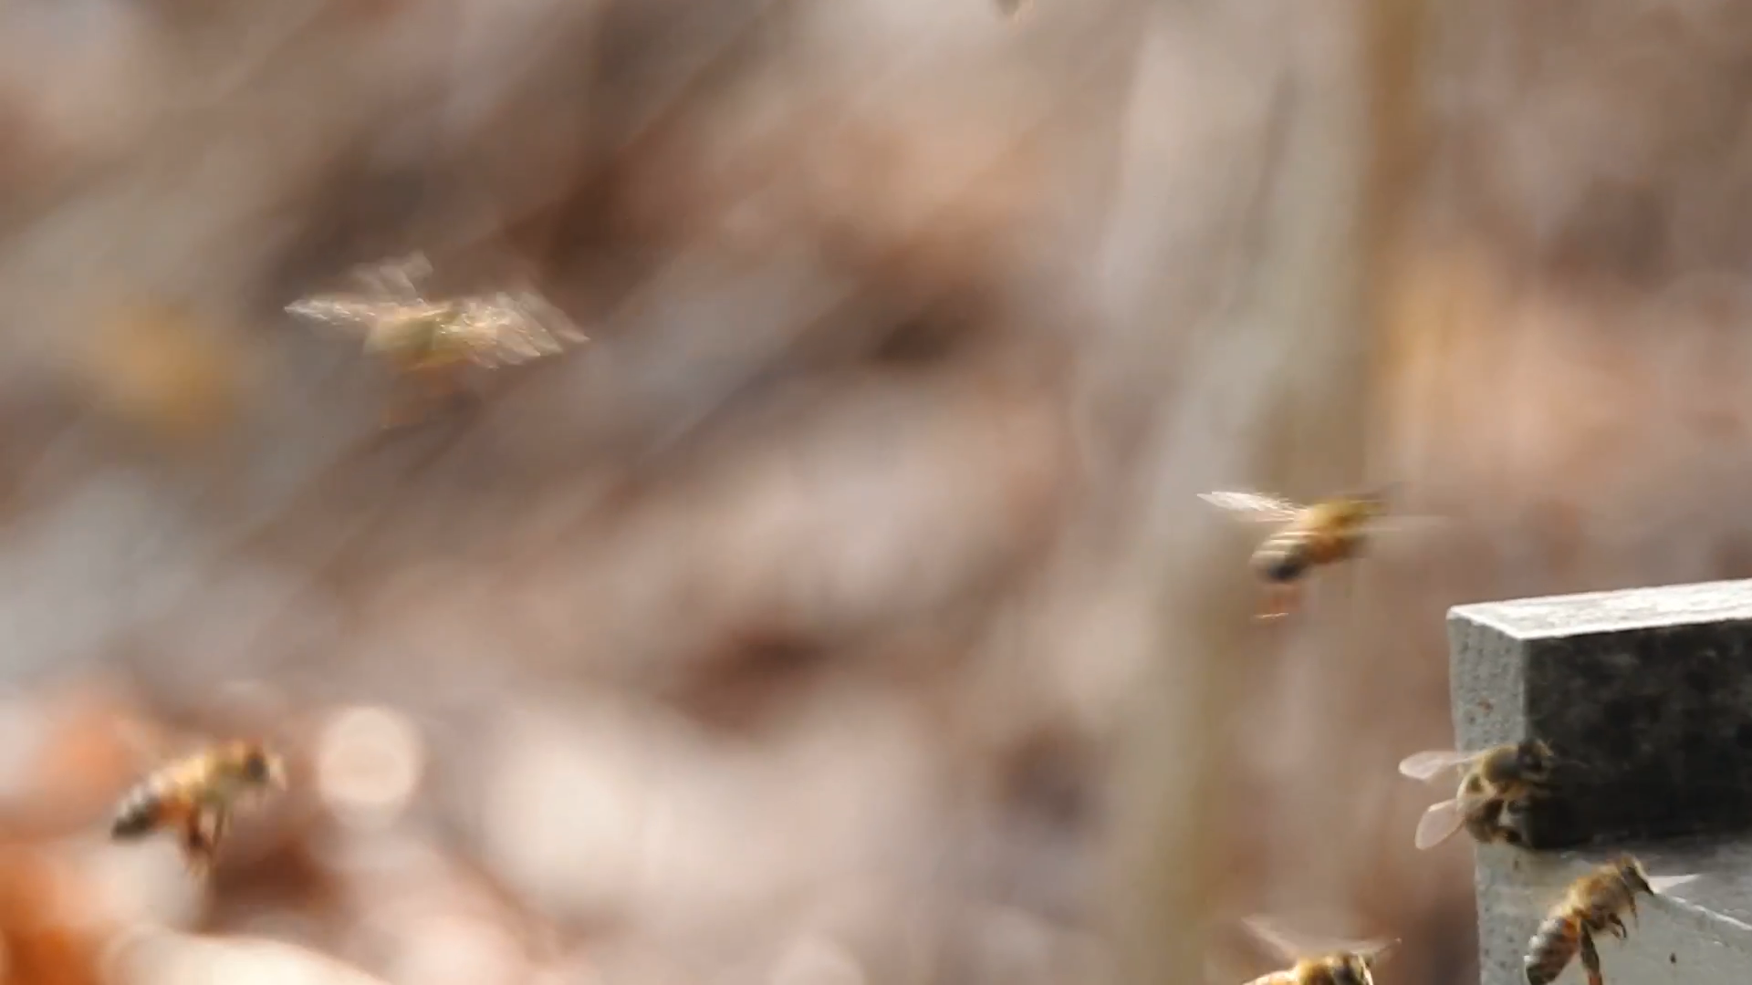
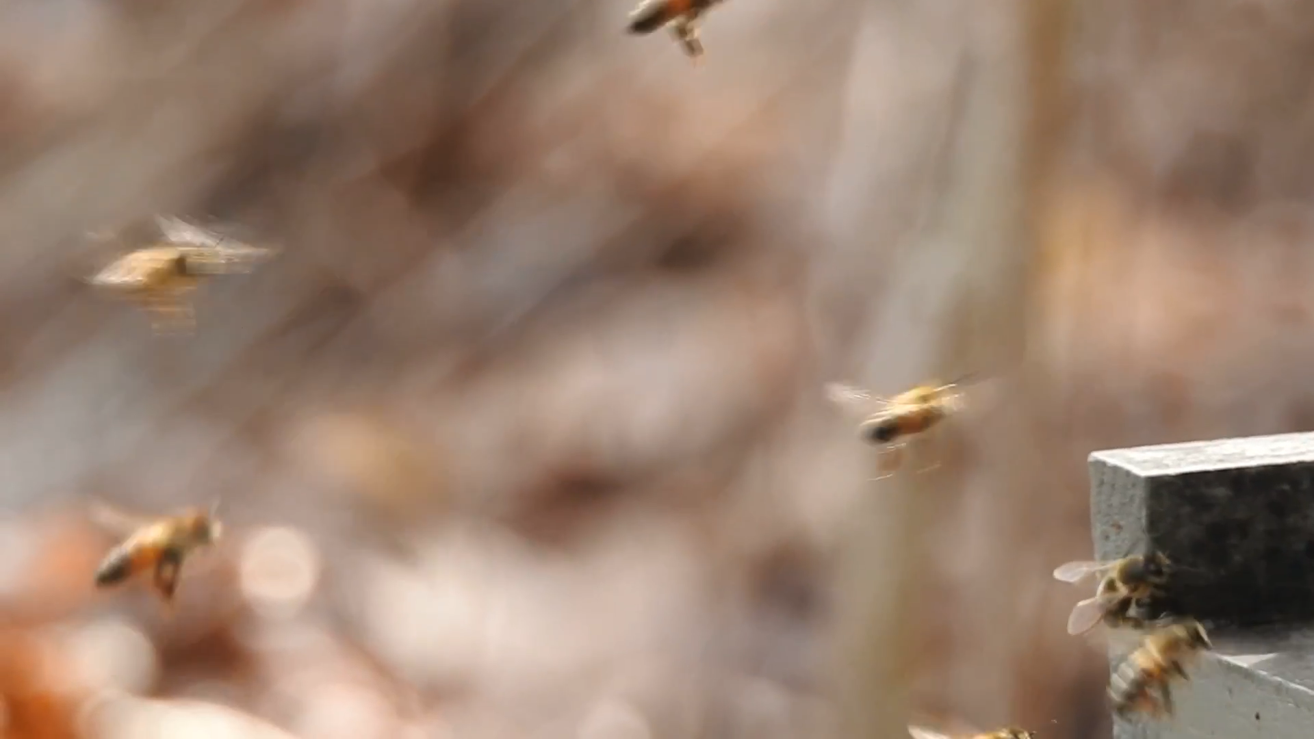
Content
About motion blur, how should we label them? If the object is really fuzzy in the whole motion process, but we can identify the tracklet of it, should we label or not?

Slide 7
Report End
程文胜 9.6

