Slide 1
Weekly Report
程文胜 2020.3.27-4.3

Slide 2
Weekly Report
Abstract
Content
End

Slide 3
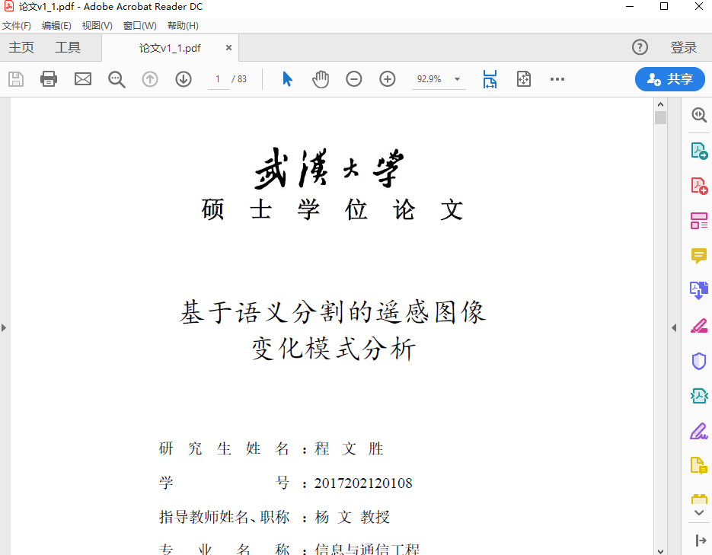
Abstract
This week I mainly put my effort on writing thesis.

Slide 4
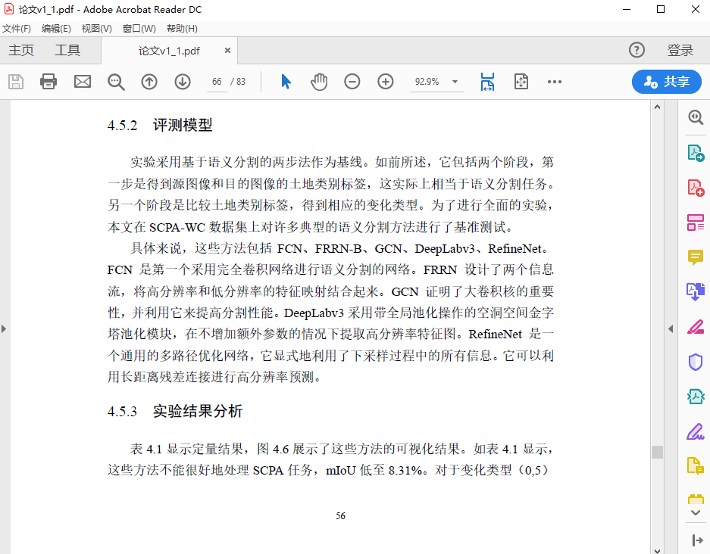
Content
I finished the draft in this week. After discussion with Prof. Yang, I need to adjust the semantic segmentation method and make it get better accuracy than other methods.

Slide 5
Report End
程文胜 VIPG

