Slide 1
Weekly Report
程文胜 2020.10.18-10.25

Slide 2
Weekly Report
Abstract
Content
End

Slide 3
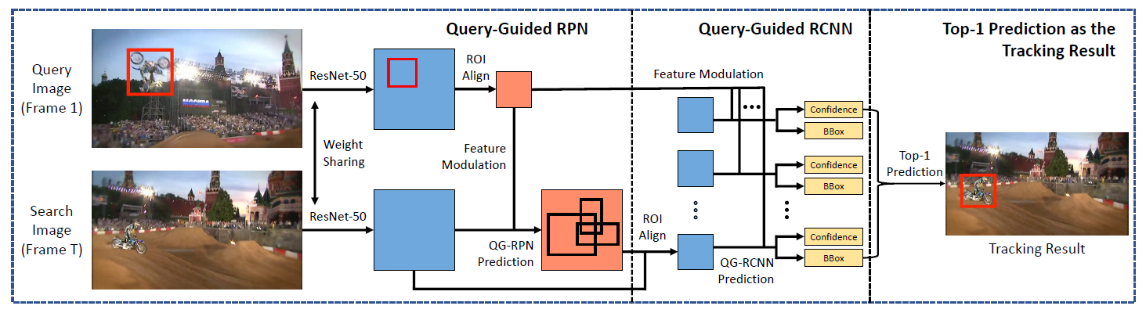
Abstract
After the class test finished in Saturday noon, I mainly focus on the Global Track framework.

Slide 4
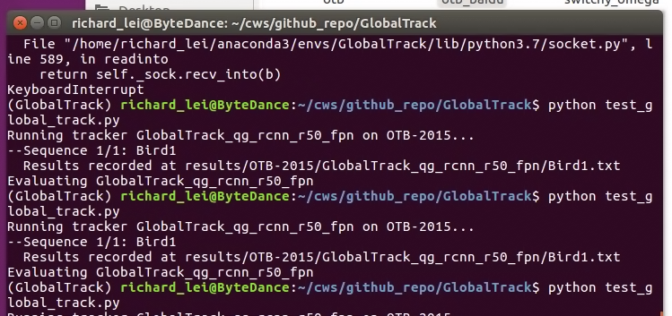
Content
I mainly spent time on setting the environment and testing the code. The network speed is really slow, and even though I chose the smallest predefined dataset OTB for the test, it took me half day to download on my laptop. I’m currently copying it from my laptop to the server, which would take 4-5 hours. I also tested with a single sequence in OTB, which worked ok on the server.

Slide 5
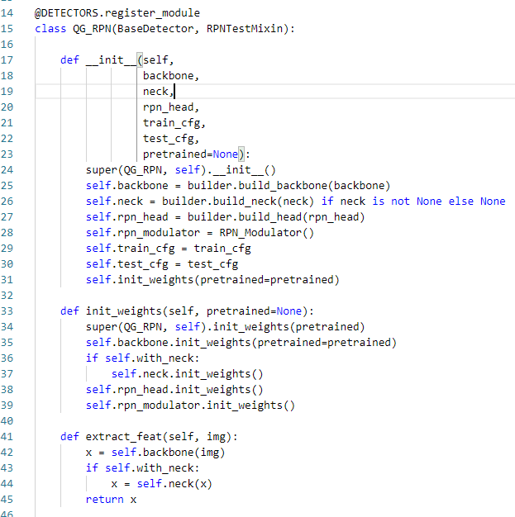
Content
After the copy, I would test it on the OTB dataset. Then I would change the code to get the feature map output after ROI align layer, and compare the features from different bboxes. I also found the tracker can return several matching bboxes, which would help our later work.

Slide 6
Report End
程文胜 10.25

