Slide 1
Weekly Report
程文胜 2019.3.2-2019.3.9

Slide 2
Weekly Report
Abstract
Content
Discussion

Slide 3
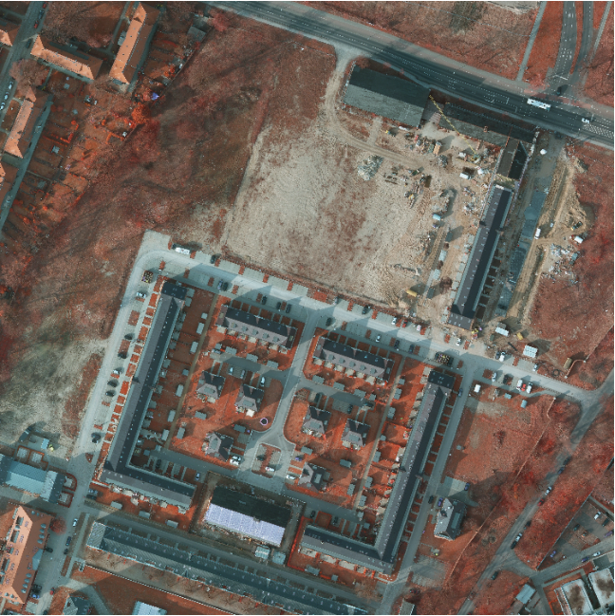
Abstract
This week I mainly put my effort on conducting experiments of Potsdam dataset and improving my model’s performance on Vaihingen dataset.
Potsdam sample image (6000* 6000)

Slide 4

Content
Last week, using multi-scale test method, I improved my model’s performance to 91.1% OA on Vaihingen dataset. This week I augmented training images with more rescaled images, and got 91.2% OA, which outperforms the best model till now.
Result on Vaihingen dataset

Slide 5
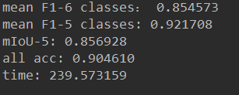
Content
I finished testing all baseline models on Potsdam dataset, which did cost a lot of time.
Then I trained my model with training images same as benchmark models to compare with them. I got a preliminary result of 90.4% OA, compared with 91.1% OA of the best model.
Result on Vaihingen dataset

Slide 6

Discussion
For Vaihingen dataset, I got 91.24% OA, which exceeds the best score 91.1% OA on Vaihingen dataset, not considering those results without paper.
For Potsdam dataset, I plan to train my model with more settings, especially with different data augmentation methods. Due to the large number of images, I’d adjust augmentation method carefully to get better performance with shorter training time.

Slide 7
Report End
程文胜 VIPG

