Slide 1
Weekly Report
程文胜 2020.9.13-9.20

Slide 2
Weekly Report
Abstract
Content
End

Slide 3
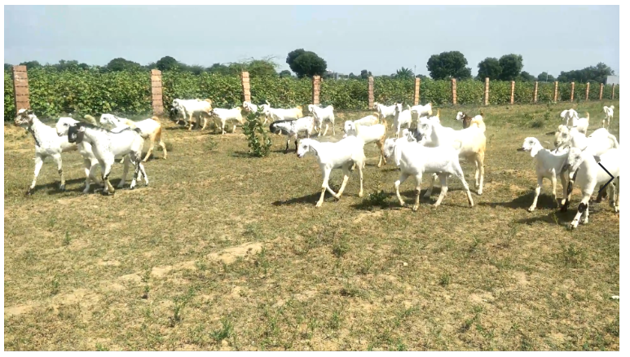
Abstract
In this week, I also put my effort on labeling the MOT images. I finished labeling the rest of bee sequence, and the goats sequence.

Slide 4
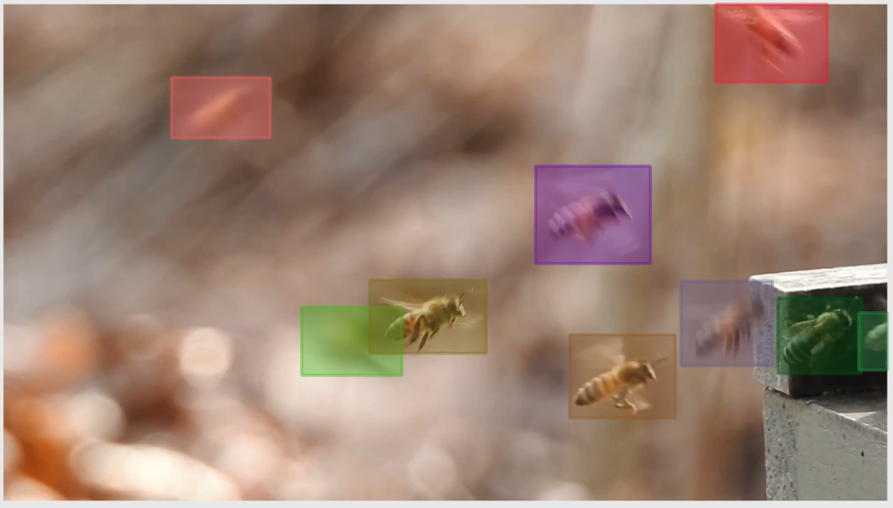
Content
I firstly finished the labeling of the bee sequence. Another special aspect for this sequence might be the short track. Many tracks are as short as 3 frames, and the shortest one has only 1 frame.

Slide 5
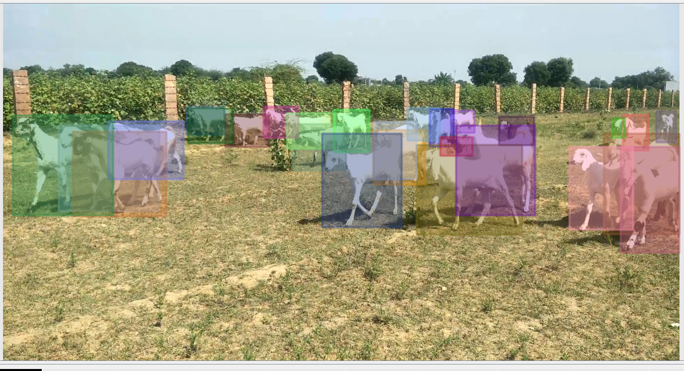
Content
I then labeled the goats sequence. The main property for this sequence might be occlusion. The view angle is horizontal and the density of goats is high. The deformation is mainly about its swinging long ears.

Slide 6
Report End
程文胜 9.20

