Slide 1
Weekly Report
程文胜 2021.5.31-6.7

Slide 2
Weekly Report
Abstract
Content
End

Slide 3
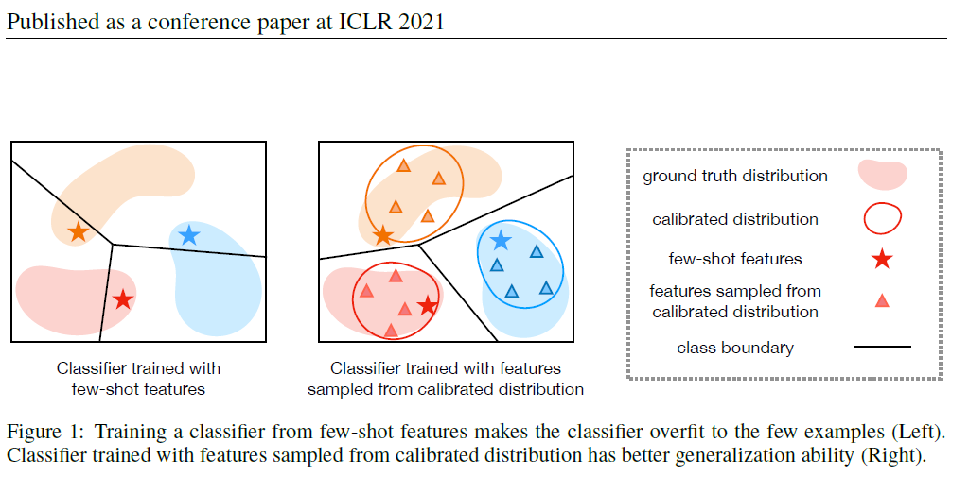
Abstract
Last week I mainly spent time on trying the method in distribution calibration paper, and discussing possible methods with senior Fan Yang.

Slide 4
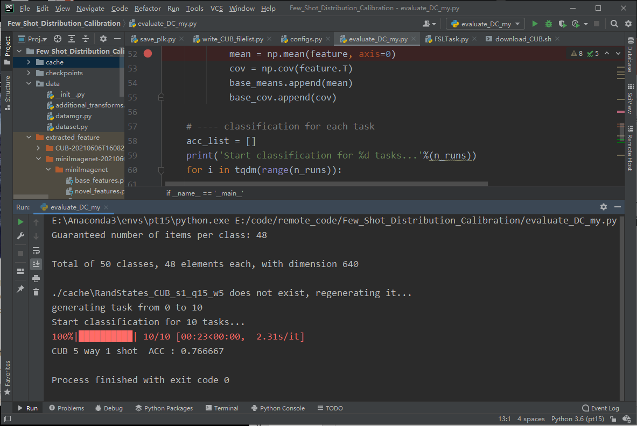
Content
I first tried the original code. After generating many pseudo samples with Gaussian distribution, it uses traditional classifiers, like SVM, Logistic Regression to do image classification.

Slide 5
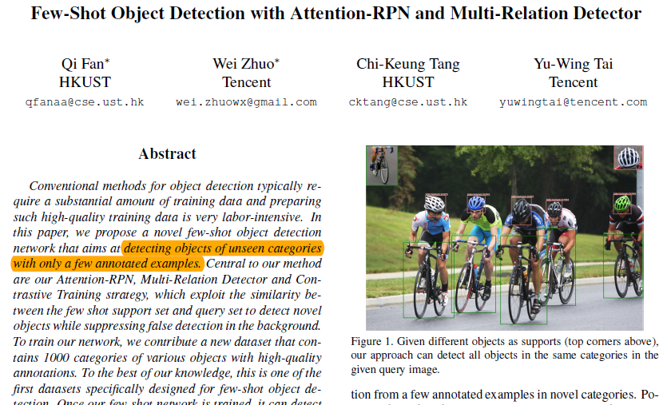
Content
Then I discussed with Senior Fan Yang, and we thought we should also try few shot object detection related works, since they are more related to our task.

Slide 6
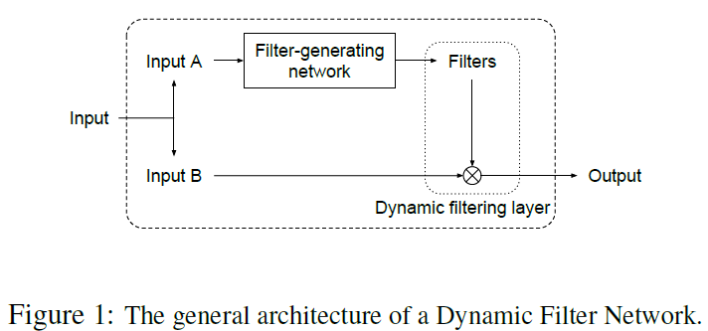
Content
Besides, we also discussed possible ways to learn the deformations of instance. We think we may use dynamic filter network to generate conv kernels, used as templates to do correlation with the input image.

Slide 7
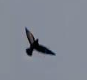
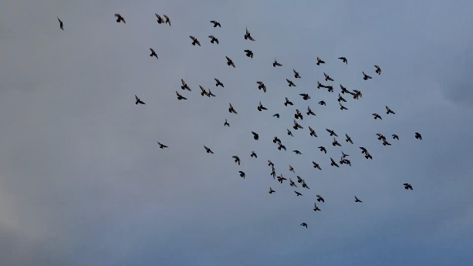
Content
Template
Feature Extraction Module
Template Feature
Add
Filter Generation Module
Conv Kernel
Input Image
Cls
Conv
Box
Input Image
Feature Extraction Module
Image Feature

Slide 8
Report End
程文胜 6.7

