Slide 1
Weekly Report
程文胜 2021.3.9-3.15

Slide 2
Weekly Report
Abstract
Content
End

Slide 3
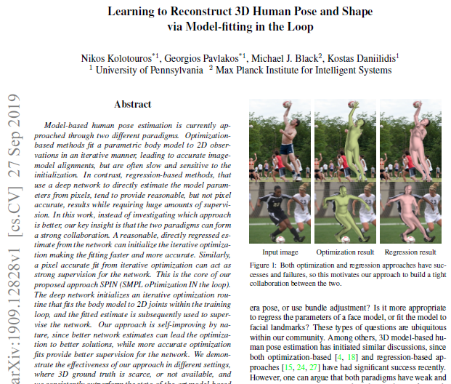
Abstract
Last week I mainly spent time on reading an influential human mesh recovery paper: Learning to Reconstruct 3D Human Pose and Shape
via Model-fitting in the Loop, and tried to run the HMR code.

Slide 4
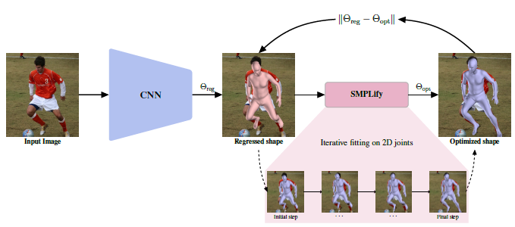
Content
The paper combines the strength of both optimization-based method and regression-based network method. The deep network initializes an iterative optimization routine that fits the body model to 2D joints within the training loop, and the fitted estimate is subsequently used to supervise the network.

Slide 5
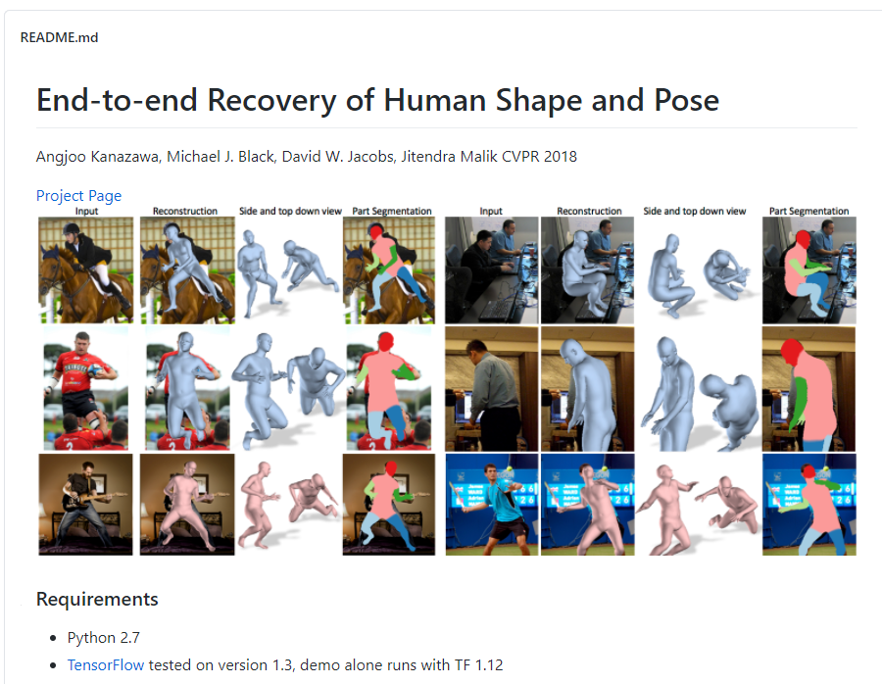
Content
I also spent time on running the code of HMR, which is a classic paper in this field. I’m currently configuring the code environment, since it’s an old method and those dependency packages need to be adjusted. I would mainly spend time on it for these days.

Slide 6
Report End
程文胜 3.15

