Slide 1
Weekly Report
程文胜 2020.6.25-7.2

Slide 2
Weekly Report
Abstract
Content
End

Slide 3
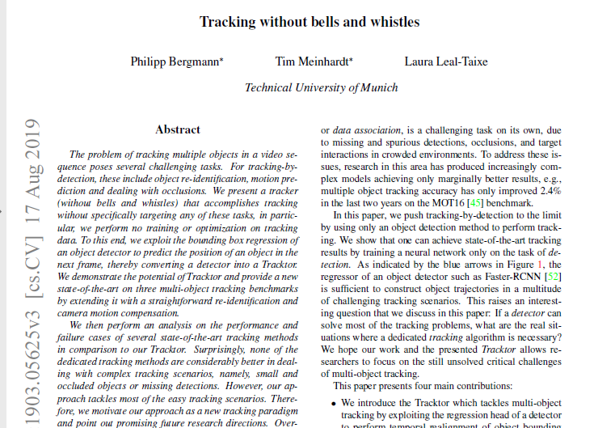
Abstract
In this week, I mainly put my effort on reading the Tracktor paper and running several MOT code.

Slide 4
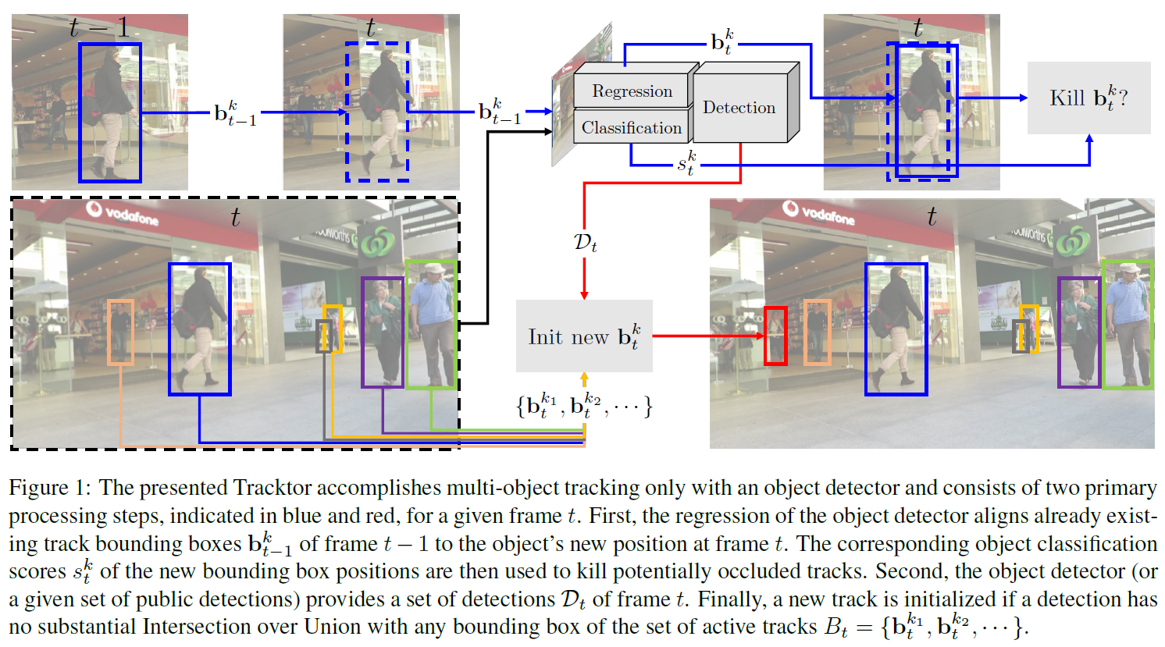
Content
Tracktor performs no training or optimization on tracking data. It exploits the bounding box regression of an object detector to predict the position of an object in the next frame, thereby converting a detector into a tracker.

Slide 5
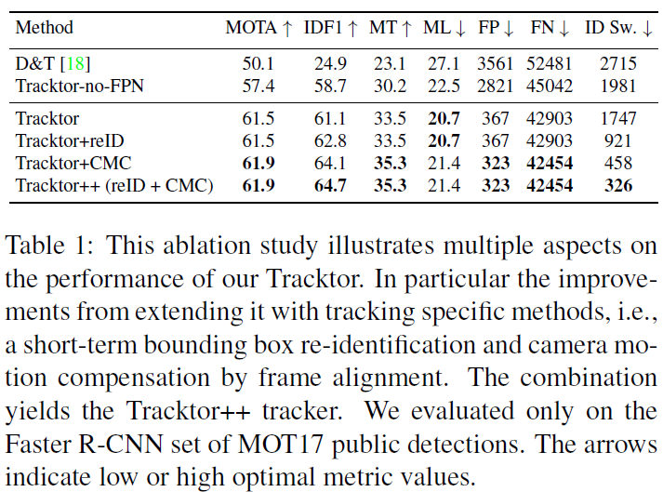
Content
Tracktor is added with a motion model and a reidentification algorithm. Both are aimed at improving identity preservation across frames and are common examples of techniques used to enhance, e.g., graph-based tracking methods.

Slide 6
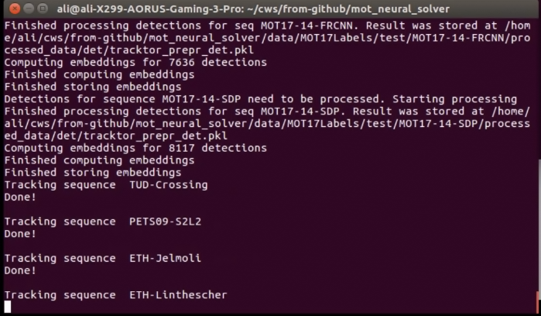
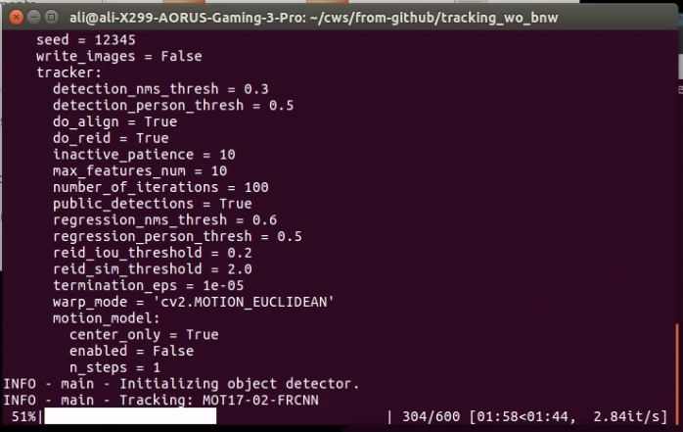
Content
I have tested code of 3 projects, including Tracktor, neural solver, and deformable surface tracking.
Neural solver
Tracktor

Slide 7
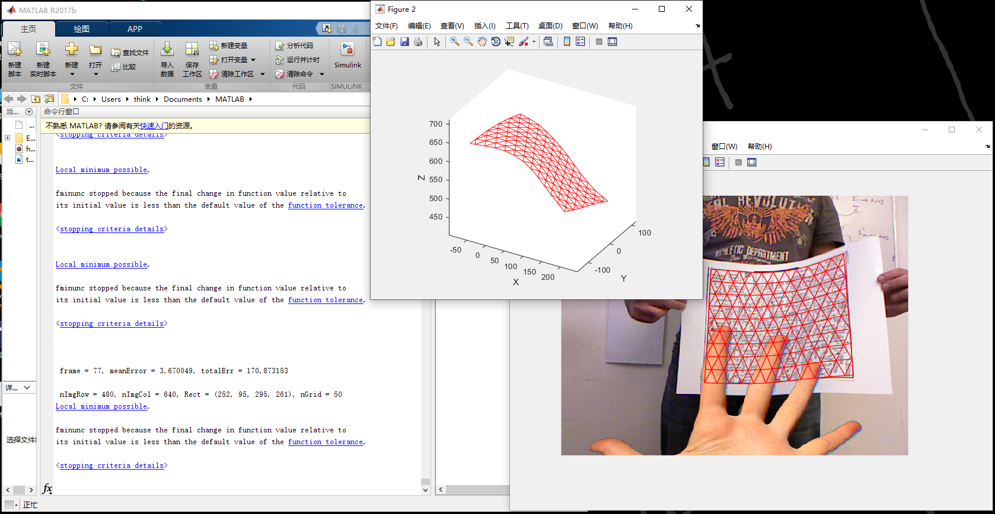
Content
The code of deformable surface tracking seems to be modified from another pami paper’s matlab code, Template-based Monocular 3D Shape Recovery using Laplacian Meshes. But the original link is broken.

Slide 8
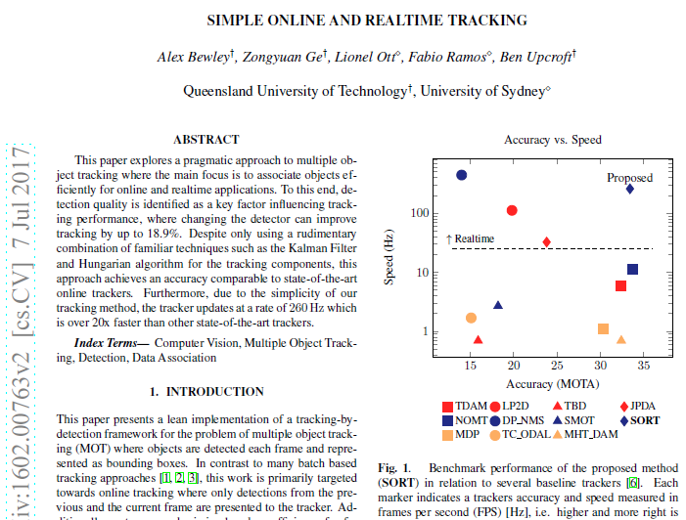

Discussion
I found MOT involves 3 fields: traditional methods, like motion model, Kalman filter; CNN, like detection, reID, SOT; and graph, classic ones and GNN/GCN. I plan to spend some time(not too short) to master these things. I would begin from SORT, and check the code line by line.

Slide 9
Report End
程文胜 7.2

