Slide 1
Weekly Report
程文胜 2021.5.17-5.25

Slide 2
Weekly Report
Abstract
Content
End

Slide 3
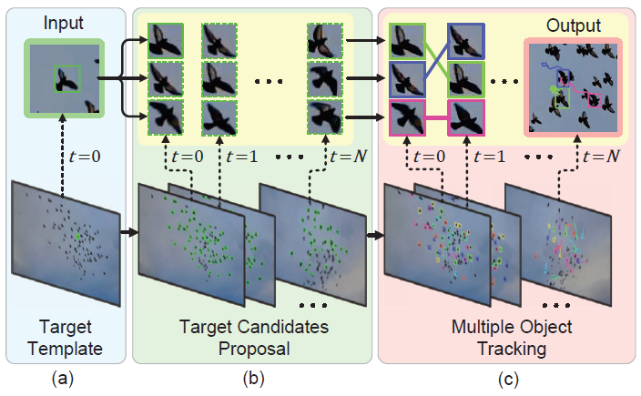
Abstract
Last week I mainly spent time on thinking about the problem, and tried the GlobalTrack model without training on SOT datasets.

Slide 4
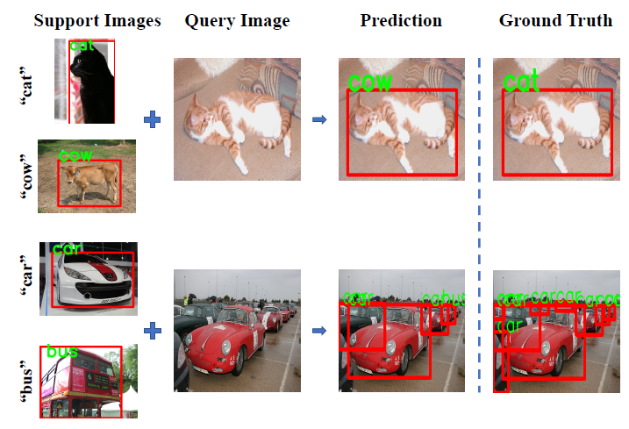
Content
The difference between few shot learning task and our one shot GMOT task is the object belongs to a new class for one shot learning task, while it is not necessary in GMOT task.

Slide 5
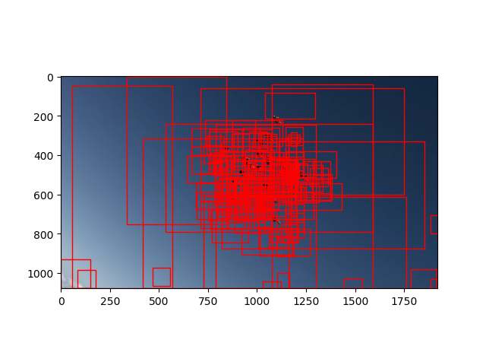
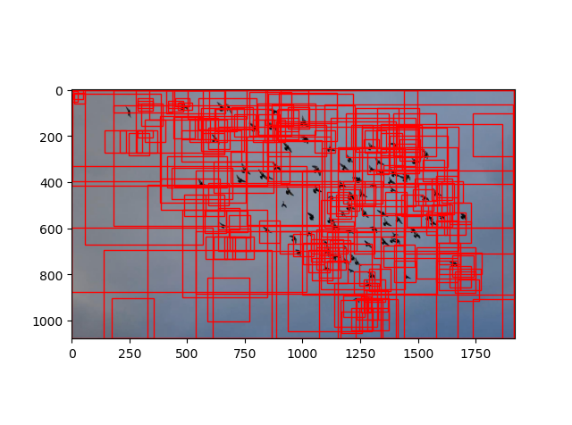
Content
Considering the influence of instance-level feature learned in the SOT process, I tried the model without pretraining on SOT benchmarks, but the result is terrible. I think this is due to the random initialization.

Slide 6
Report End
程文胜 5.25

