Slide 1
Weekly Report
程文胜 2018.10.28-11.3

Slide 2
Weekly Report
Abstract
Content
Discussion

Slide 3
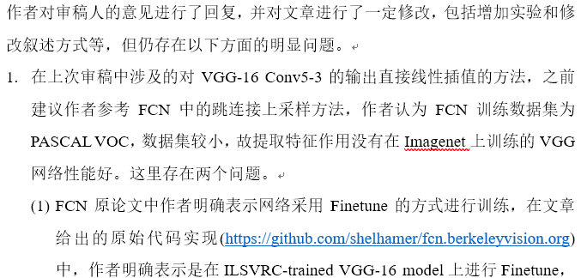
Abstract
This week I mainly put my effort on reviewing the semantic segmentation paper and thinking of the semantic segmentation project.
The review opinion

Slide 4
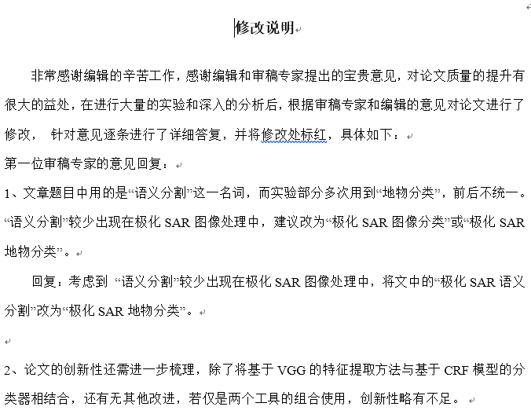
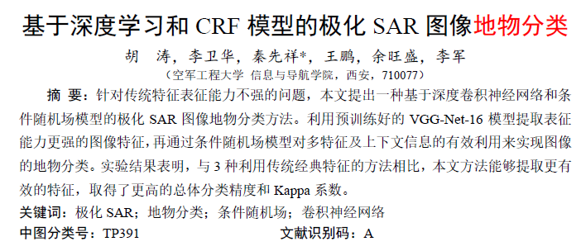
Content
From the author’s response to reviewer’s opinion and corresponding adjustments on paper, I got to know what the reviewers care and how authors should response.

Slide 5

Discussion
About reviewer’s opinion, although it may be unsuitable for author’s original purposes, author should be polite and mild, especially do not despise reviewer.
About the paper itself, it compared its accuracy with traditional methods and compared its complexity with deep learning method, which is really unconvincing. This is kind of cunning and should be avoided in quality papers.

Slide 6
Report End
程文胜 2018.10.28-11.3

