Slide 1
Weekly Report
程文胜 2018.11.24-12.1

Slide 2
Weekly Report
Abstract
Content
Discussion

Slide 3
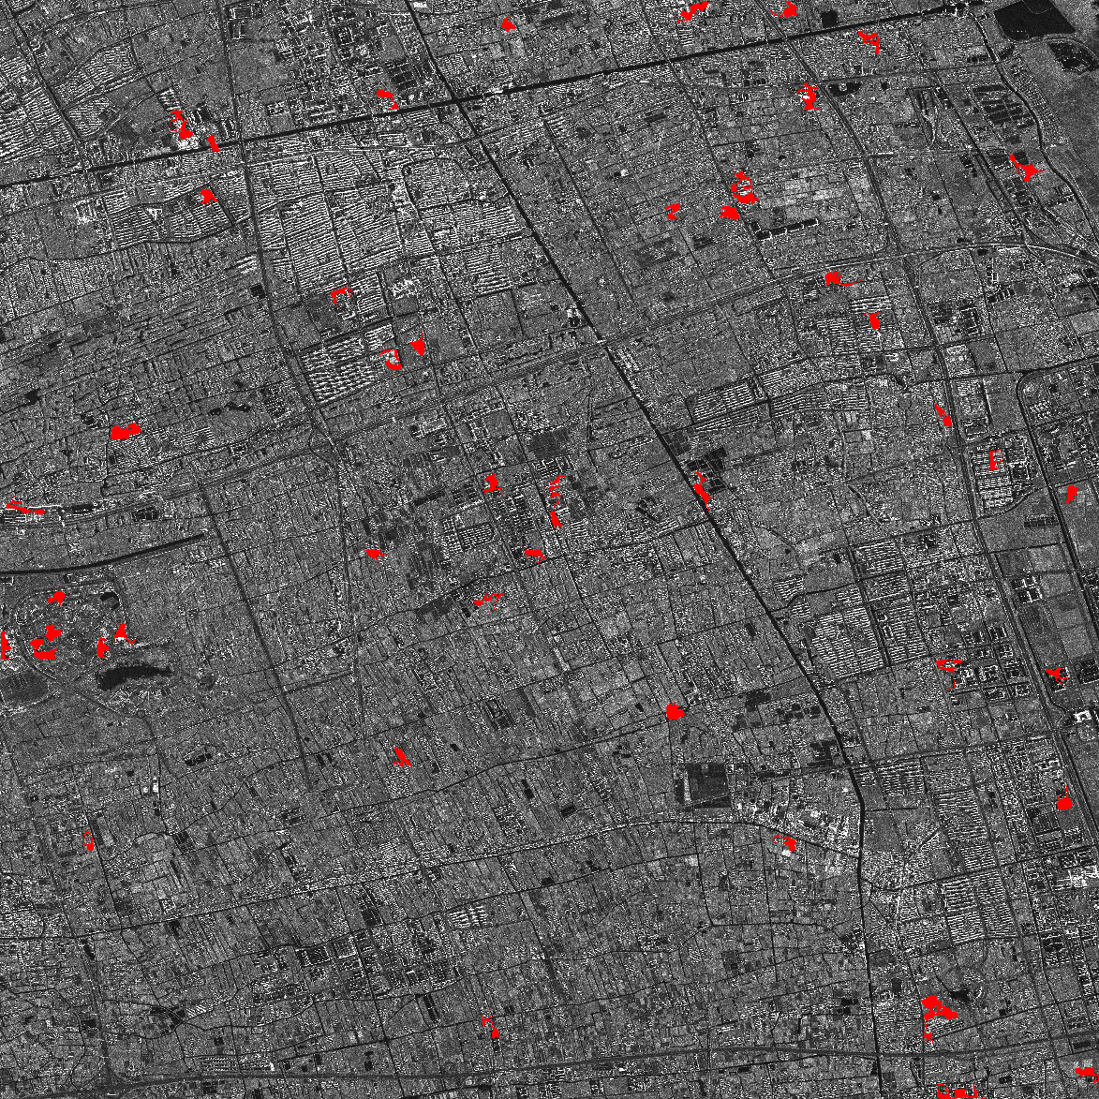
Abstract
This week I mainly put my effort on reviewing semantic segmentation results of Shanghai SAR image and making PPT slides.
Image on the right is the change detection result for buildings with red mask.
Change detection result

Slide 4
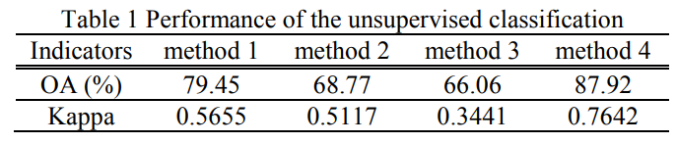
Content
About evaluation metrics, for remote sensing field, we use overall accuracy(OA) and kappa score. Table.A is our quantitative result of Shanghai City SAR image. At first, I feel weird that Kappa is much smaller than accuracy and F1 score. After checking its definition, calculating it by hand and looking through related papers, I found it’s reasonable. For example, Table.B is the result of junior Xiangli Yang’s paper. It shows high OA(87.92%) vs. lower Kappa score(0.76).
 | Accuracy | Kappa | F1 score
RefineNet | 85.99% | 0.6720 | 0.7730
Table A. Our result
Table B. Xiangli Yang’s paper
Yang X , Tu S , Bai Y , et al. Fusion of intensity/coherent information using region covariance features for unsupervised classification of SAR imagery[C]. Geoscience & Remote Sensing Symposium. IEEE, 2016.

Slide 5
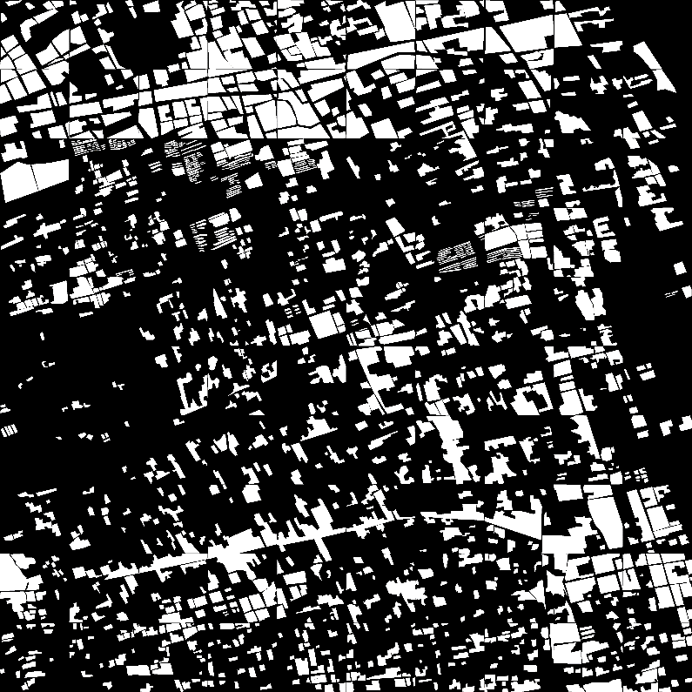
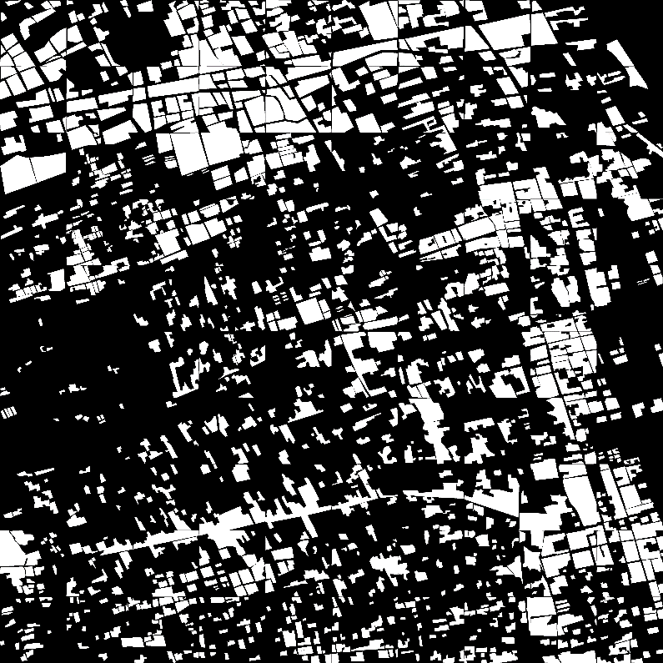
Content
About data annotation, since undergraduates’ label standards aren’t consistent, we need to correct this. Specifically, some students label nearby buildings as a whole, including slender roads between them, while others tend to label them separately. Considering practical situation, we choose to label nearby buildings as a whole.
GT before
After

Slide 6

Discussion
For machine learning problems, the annotation quality is of great importance. It influences model’s performance directly.
After revising labels, performance has gained obvious improvement. Accuracy increased from 84.59% to 85.99%, and Kappa increased from 0.6307 to 0.6720, F1 from 0.7386 to 0.7730 as well.
For future label work, we need to set up consistent standards and check undergraduates’ labels, or let them check crossly. It’s necessary to make a dataset with high quality annotation.

Slide 7
Report End
程文胜 VIPG

