Slide 1
Weekly Report
程文胜 2018.12.14-12.21

Slide 2
Weekly Report
Abstract
Content
Discussion

Slide 3
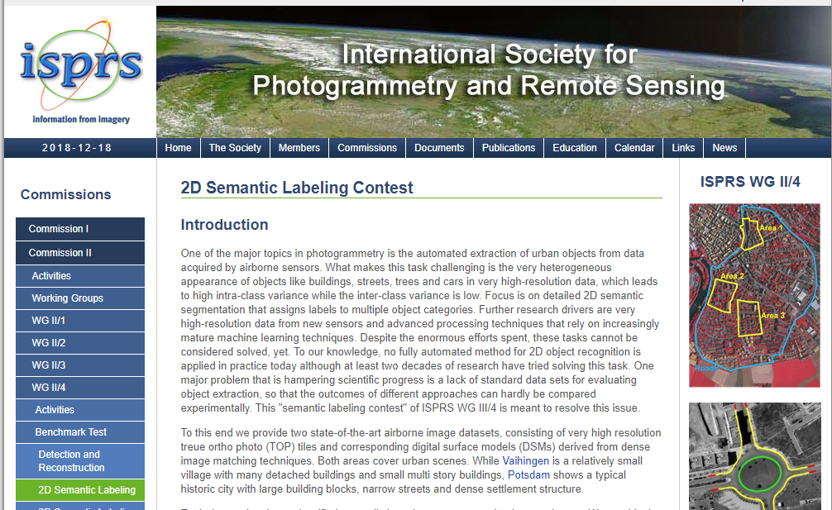
Abstract
This week I mainly put my effort on writing project files and finding common high resolution datasets of remote sensing field.
ISPRS contest

Slide 4
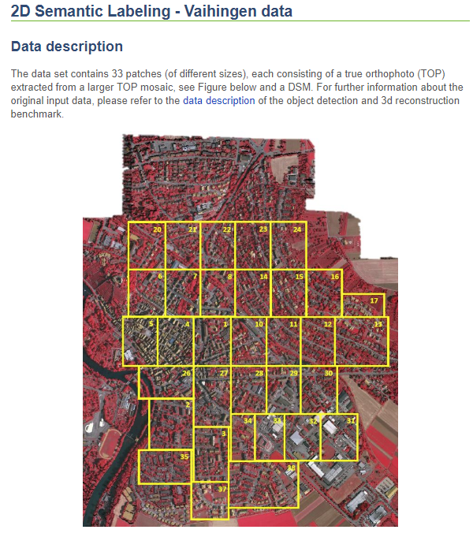
Content
Since results of SAR buildings are not so convictive, so I turn to other public datasets, mainly about optical images. After reading relevant papers, I found two common datasets, Vaihingen and Postdam, about semantic segmentation on remote sensing images.
Vaihingen data

Slide 5
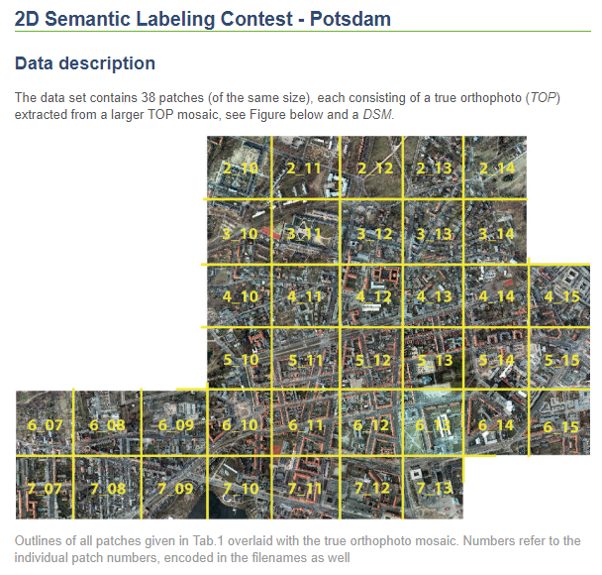
Content
They are benchmark datasets for ISPRS 2D semantic labeling challenge. They consist of 3-band IRRG image data and corresponding DSM. Vaihingen dataset has 33 images of ~2500* 2500 images, and Postdam has 38 images of ~6000* 6000 images. Like these papers, we don’t use DSM information.
Postdam data

Slide 6

Discussion
Dataset is important, and label quality matters. It’s hard to explain weird results, especially when you get a bad dataset.
To be more credible, I plan to do some baseline experiments to get preliminary results, following existing papers. By observing these results and comparing them with performance reported by papers, it would make sure these datasets and baseline models are reliable. Then we could move ahead.

Slide 7
Report End
程文胜 VIPG

