Slide 1
Weekly Report
程文胜 2019.4.7-2019.4.13

Slide 2
Weekly Report
Abstract
Content
Discussion

Slide 3

Abstract
This week I mainly put my effort on the journal paper and workshop camera-ready paper.

Slide 4
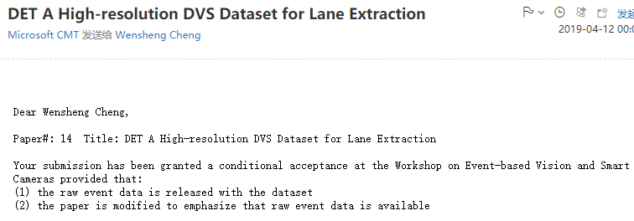
Content
At first, we got reviews from 4 reviewers. 3 of them gave accept and 1 rejected. The main weakness is the lack of raw event data. Then the committee gave us another chance to provide the raw data. We agreed and got a conditional acceptance.

Slide 5
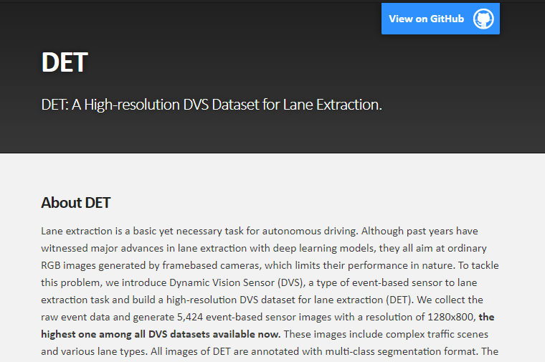
Content
We then revise the paper as suggested by these reviewers. We emphasize that the raw event data is available, though it’s really large, about 240 GB. We then make a website of our dataset on GitHub for people interested in our work.

Slide 6

Discussion
There are 2 reasons we didn’t provide raw event data at first. One is considering the application target: lane extraction and methods designed for this task, which are all based on frame-based images, we have to use images to deal with this task, rather than event data. The other one is the raw event data is too large to be provided publicly easily.
After receiving these comments, I turn to other DVS datasets and found that they do provide raw event data. So this seems to be a habit for event camera dataset, and we’d better follow this.

Slide 7
Report End
程文胜 VIPG

