Slide 1
Weekly Report
程文胜 2019.10.21-10.27

Slide 2
Weekly Report
Abstract
Content
End

Slide 3
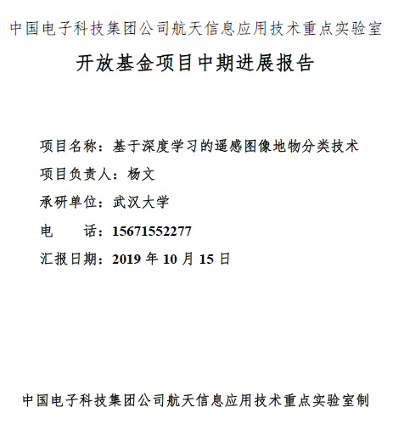
Abstract
This week I mainly put my effort on dealing with CETC 54 project and discussing paper-related experiments with Luo Hao.

Slide 4
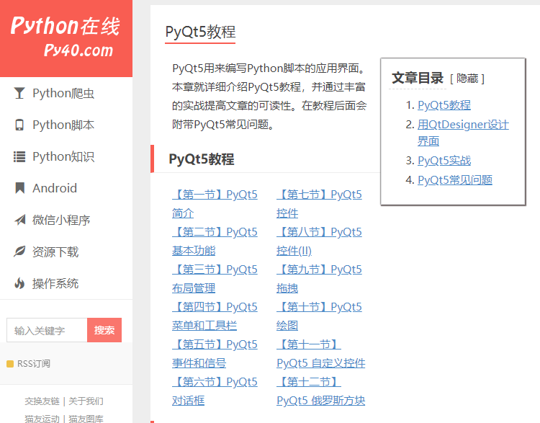
Content
We have arranged files about CETC 54 project, including mid-term meeting. We made tasks clearer and assigned tasks to people. I need to coordinate with them and make sure everything goes well.

Slide 5
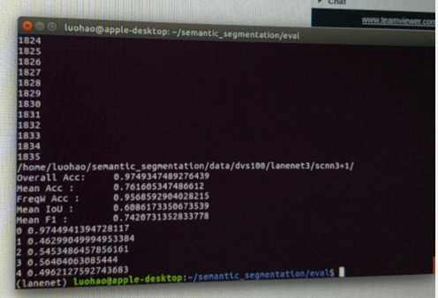
Content
I also discussed with Luo Hao about paper experiments. The optical dataset experiment has been done, but the post-processing experiment shows negative results. We need to clarify it in the paper.
Experimental result

Slide 6
Report End
程文胜 VIPG

