Slide 1
Weekly Report
程文胜 2019.10.28-11.2

Slide 2
Weekly Report
Abstract
Content
End

Slide 3
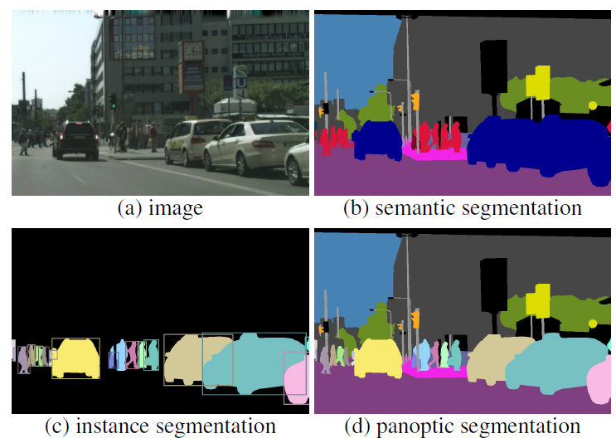
Abstract
This week I mainly put my effort on discussing CETC 54 project with Zhao Jialin and preparing my own application files.

Slide 4
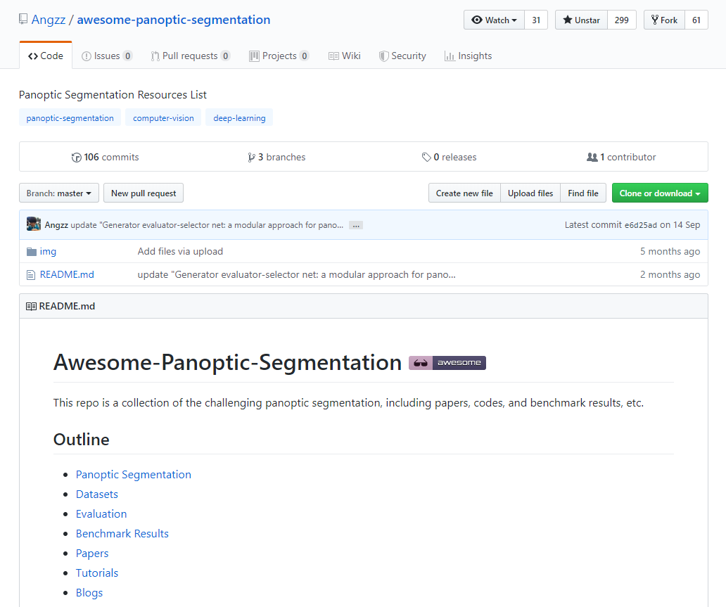
Content
Since Zhao Jialin would focus on semantic segmentation field, I talked with him about the learning route and what skill he needs to master. I also suggested that he could read some panoptic segmentation paper and try to do some related work.

Slide 5
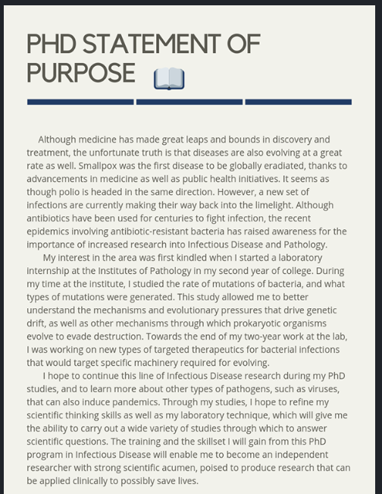
Content
I also have prepared some of my own application files, like statement of purpose(SOP) and motivation letter. During the process, I found they could help me to organize my thoughts and know what to do. I think Ph.D students in our lab could write them before starting their research.

Slide 6
Report End
程文胜 VIPG

