Slide 1
Weekly Report
程文胜 2019.12.7-12.12

Slide 2
Weekly Report
Abstract
Content
End

Slide 3
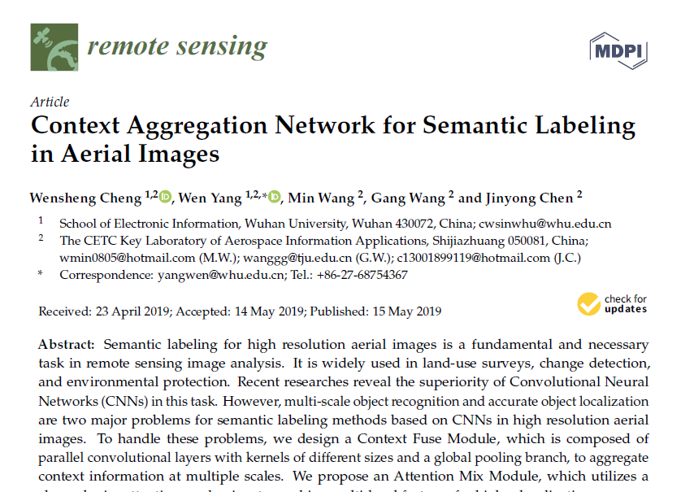
Abstract
This week I mainly put my effort on preparing 2 reports.

Slide 4
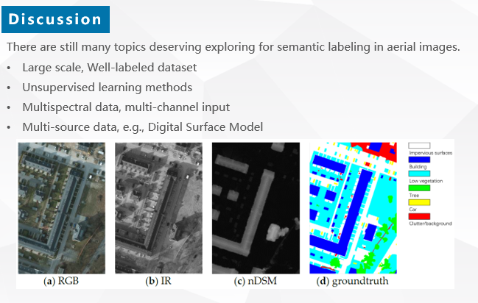
Content
One is about the RS paper. Prof. Antonio Plaza is very experienced in remote sensing field, and he also thinks data fusion is helpful for semantic segmentation in aerial images.

Slide 5
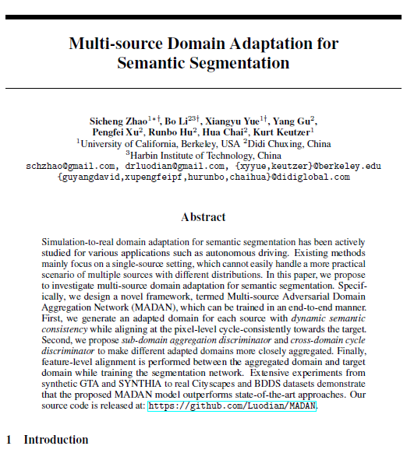
Content
Another report is about multi-domain adaptation. This is a hot topic in recent years. Because it can help deal with unsupervised tasks, using other well-labeled data. This task is really meaningful and deserves exploration.

Slide 6
Report End
程文胜 VIPG

