Slide 1
Weekly Report
程文胜 2019.1.3-2020.1.11

Slide 2
Weekly Report
Abstract
Content
End

Slide 3
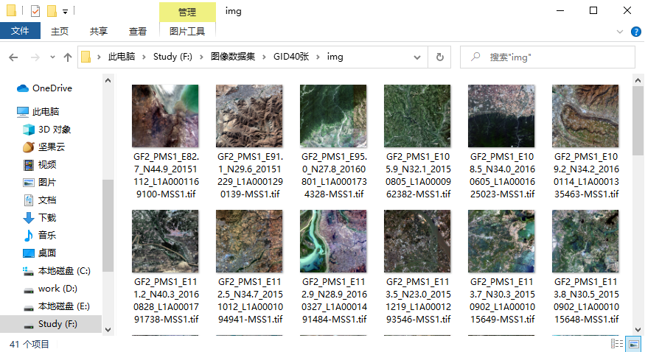
Abstract
This week I mainly put my effort on training models for the CETC 54 project.

Slide 4
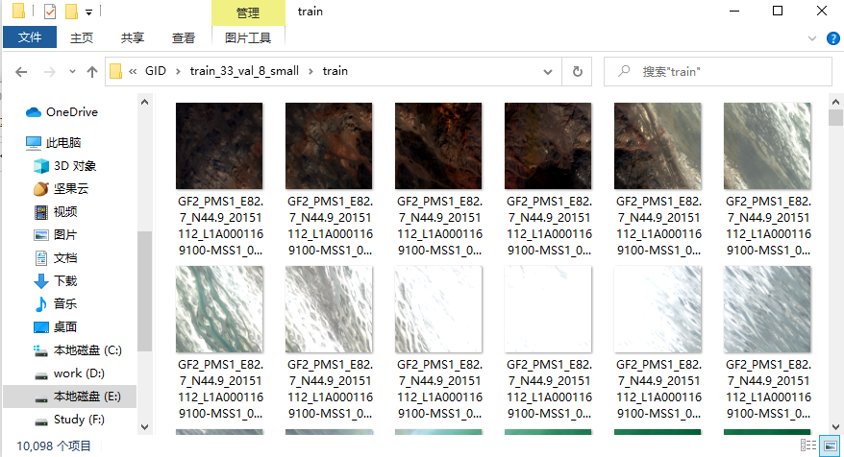
Content
We have 41 large images of Gaofen 2 satellite. These image are labeled with 15 classes. I cropped them into 10098 image patches with size of 512*512 as training set, and 1680 image patches as test set.

Slide 5
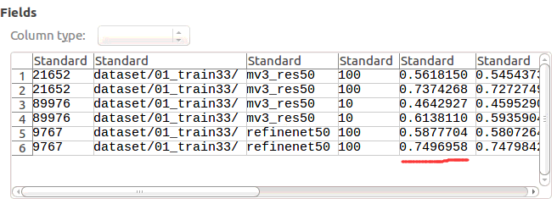
Content
I use RefineNet as the semantic segmentation model and the test accuracy is about 74%, which is not enough for the 85% accuracy. I plan to adjust the settings of train set and test set to make classes more balance and test models again.

Slide 6
Report End
程文胜 VIPG

