Slide 1
Weekly Report
程文胜 2019.12.27-2020.1.3

Slide 2
Weekly Report
Abstract
Content
End

Slide 3
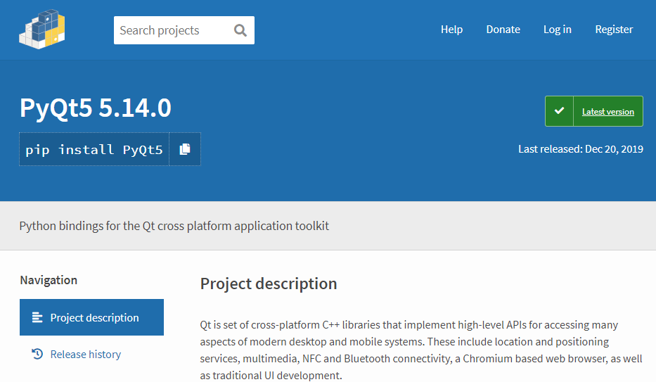
Abstract
This week I basically finished the work on the pyqt5 GUI software.

Slide 4
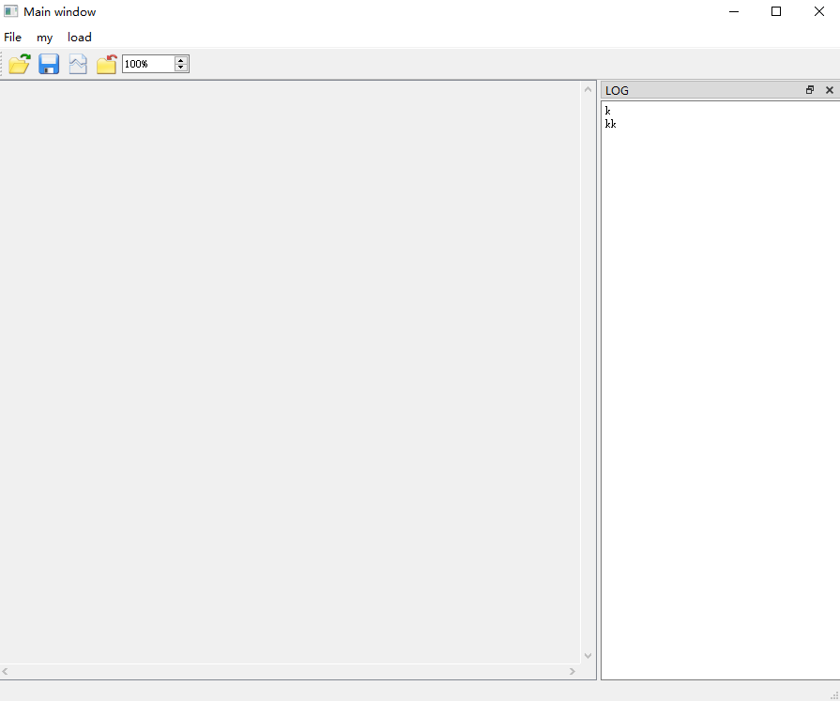
Content
I use Qmainwindow as the main Qwidget. I then add Qmenubar, Qtoolbar, Qtextbrowser, Qstatusbar to construct the GUI.

Slide 5
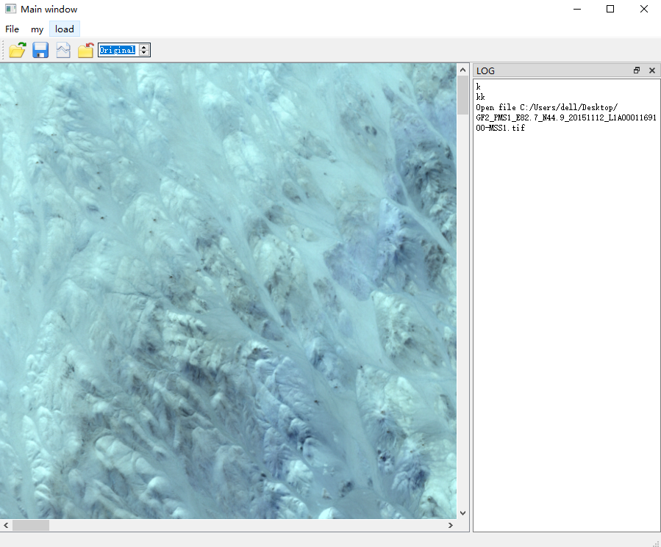
Content
I also add Qscrollarea and Qlabel to resize the image. When the image is too large, it would create scroll bars for us to slide and view the whole image.

Slide 6
Report End
程文胜 VIPG

