Slide 1
Weekly Report
程文胜 2019.5.4-2019.5.11

Slide 2
Weekly Report
Abstract
Content
Discussion

Slide 3
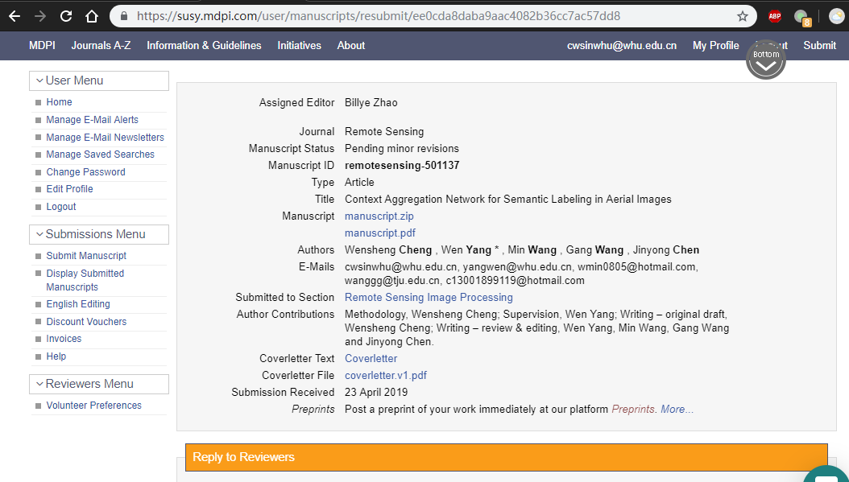
Abstract
This week I mainly put my effort on revising ICIP paper and revising Remote Sensing journal paper.

Slide 4
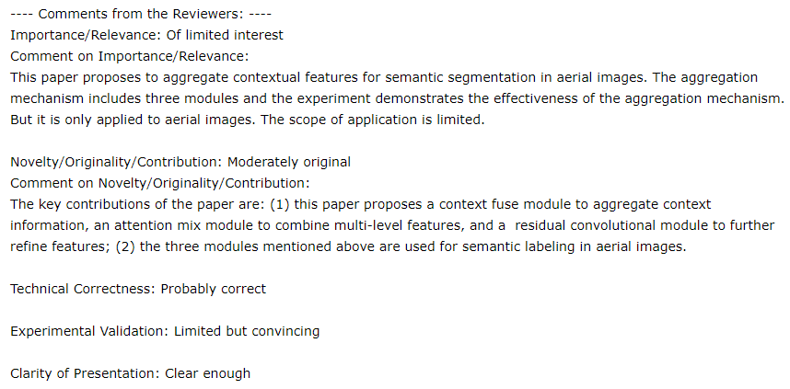
Content
About ICIP paper, I revised the manuscript partially. I added more specific description according to reviewer’s opinion. But for those comments calling for extra time-consuming experiments which are not necessary, I neglect them to maintain improvement space for journal paper.
ICIP reviewer’s comments.

Slide 5
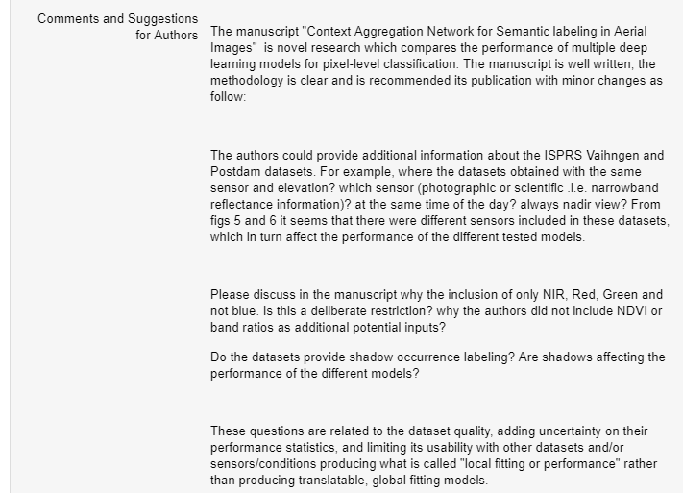
Content
About RS paper, three reviewers gave the opinion of minor revision. One reviewer was not familiar with semantic segmentation and gave some wrong opinions. Two reviewers gave valuable comments and I revised the manuscript accordingly.
RS reviewer’s comments

Slide 6
Discussion
Reviewer’s ability matters. I think the key difference between ordinary journal and top ones is the reviewer’s ability. Top journals own reviewers familiar with the topic of your paper and they would give high-level comments to further improve your paper. Even the paper is rejected, you can get valuable comments and refine your paper for next submission.
Even certain comments seem unreasonable, we need to reply to them politely. It’s improper to quarrel with the reviewer which may have the bad effect on our manuscript. Just state the responses with a mild tone.

Slide 7
Report End
程文胜 VIPG

