Slide 1
Weekly Report
程文胜 2019.9.9-2019.9.13

Slide 2
Weekly Report
Abstract
Content
Discussion

Slide 3
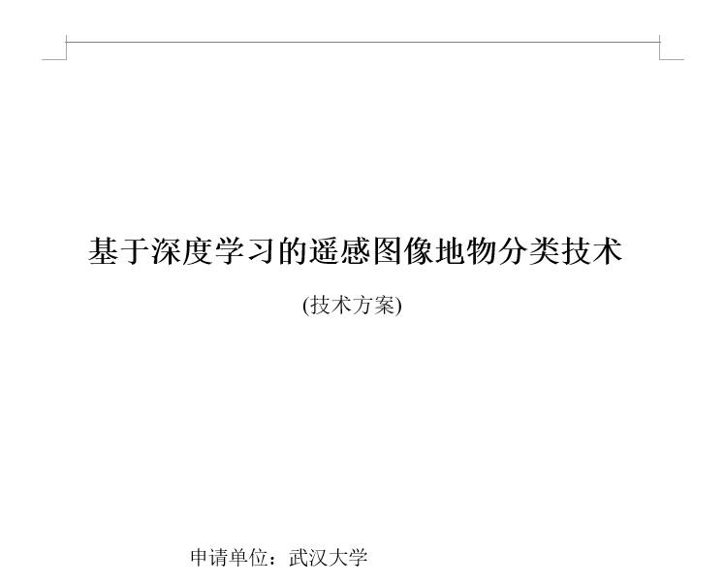
Abstract
This week I mainly put my effort on preparing CETC 54 project and making ICIP 2019 poster.

Slide 4
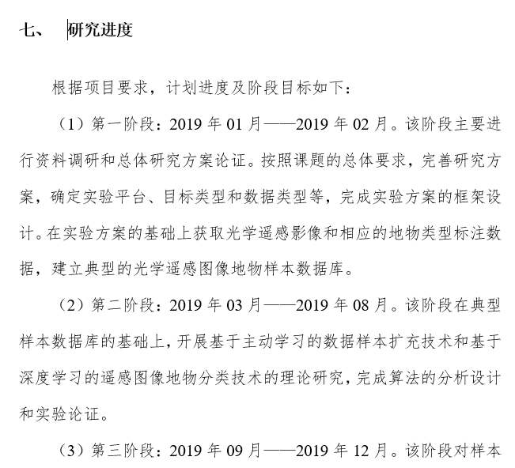
Content
About CETC 54 project, Zhang Ruixiang and I are working together to meet the original plan, yet we are still waiting for the updated document model.

Slide 5
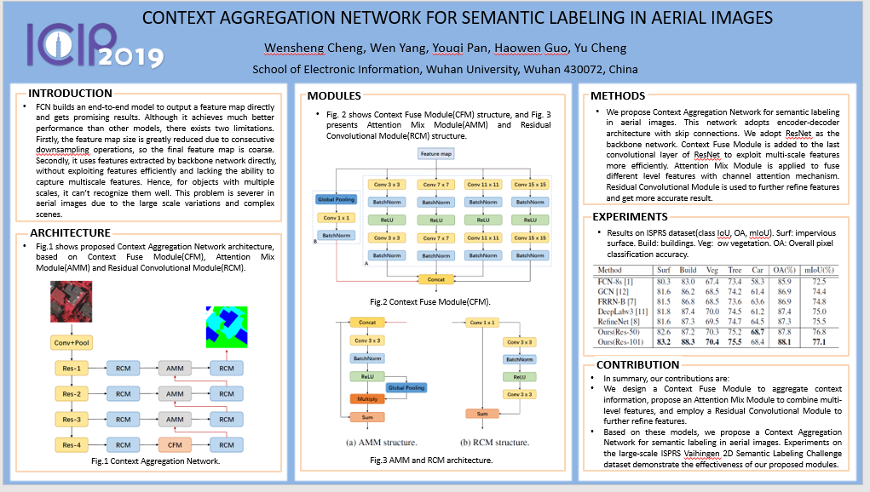
Content
About ICIP paper, since it’s going to be held in late September, I have to make the poster in time. Per the official poster model, I made my own ICIP poster.

Slide 6
Discussion
I have given the ICIP poster to Cheng Yu, and he would bring it to Taipei.
Zhang Ruixiang and I plan to run models based on the New edition GID data, and we plan to use both semantic segmentation model and road extraction model.

Slide 7
Report End
程文胜 VIPG

