Slide 1
Weekly Report
程文胜 2020.9.6-9.13

Slide 2
Weekly Report
Abstract
Content
End

Slide 3
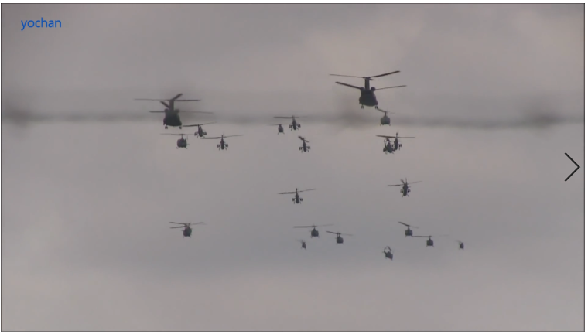
Abstract
In this week, I also put my effort on labeling the MOT images. I first refine the helicopter sequence, and then label the bee sequence.

Slide 4
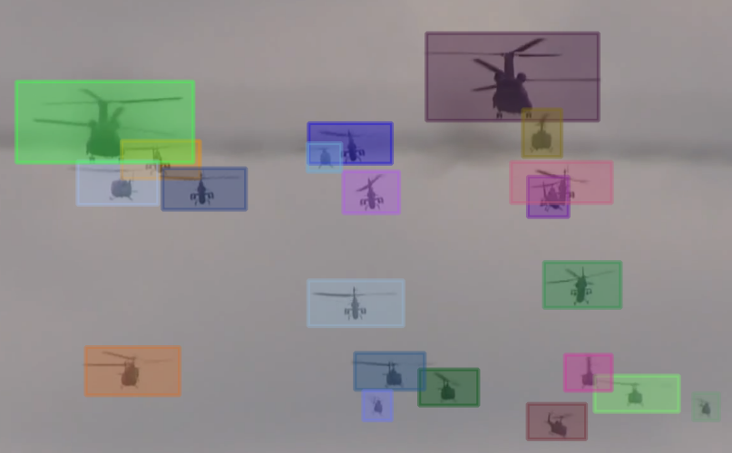
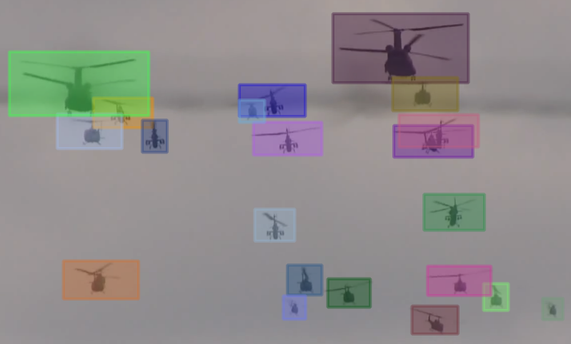
Content
I adjusted all tracks to reflect the change of aspect ratio, due to the variety of propeller. The updated file is uploaded to the shared GoogleDrive.
T frame
T+1 frame

Slide 5
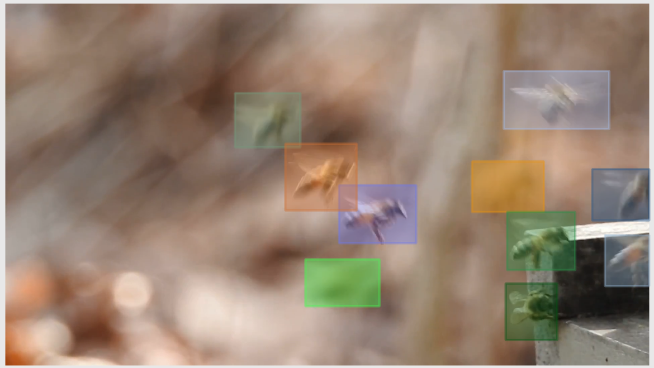
Content
The bee sequence is really difficult. It has over 100 tracks, while the helicopter has about 30 tracks. Some objects can not be recognized even by human without neighbor frames. Many tracks only have 2-3 frames. I think if a tracker can deal with this sequence, it’s definitely the King.

Slide 6
Report End
程文胜 9.13

